Slide 1

Astro Images with Original Music
by
Ron Yelton
Some Image Data From Telescope Live
All Images Processed by Ron Yelton
May 2023

Slide 2
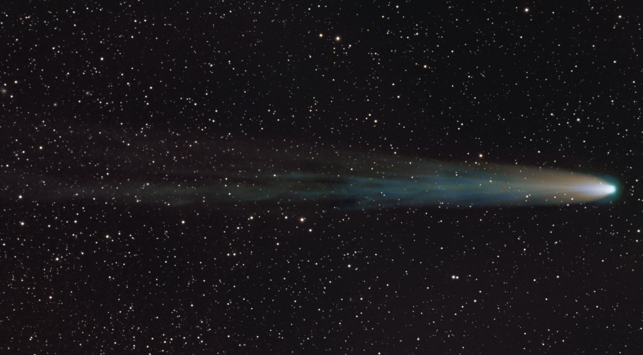

Slide 3

We have had a room change. We now will be meeting in the
OC Multi-media Room which is right across the hallway
from our old room.

Slide 4
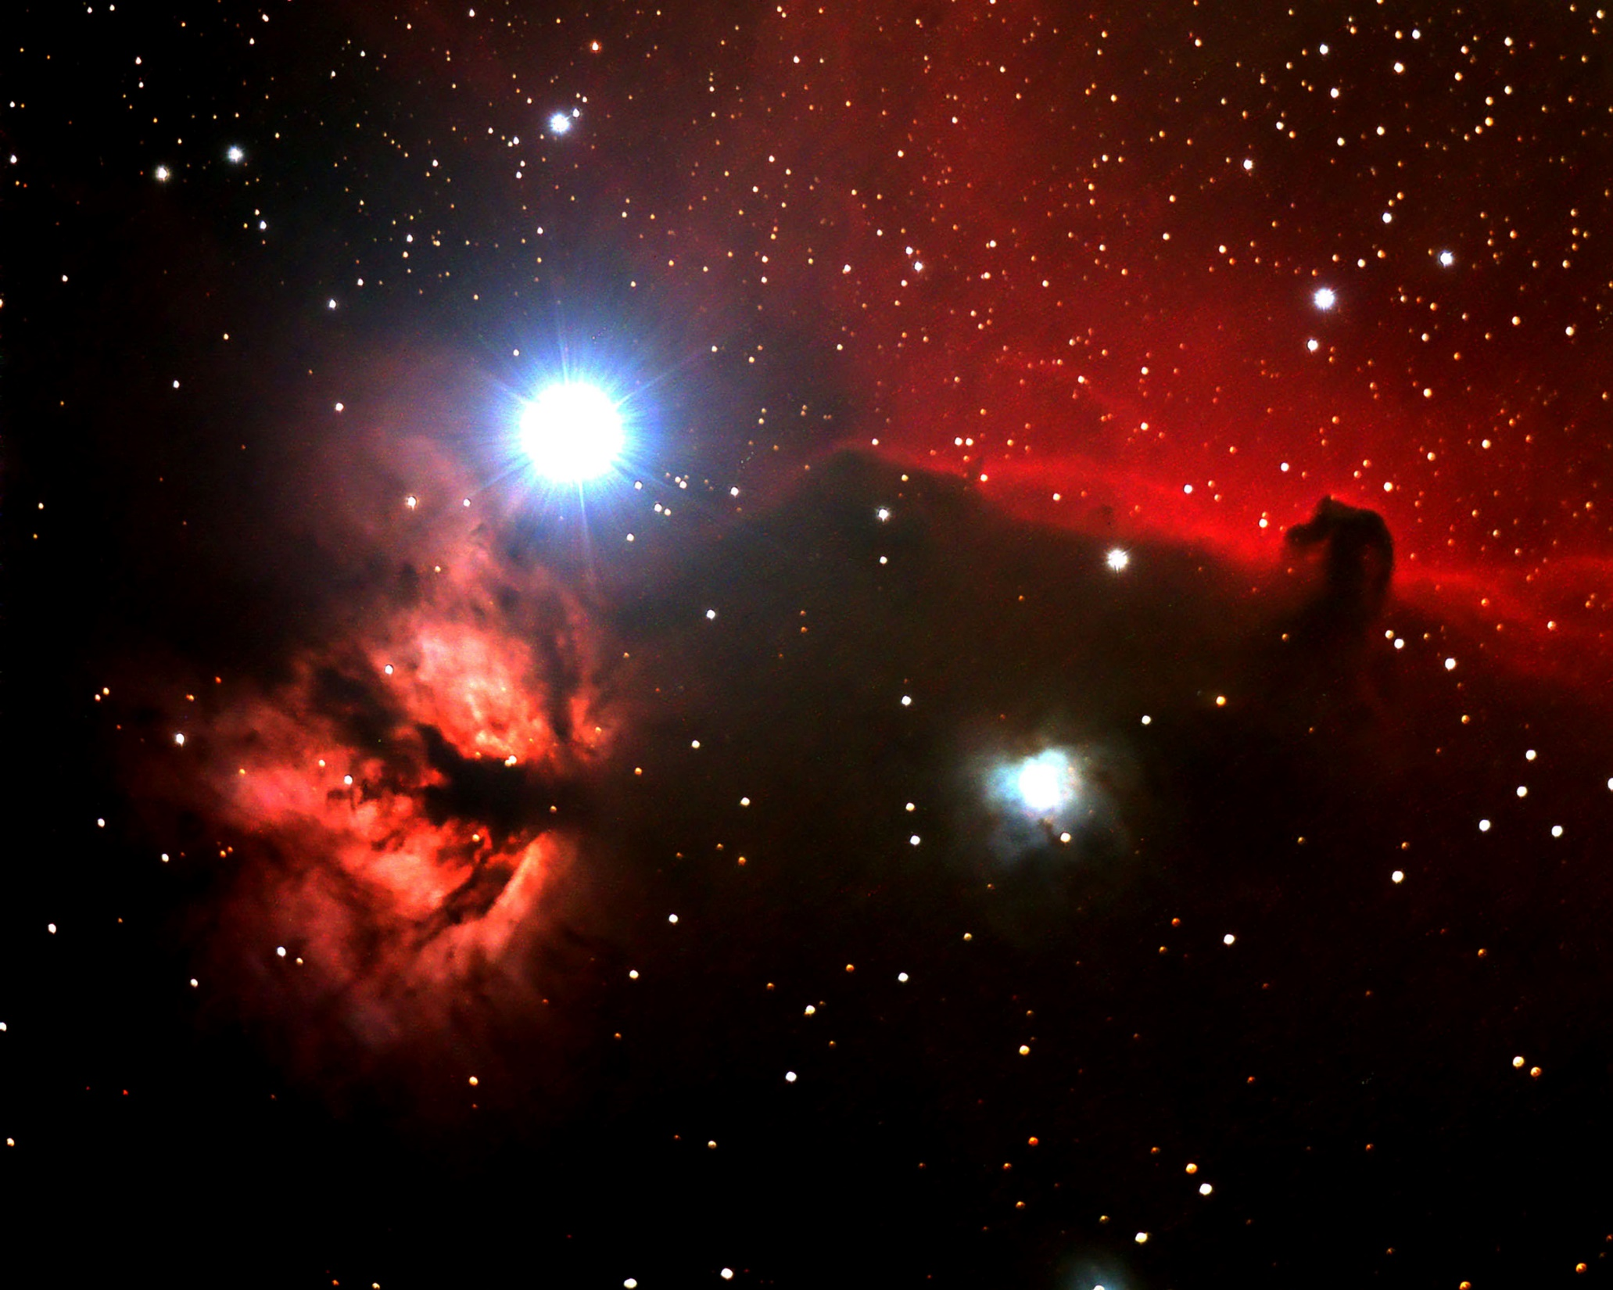

Slide 5
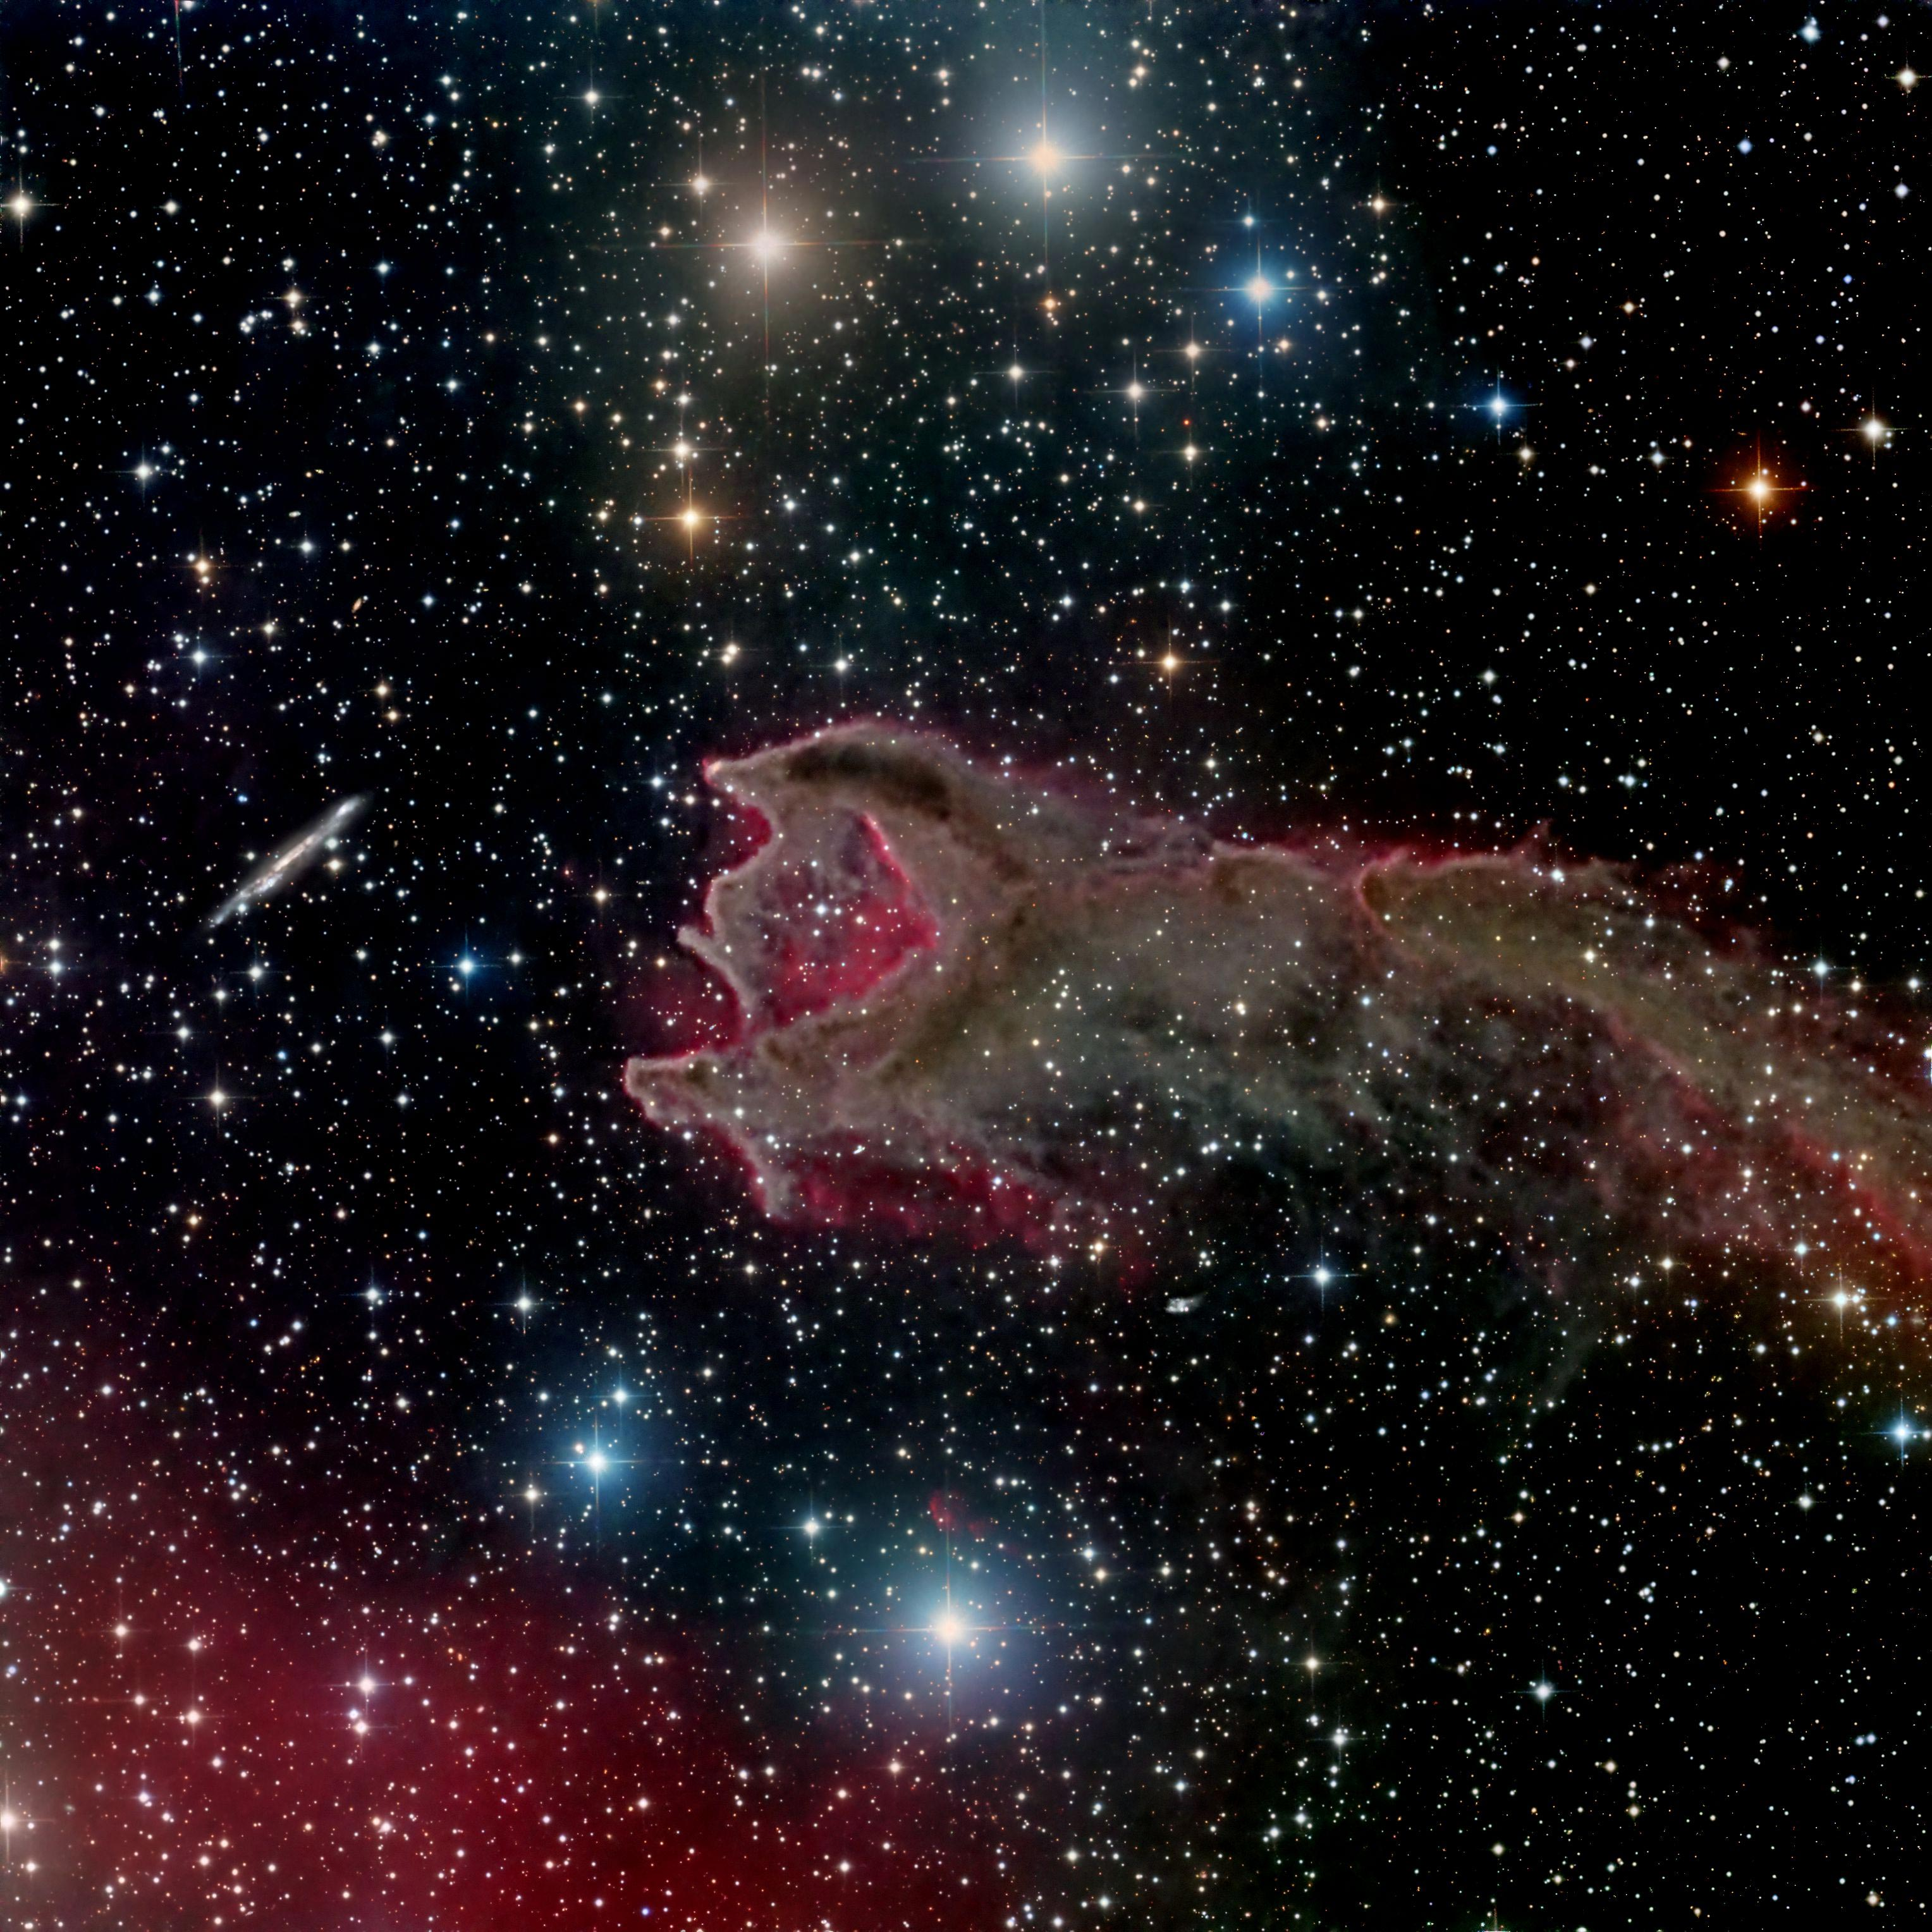
We have had a room change. We now will be meeting in the
OC Multi-media Room which is right across the hallway
from our old room.

Slide 6
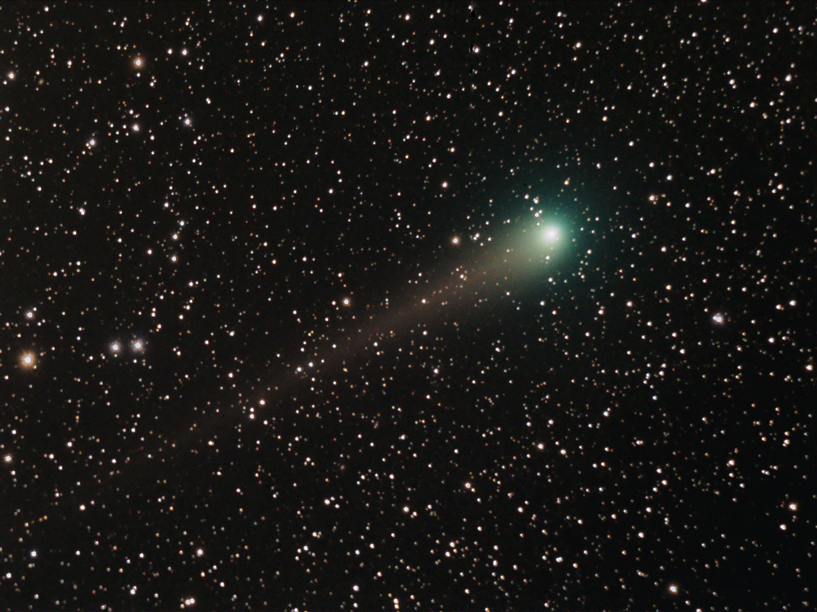
We have had a room change. We now will be meeting in the
OC Multi-media Room which is right across the hallway
from our old room.

Slide 7
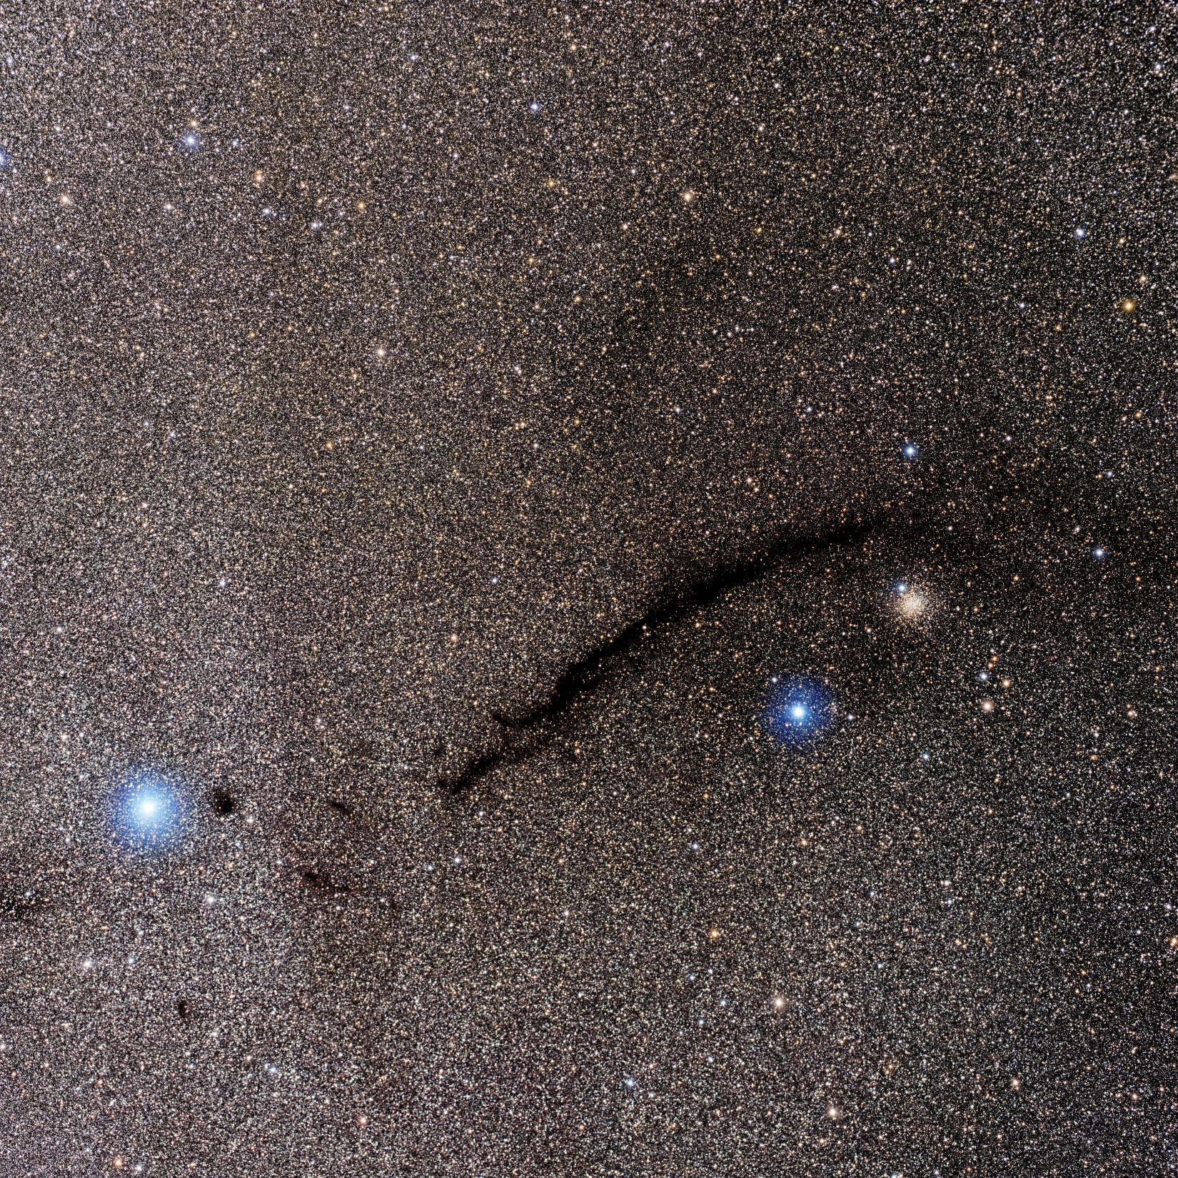
We have had a room change. We now will be meeting in the
OC Multi-media Room which is right across the hallway
from our old room.

Slide 8
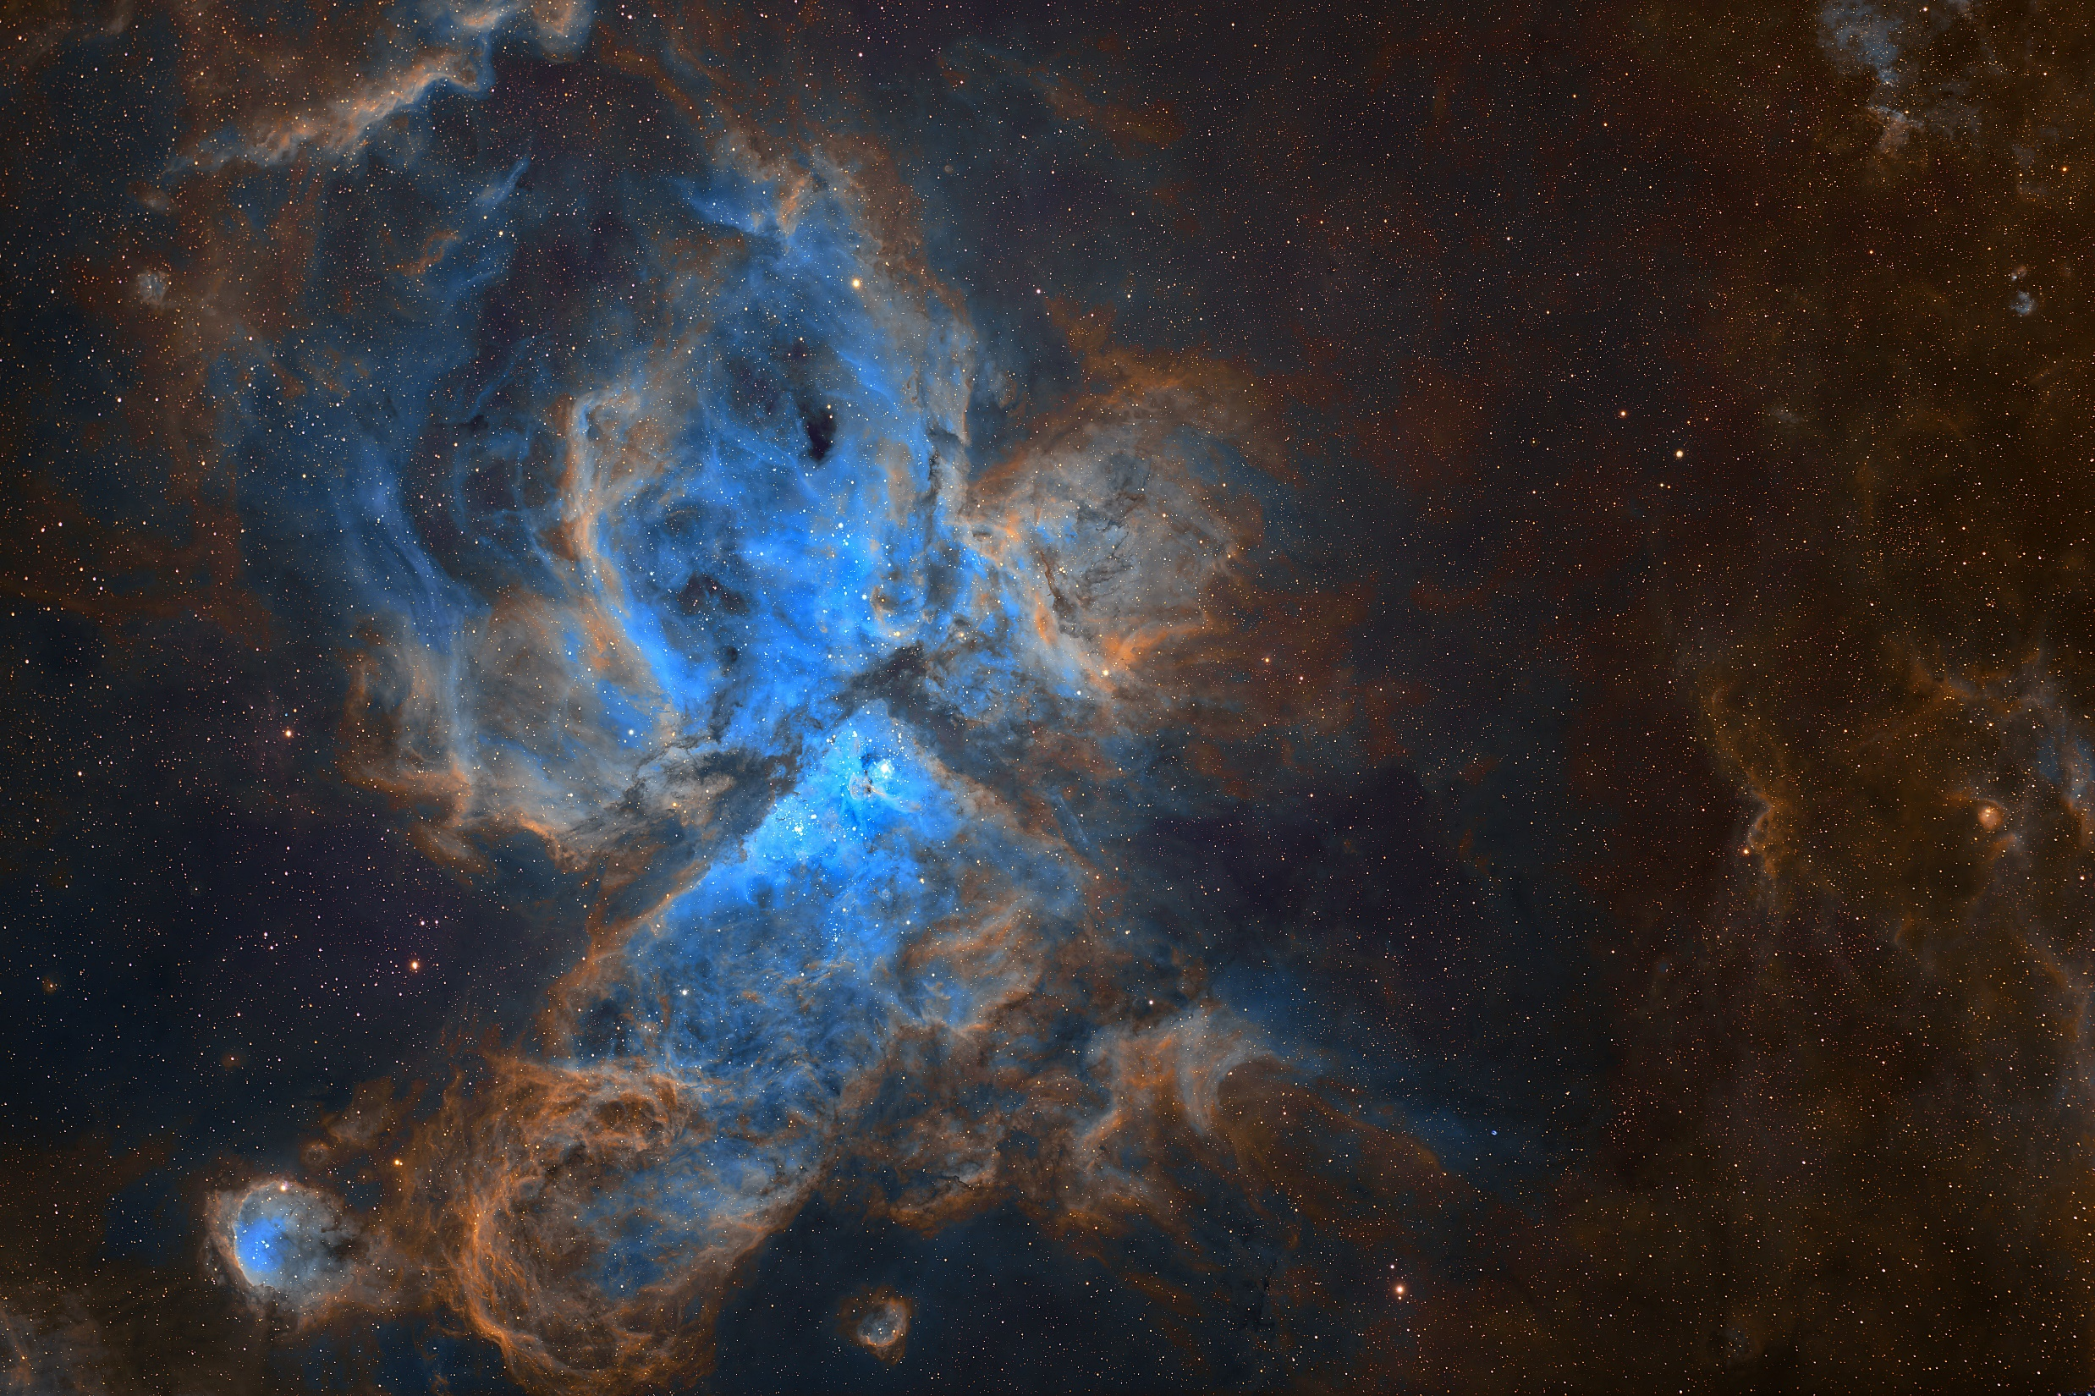
We have had a room change. We now will be meeting in the
OC Multi-media Room which is right across the hallway
from our old room.

Slide 9
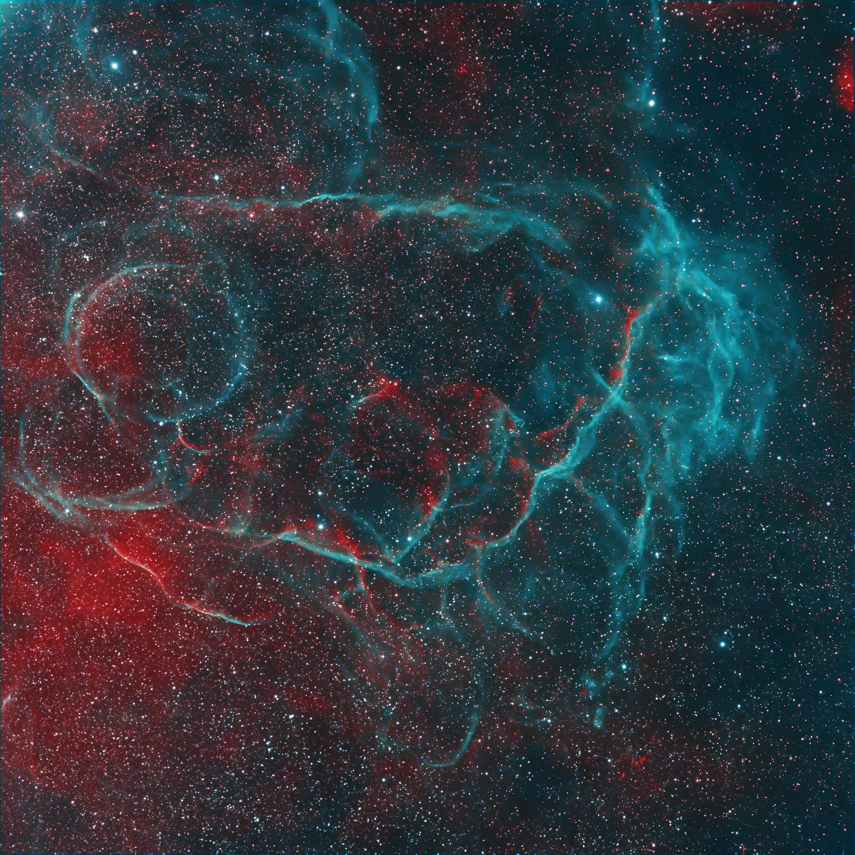
We have had a room change. We now will be meeting in the
OC Multi-media Room which is right across the hallway
from our old room.

Slide 10
We have had a room change. We now will be meeting in the
OC Multi-media Room which is right across the hallway
from our old room.

Slide 11
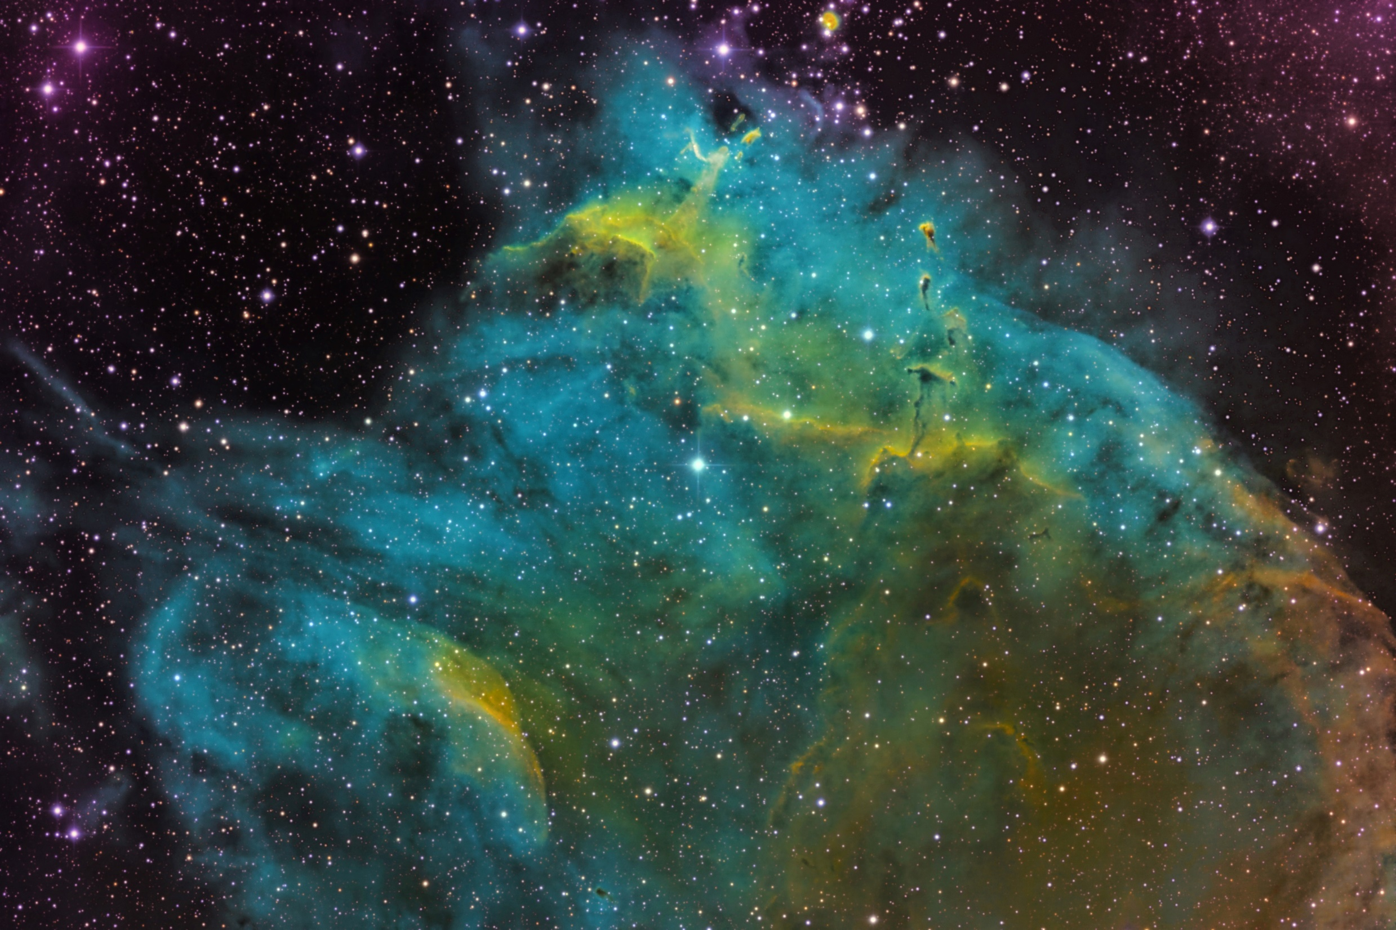
We have had a room change. We now will be meeting in the
OC Multi-media Room which is right across the hallway
from our old room.

Slide 12
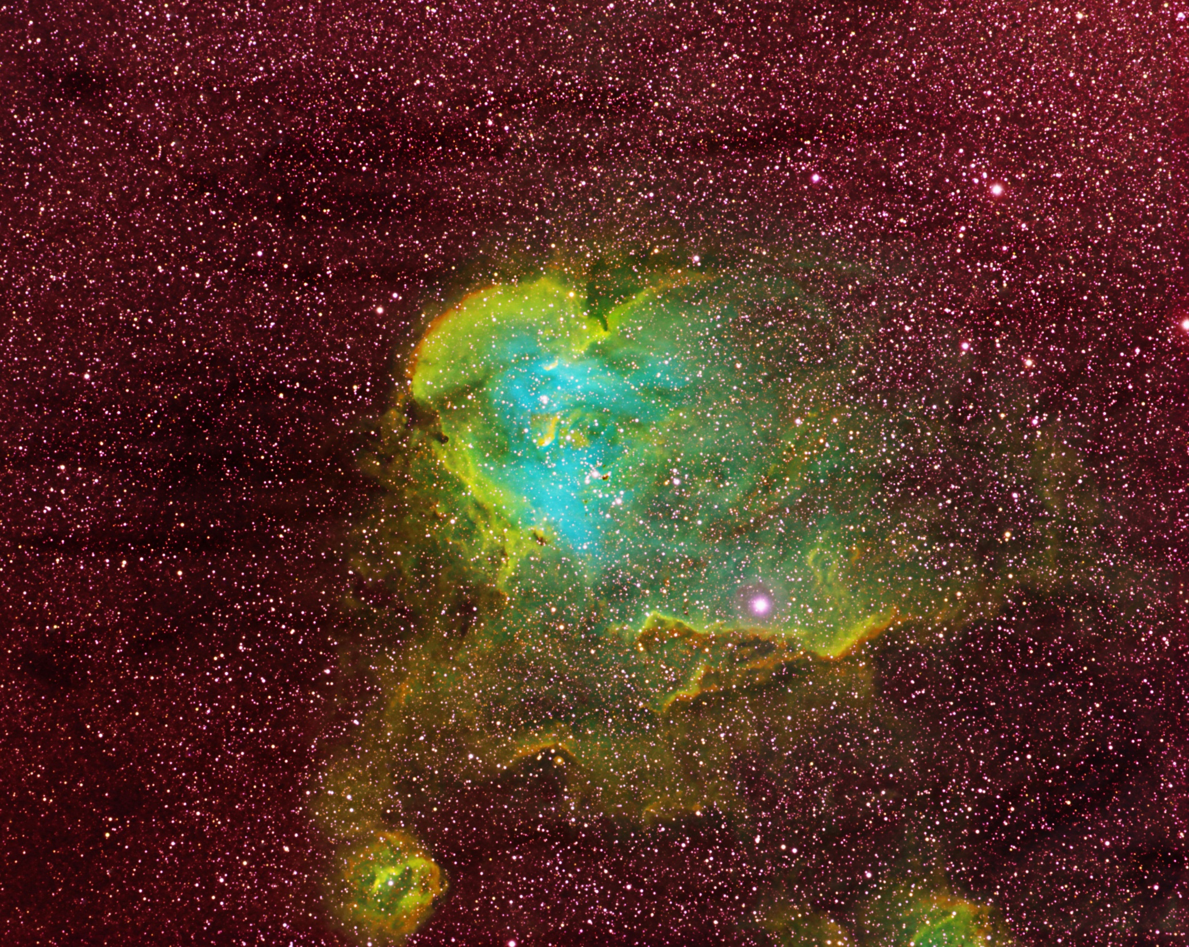
We have had a room change. We now will be meeting in the
OC Multi-media Room which is right across the hallway
from our old room.

Slide 13
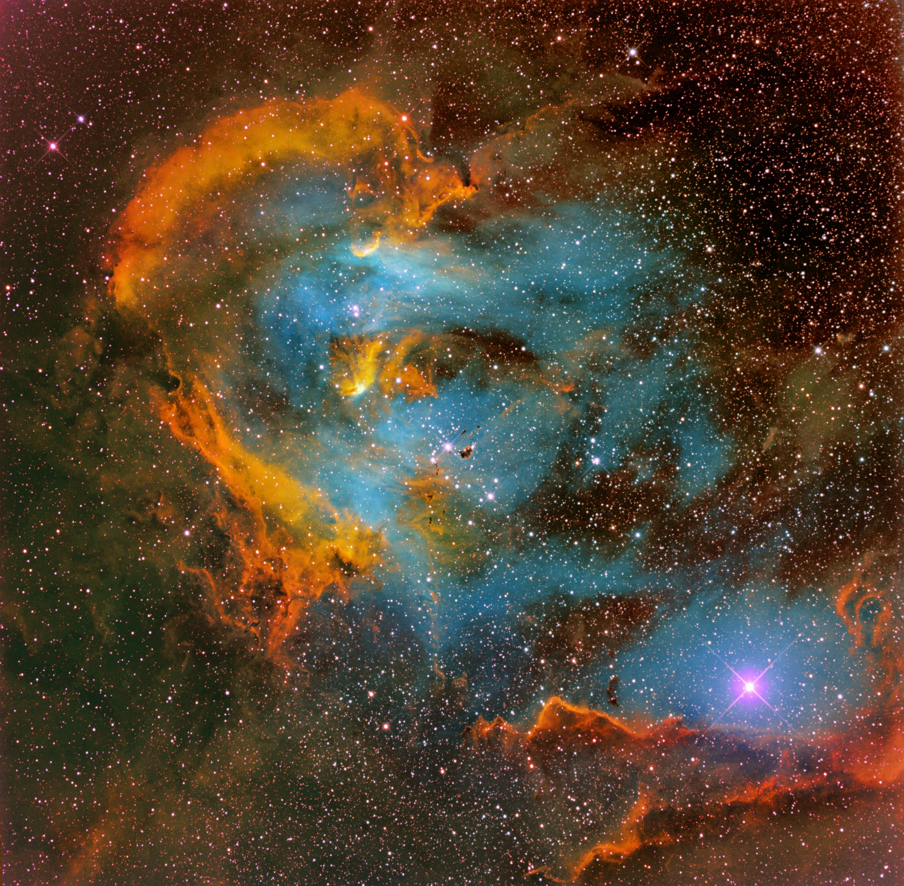
We have had a room change. We now will be meeting in the
OC Multi-media Room which is right across the hallway
from our old room.

Slide 14
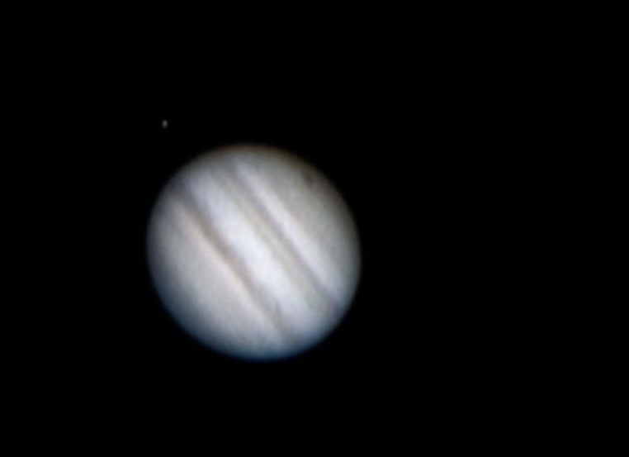
We have had a room change. We now will be meeting in the
OC Multi-media Room which is right across the hallway
from our old room.

Slide 15
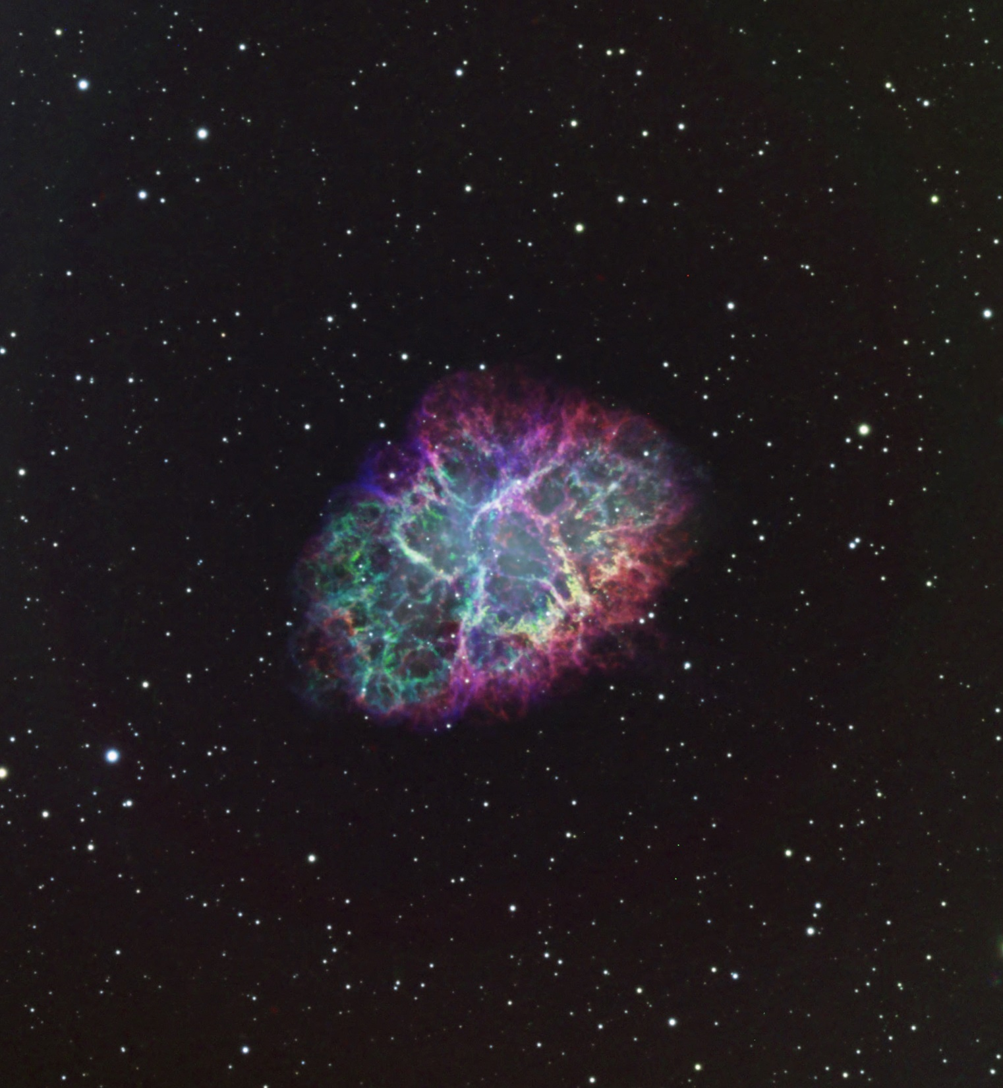
We have had a room change. We now will be meeting in the
OC Multi-media Room which is right across the hallway
from our old room.

Slide 16

We have had a room change. We now will be meeting in the
OC Multi-media Room which is right across the hallway
from our old room.

Slide 17
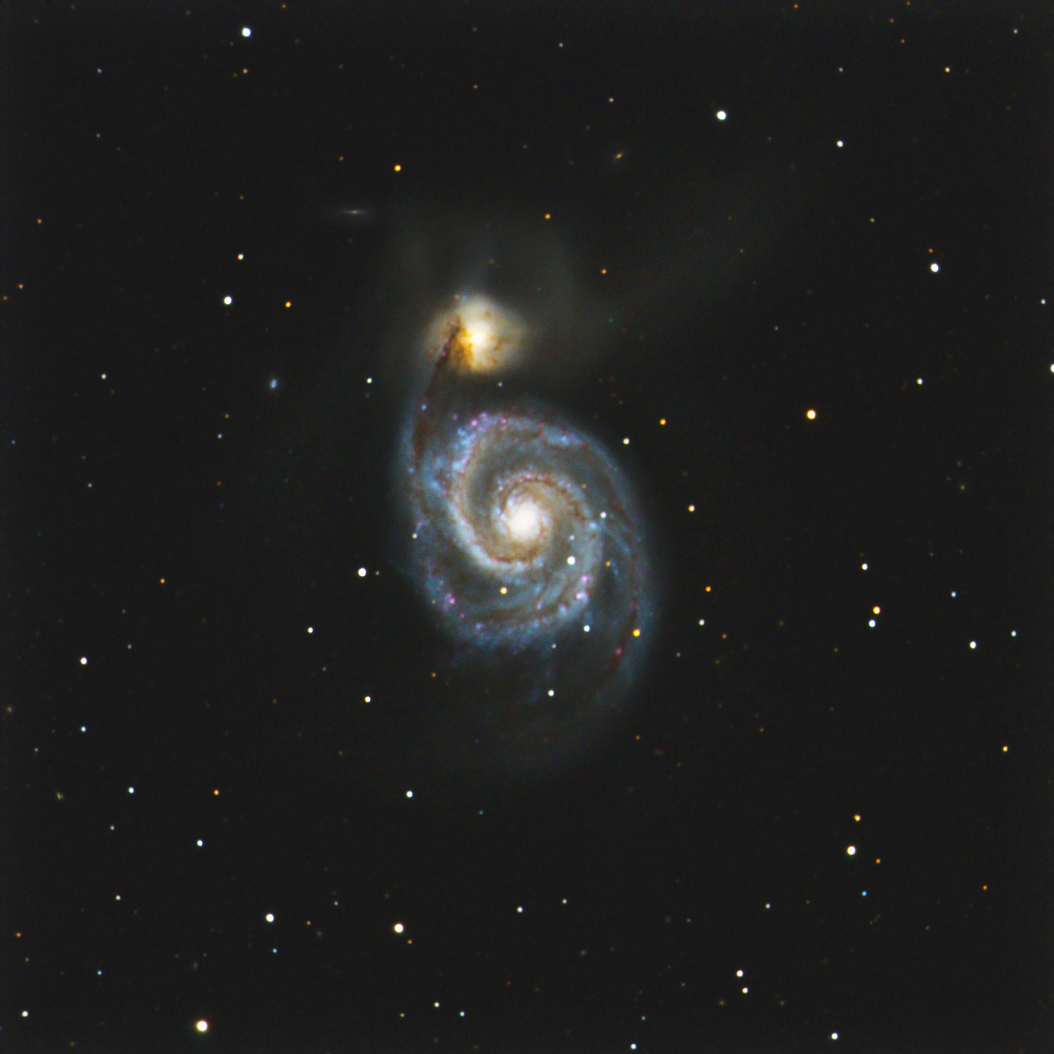
We have had a room change. We now will be meeting in the
OC Multi-media Room which is right across the hallway
from our old room.

Slide 18
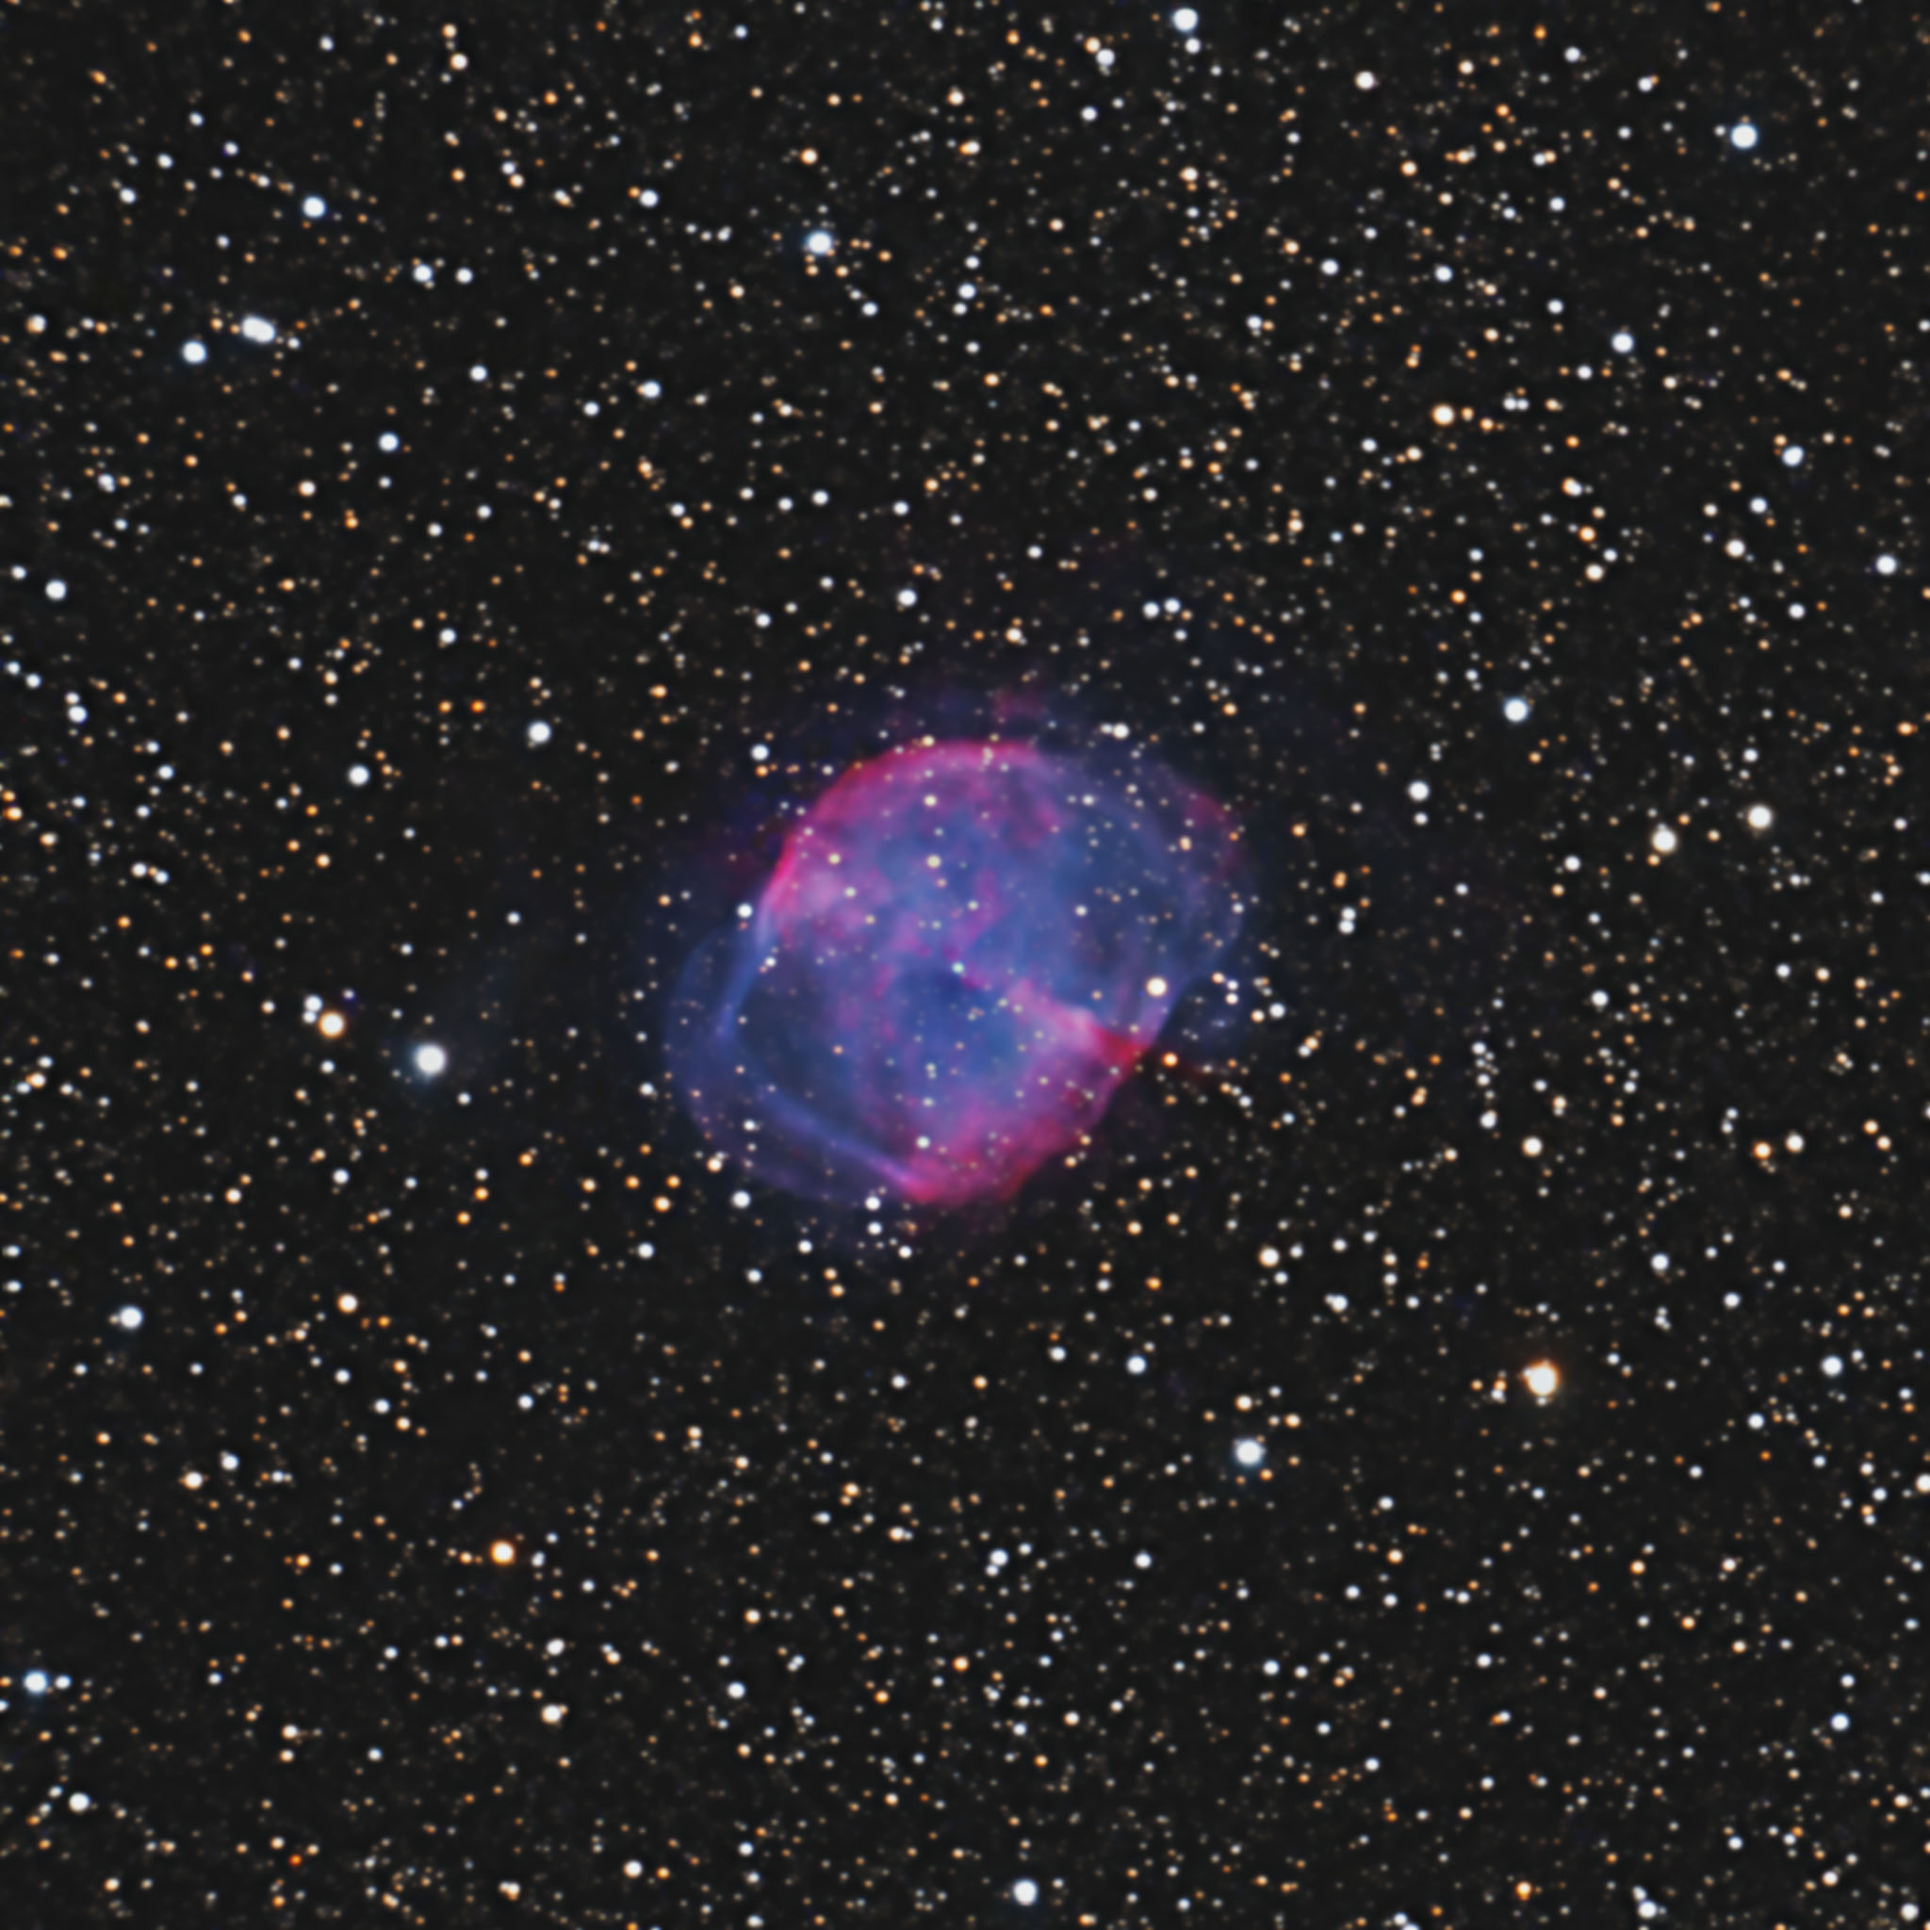
We have had a room change. We now will be meeting in the
OC Multi-media Room which is right across the hallway
from our old room.

Slide 19
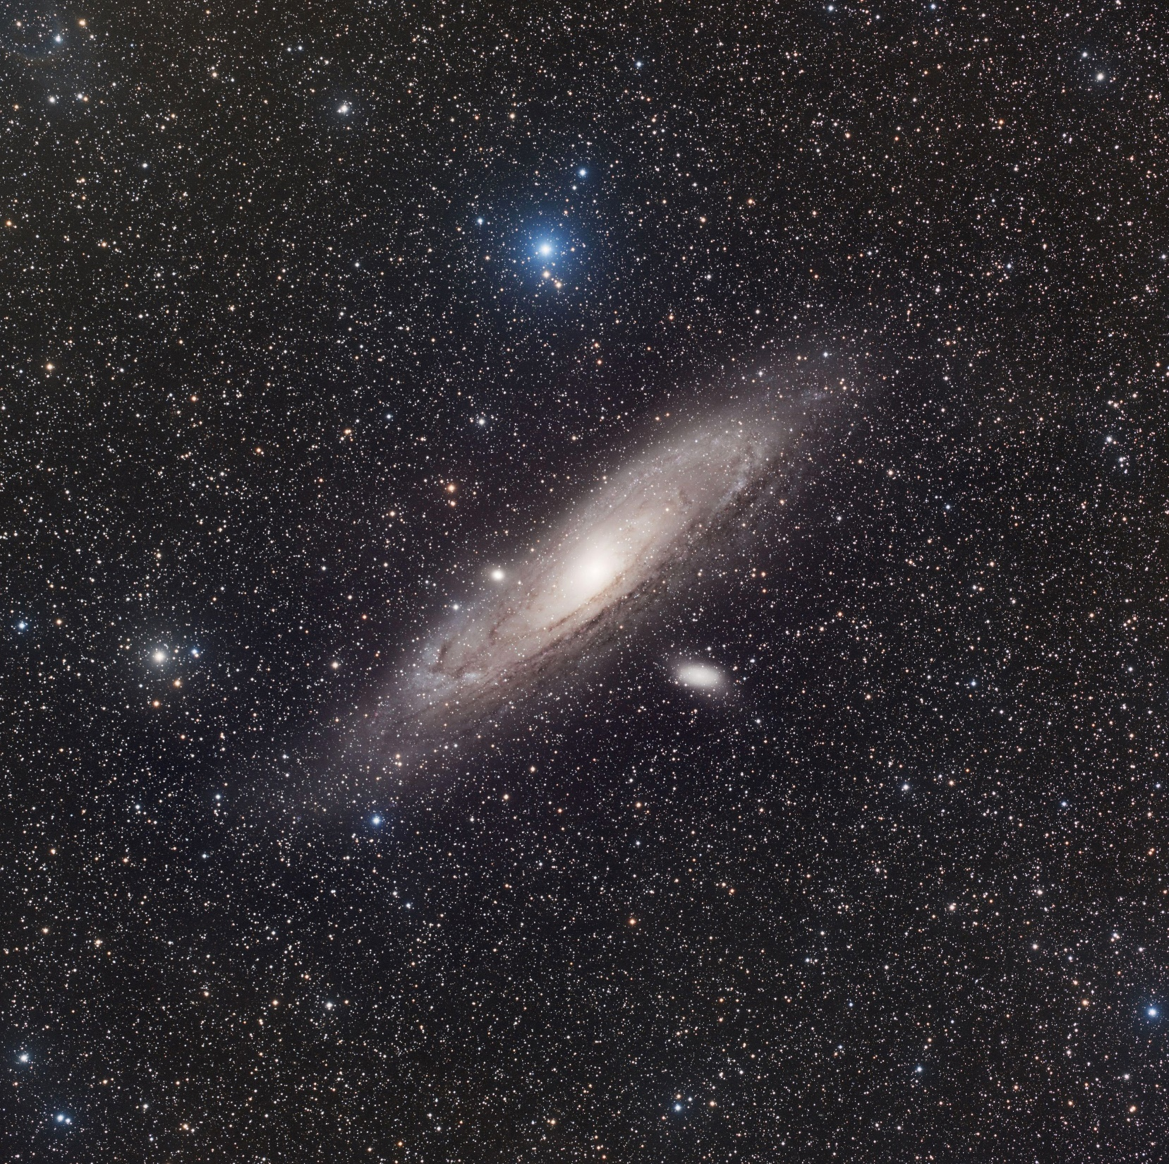
We have had a room change. We now will be meeting in the
OC Multi-media Room which is right across the hallway
from our old room.

Slide 20
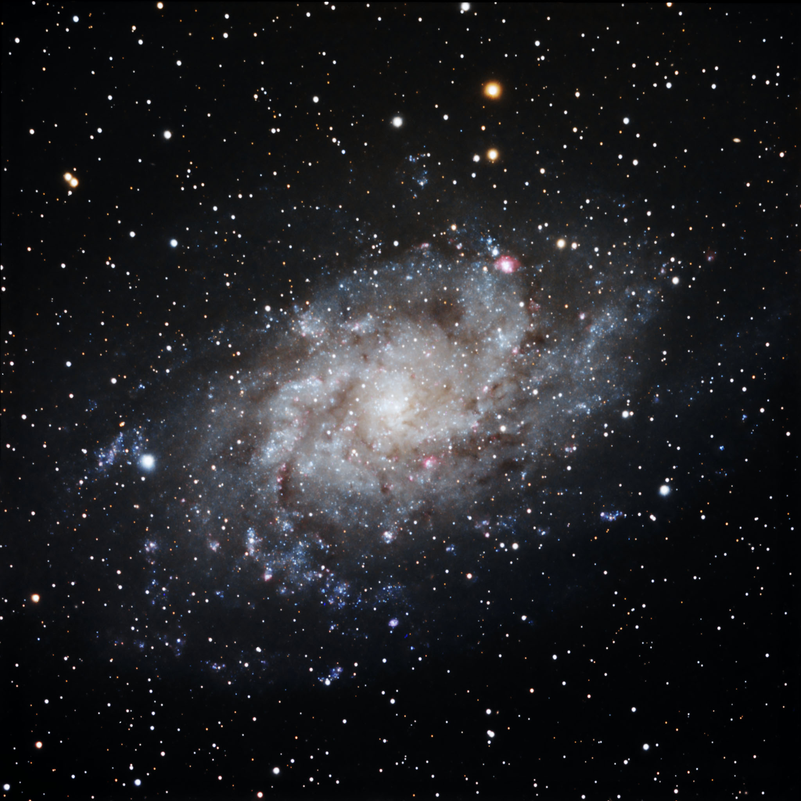
We have had a room change. We now will be meeting in the
OC Multi-media Room which is right across the hallway
from our old room.

Slide 21
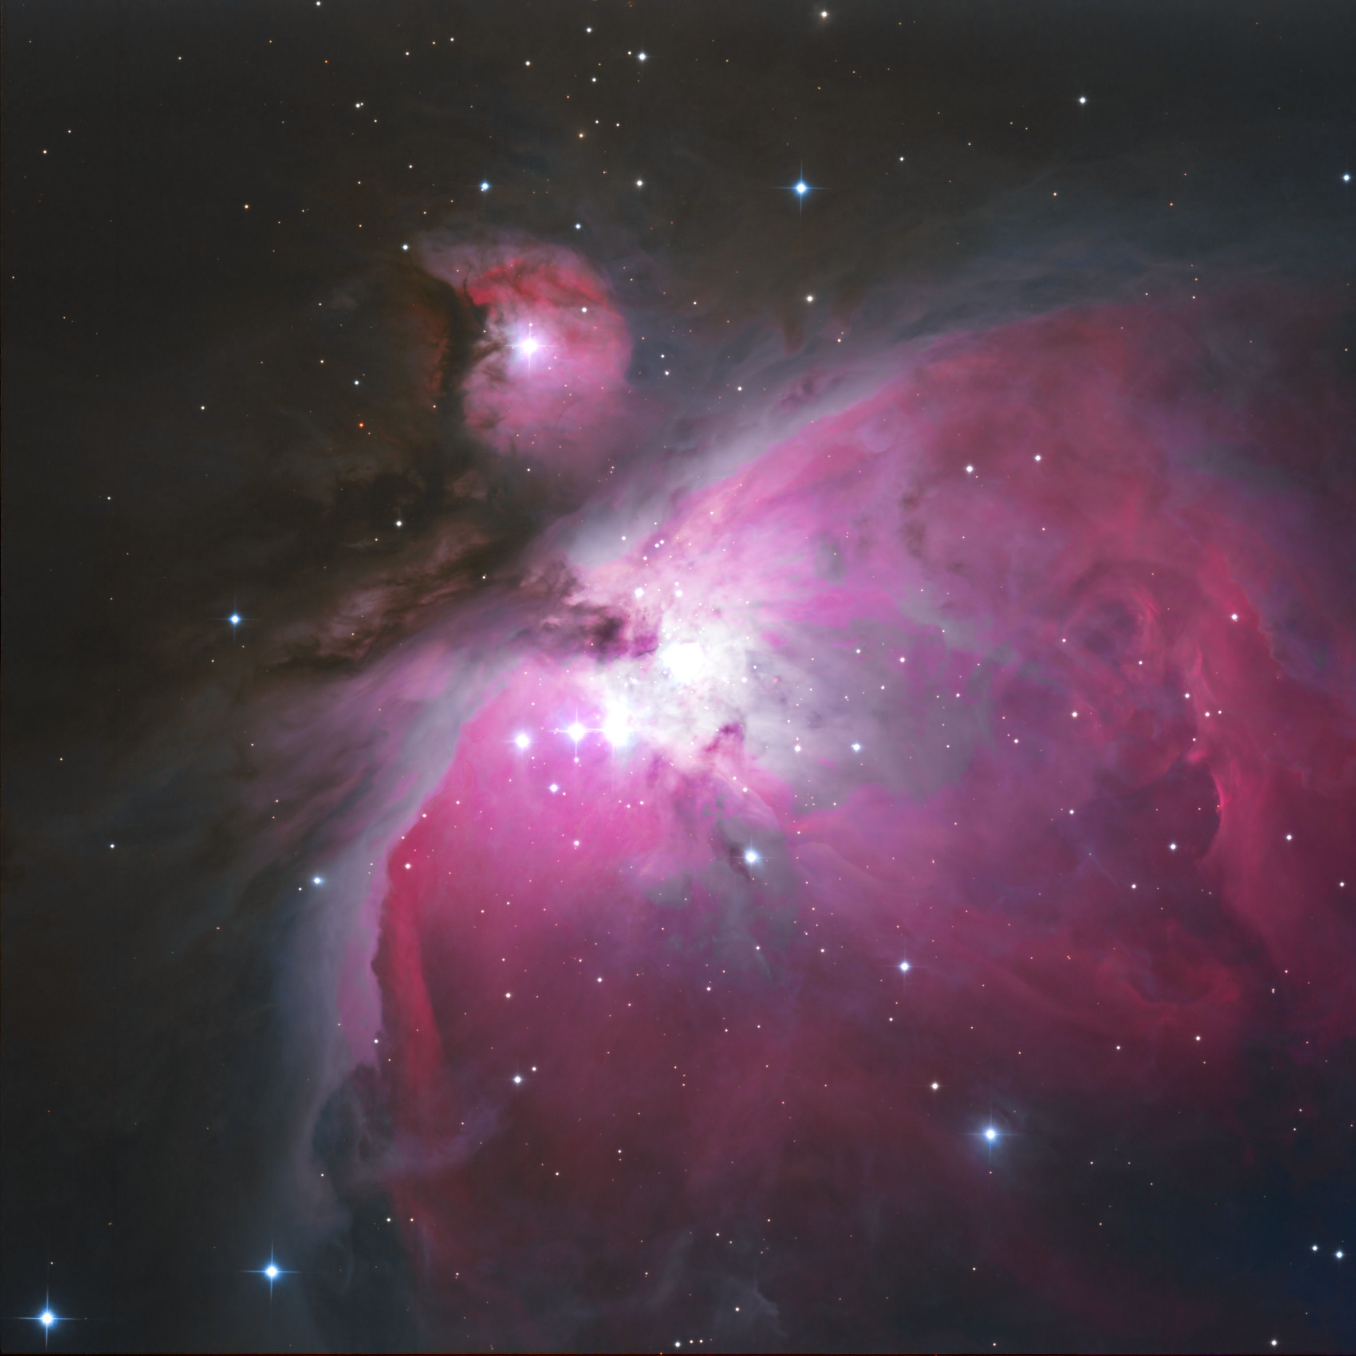
We have had a room change. We now will be meeting in the
OC Multi-media Room which is right across the hallway
from our old room.

Slide 22
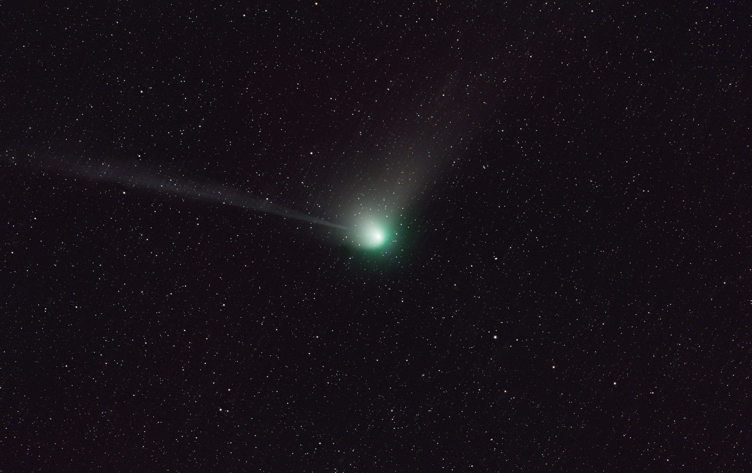

Slide 23

We have had a room change. We now will be meeting in the
OC Multi-media Room which is right across the hallway
from our old room.

Slide 24
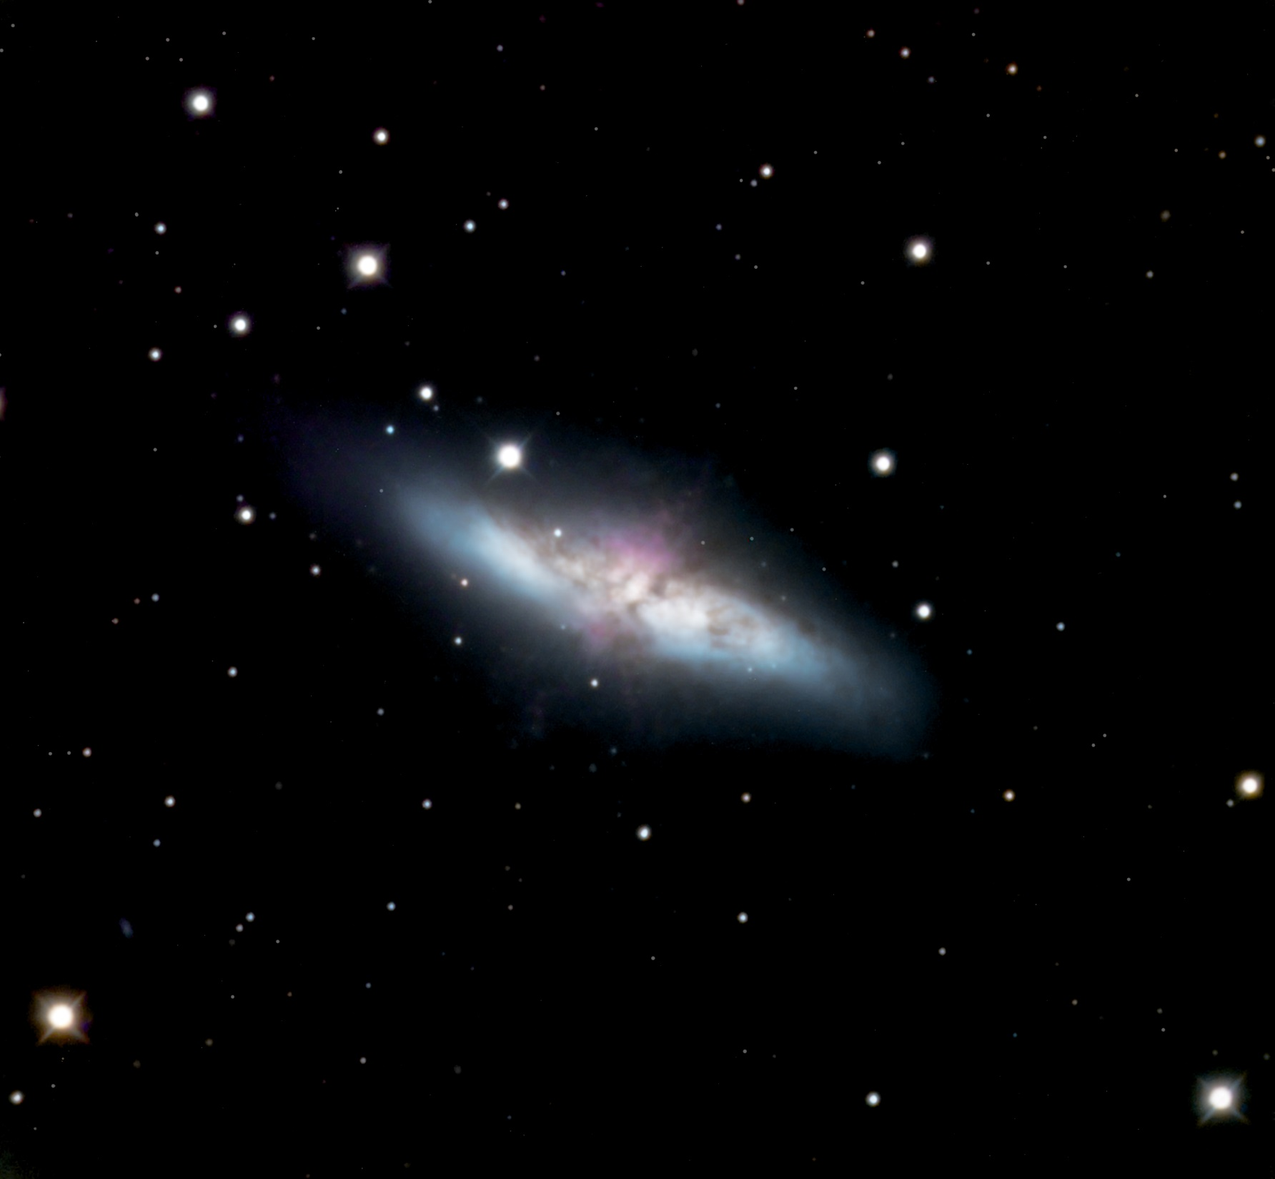
We have had a room change. We now will be meeting in the
OC Multi-media Room which is right across the hallway
from our old room.

Slide 25
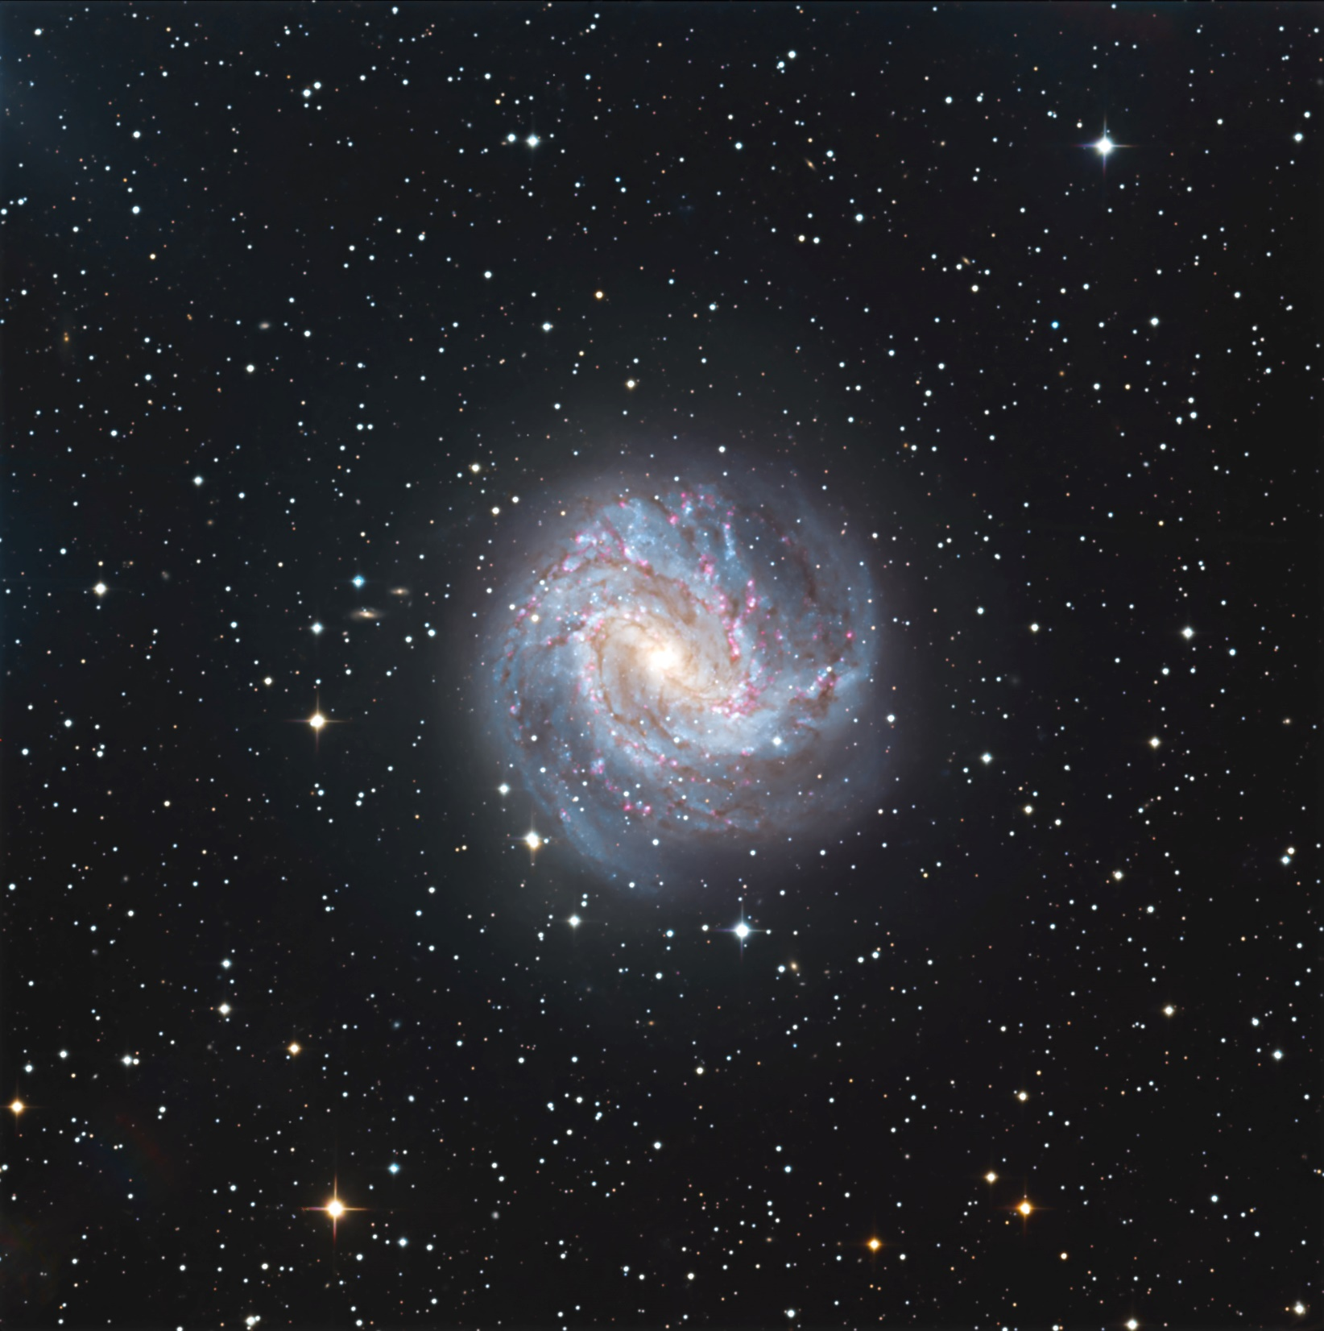
We have had a room change. We now will be meeting in the
OC Multi-media Room which is right across the hallway
from our old room.

Slide 26
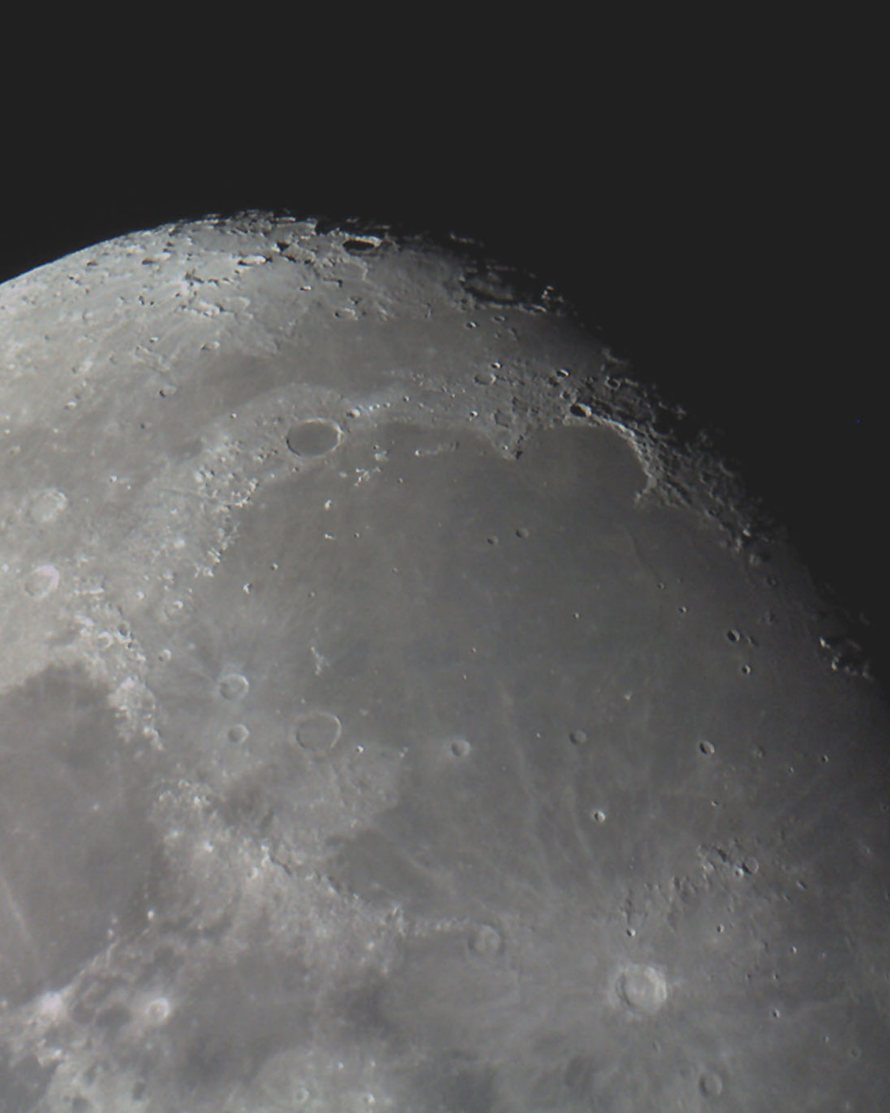
We have had a room change. We now will be meeting in the
OC Multi-media Room which is right across the hallway
from our old room.

Slide 27
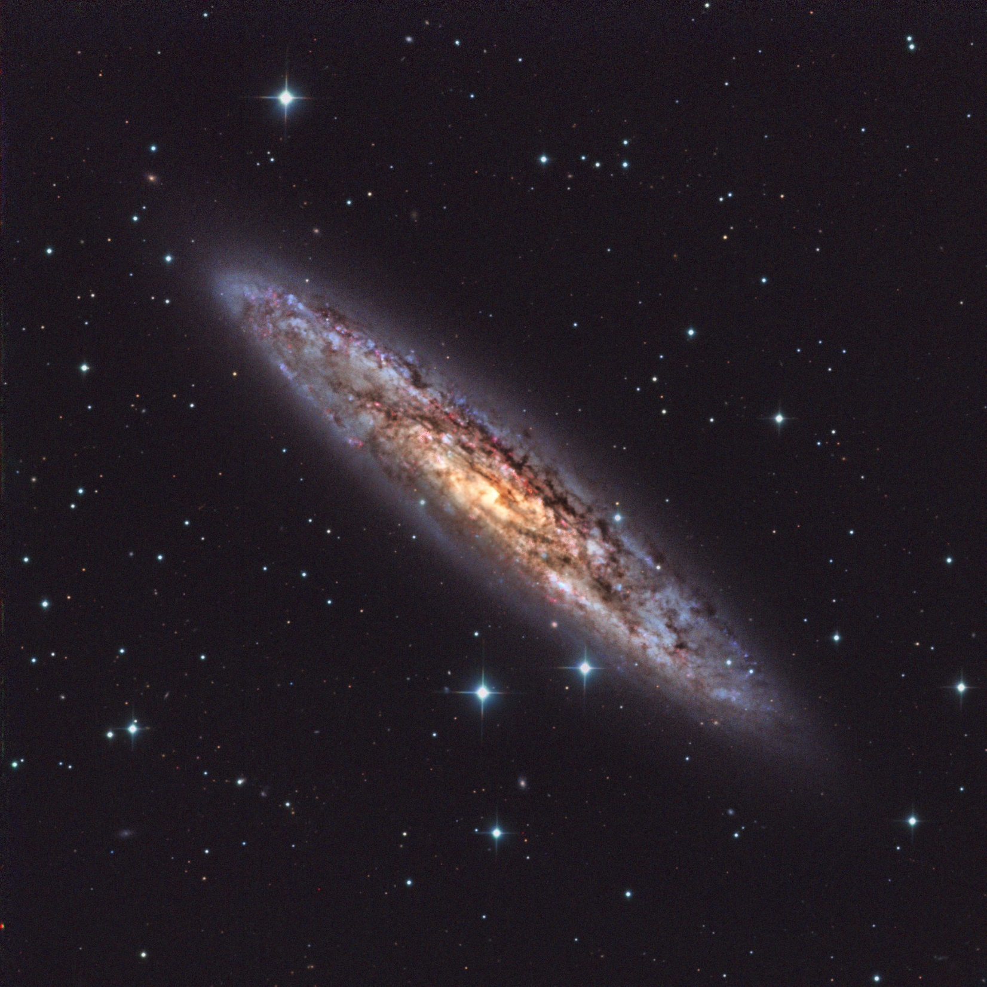
We have had a room change. We now will be meeting in the
OC Multi-media Room which is right across the hallway
from our old room.

Slide 28
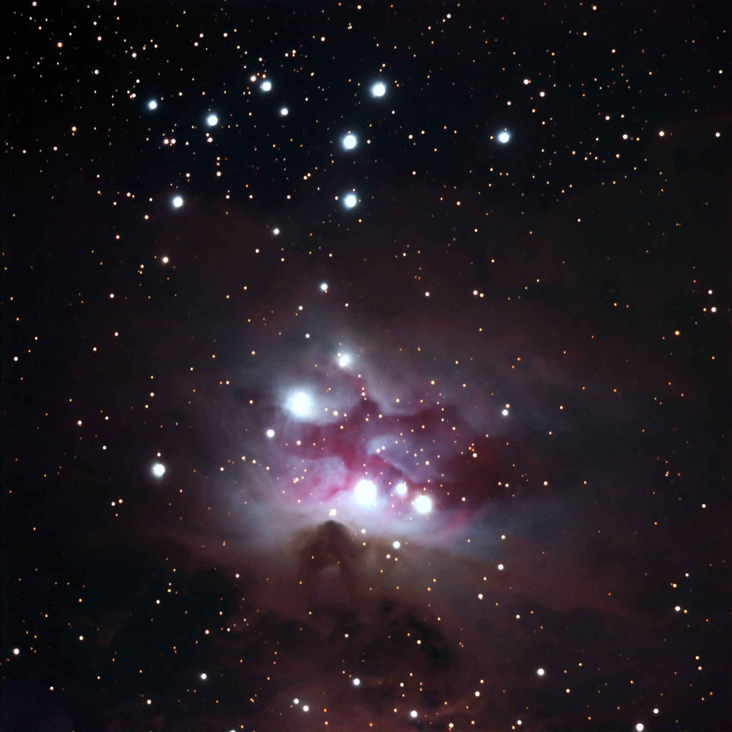
We have had a room change. We now will be meeting in the
OC Multi-media Room which is right across the hallway
from our old room.

Slide 29

We have had a room change. We now will be meeting in the
OC Multi-media Room which is right across the hallway
from our old room.

Slide 30
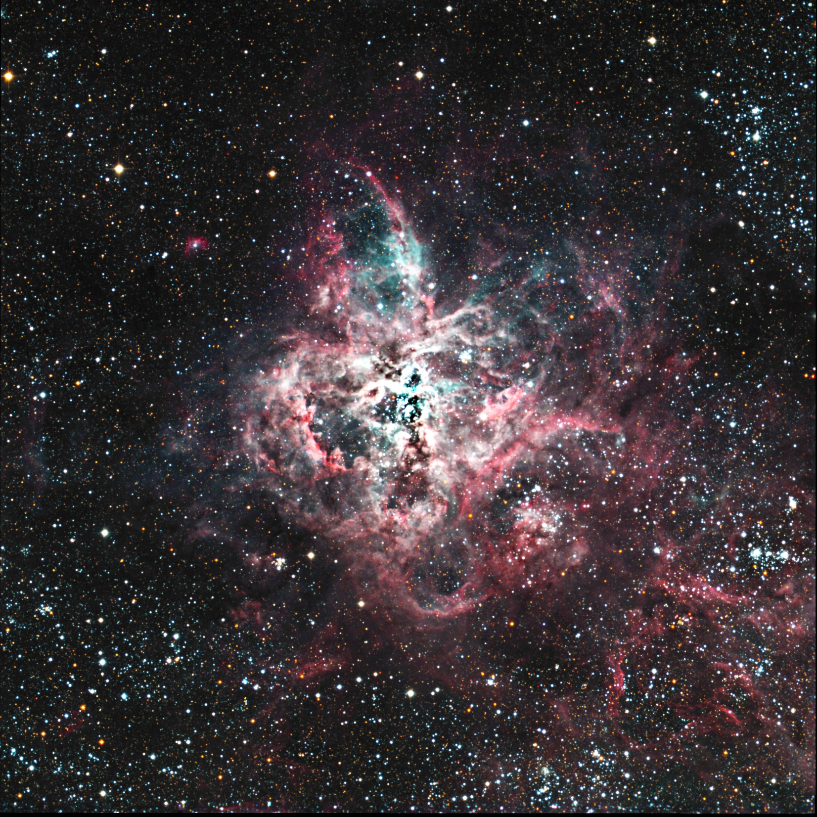
We have had a room change. We now will be meeting in the
OC Multi-media Room which is right across the hallway
from our old room.

Slide 31
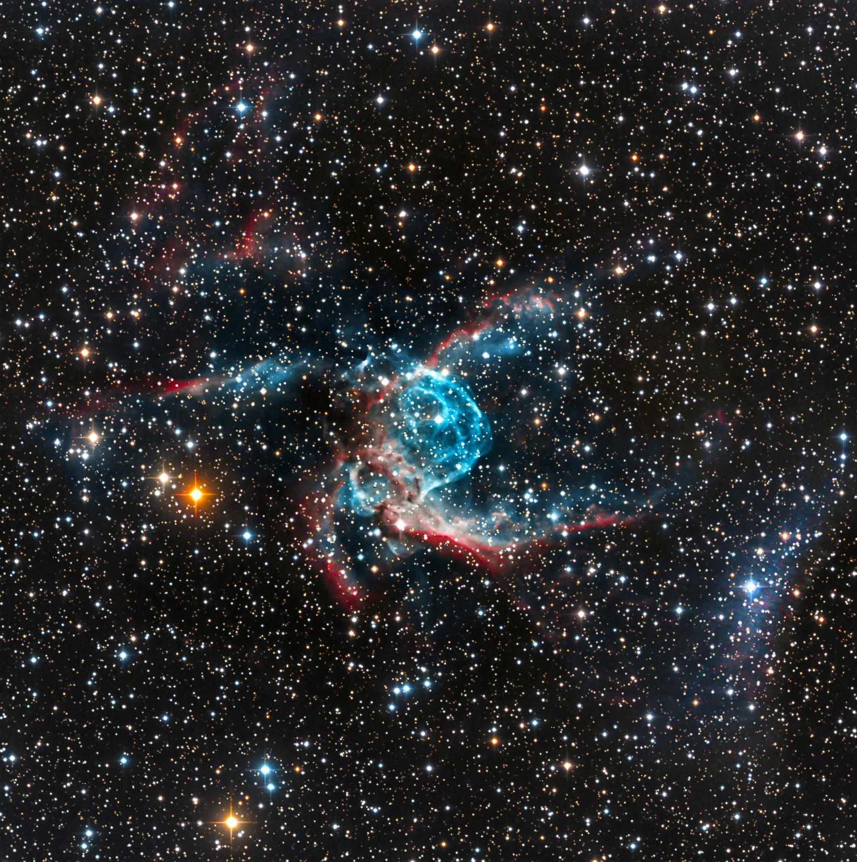
We have had a room change. We now will be meeting in the
OC Multi-media Room which is right across the hallway
from our old room.

Slide 32
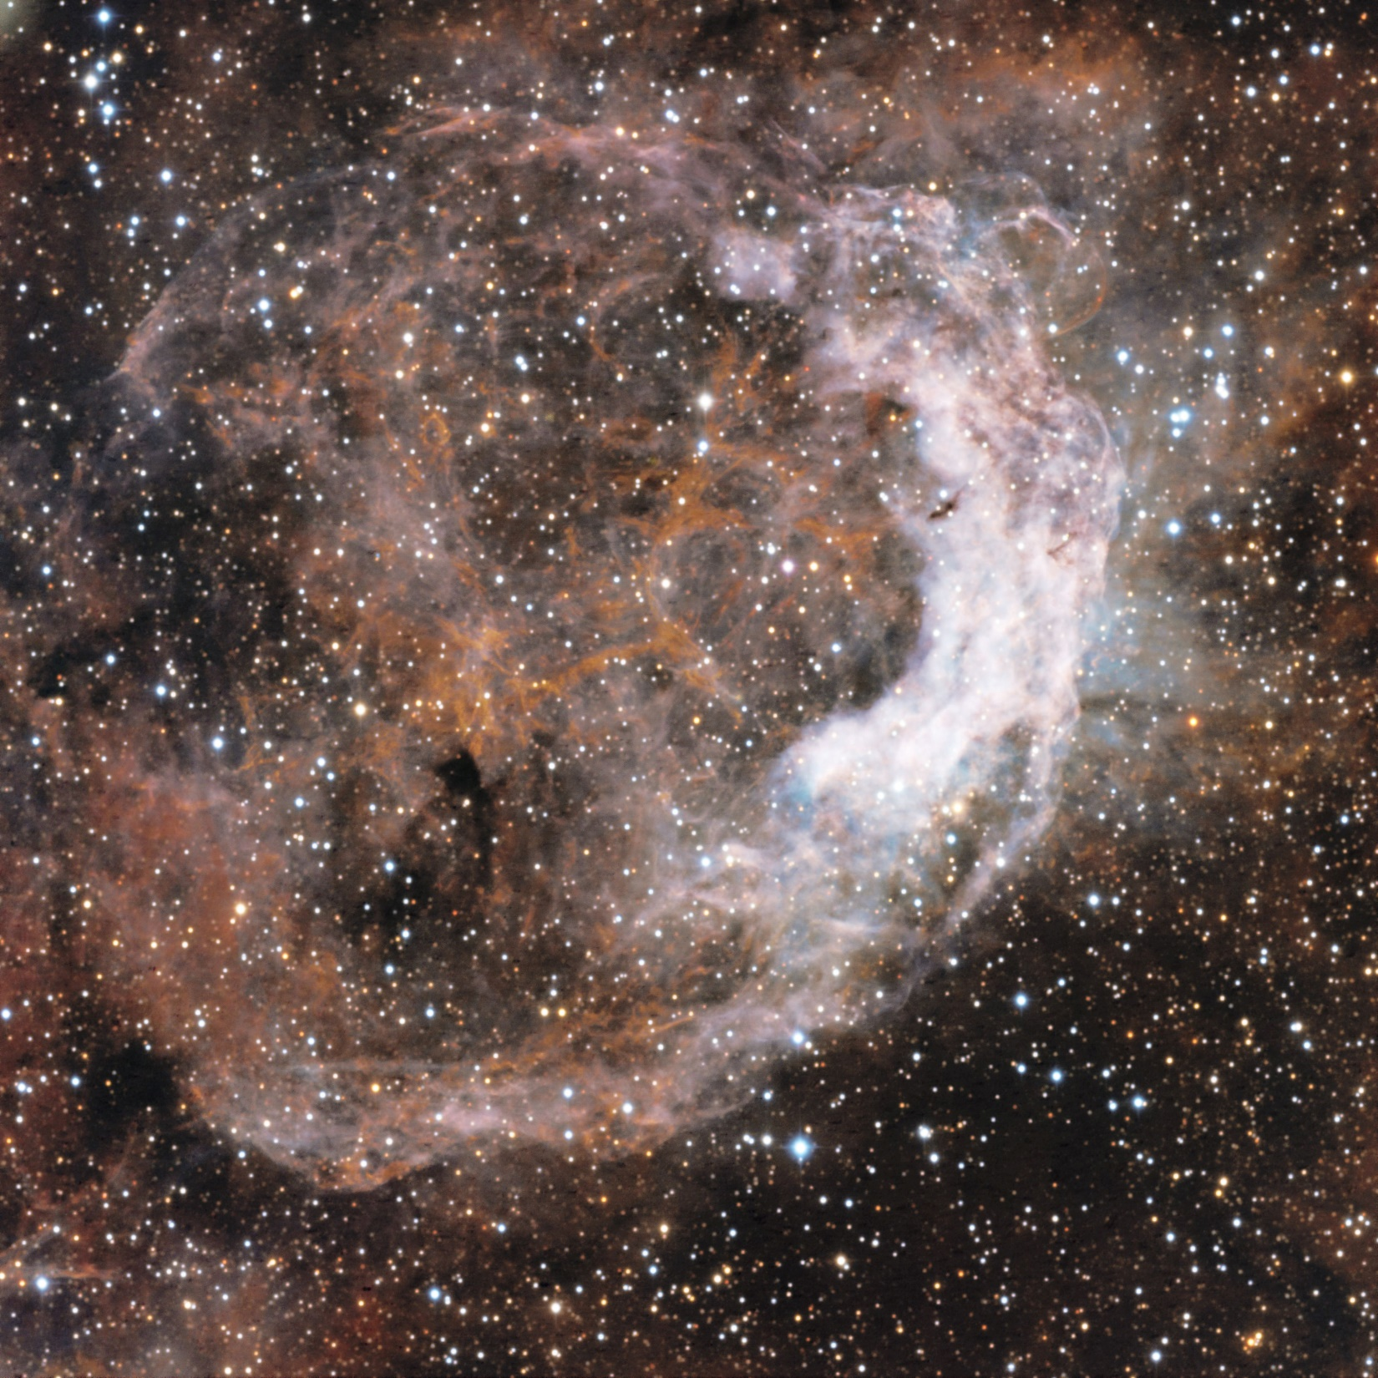
We have had a room change. We now will be meeting in the
OC Multi-media Room which is right across the hallway
from our old room.

Slide 33

We have had a room change. We now will be meeting in the
OC Multi-media Room which is right across the hallway
from our old room.

Slide 34
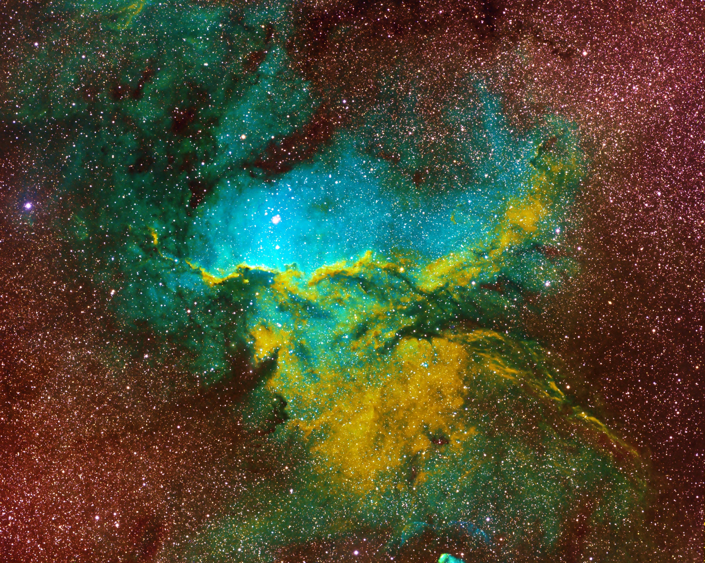
We have had a room change. We now will be meeting in the
OC Multi-media Room which is right across the hallway
from our old room.

Slide 35
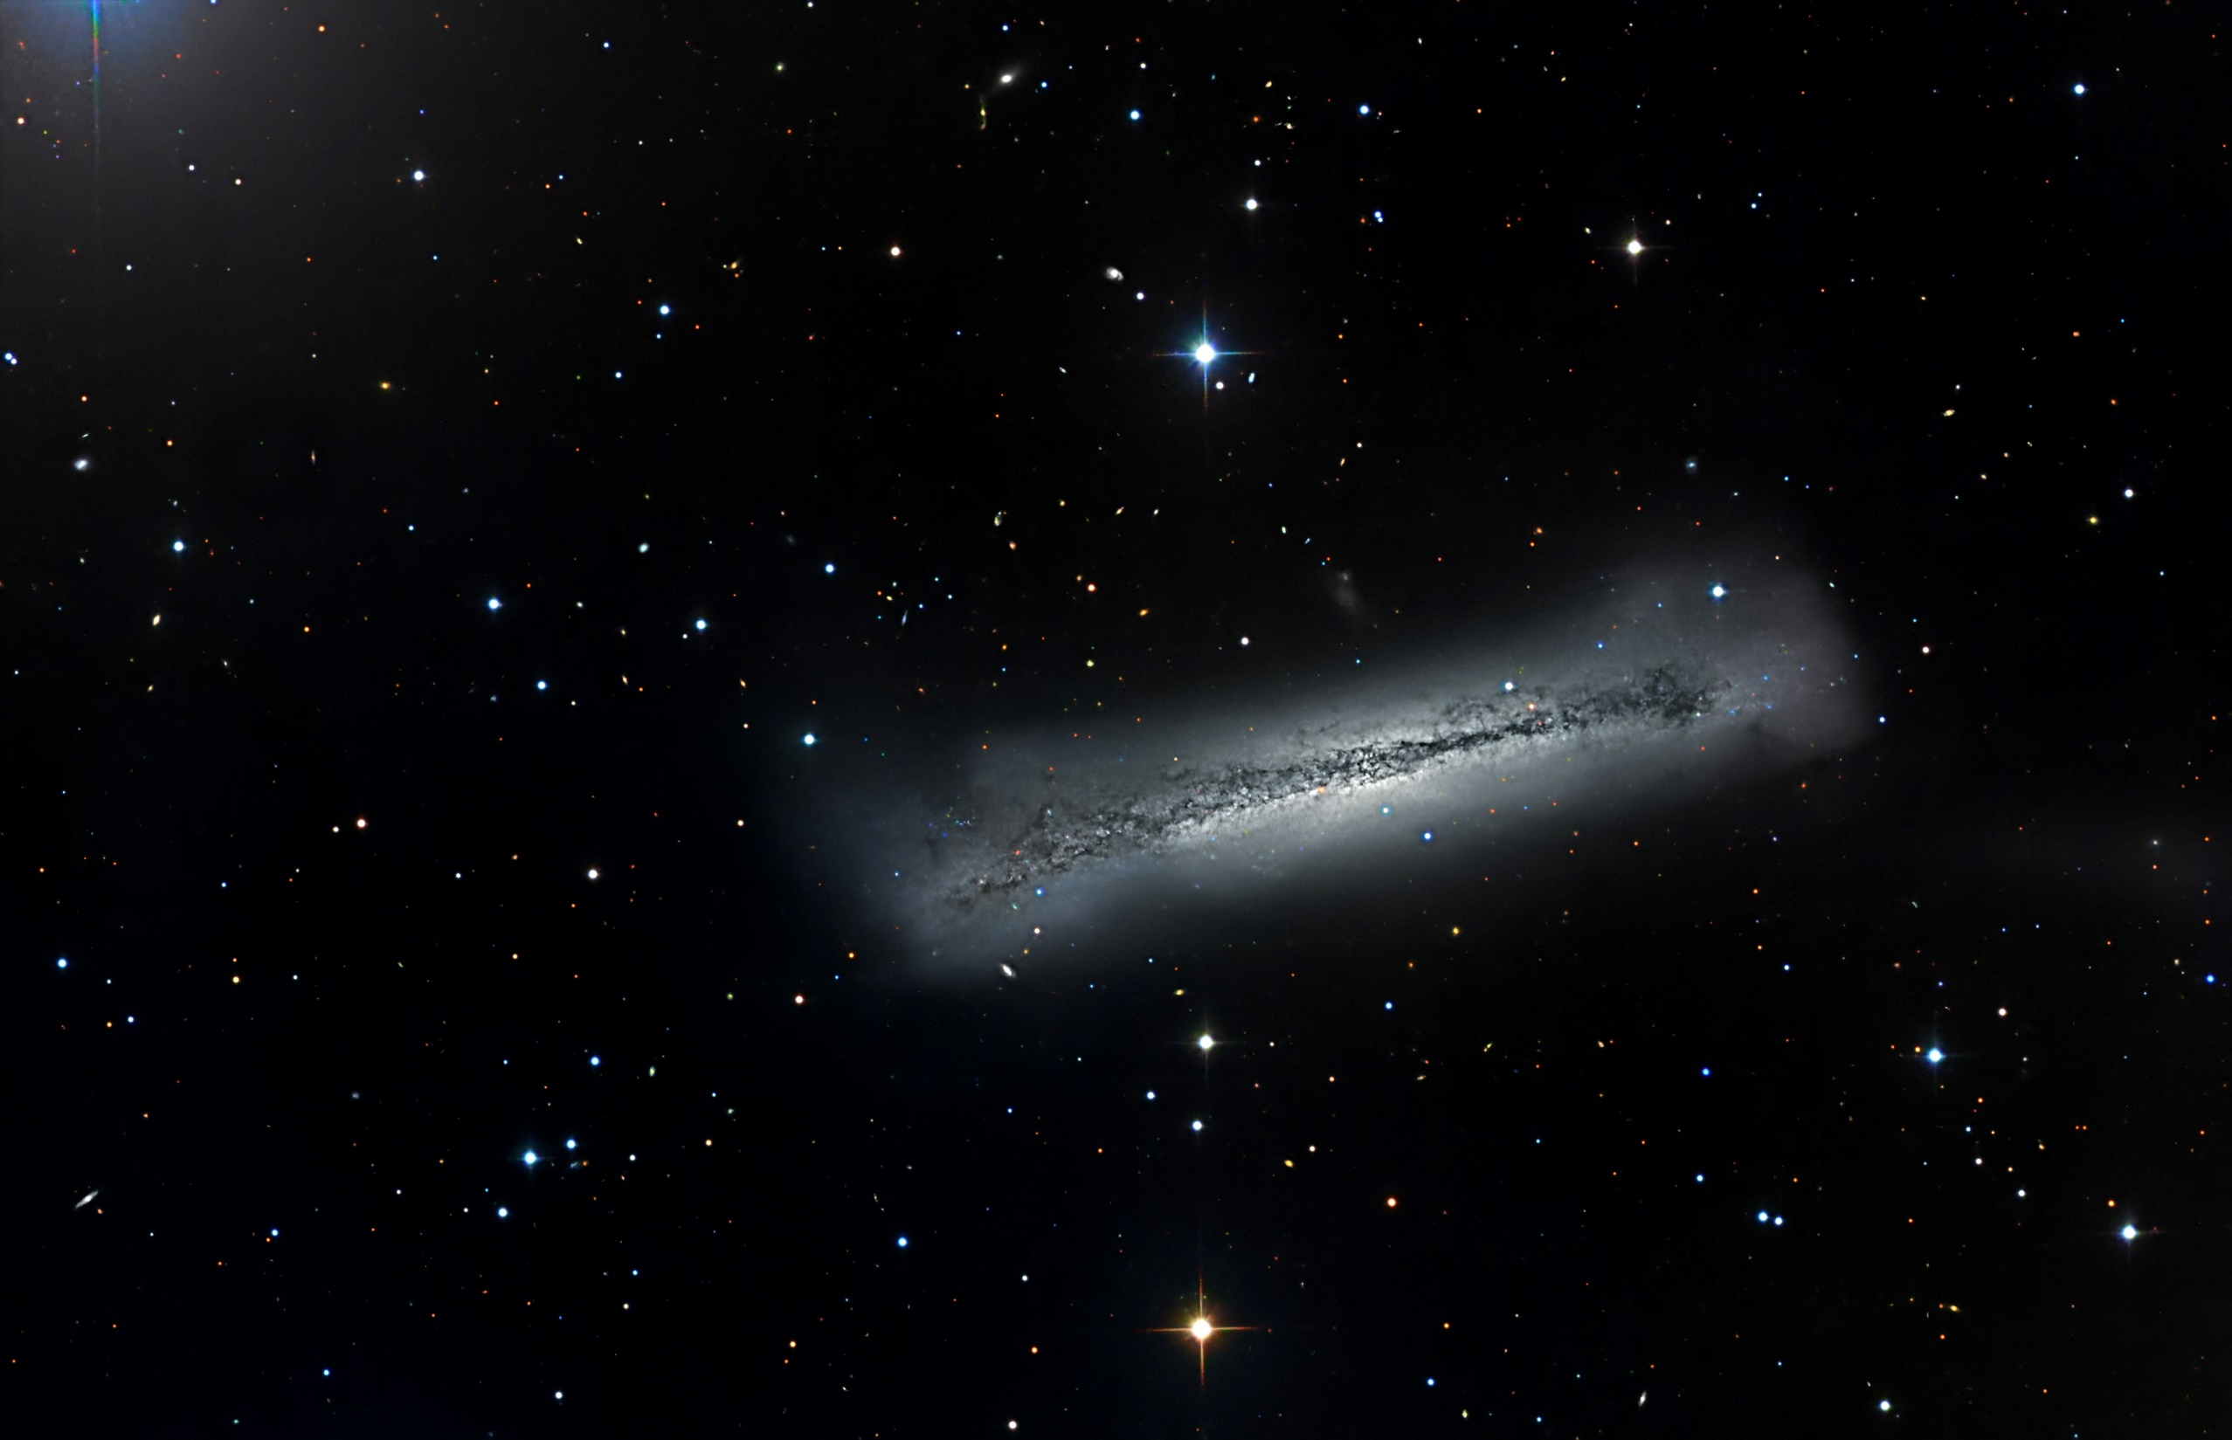
We have had a room change. We now will be meeting in the
OC Multi-media Room which is right across the hallway
from our old room.

Slide 36
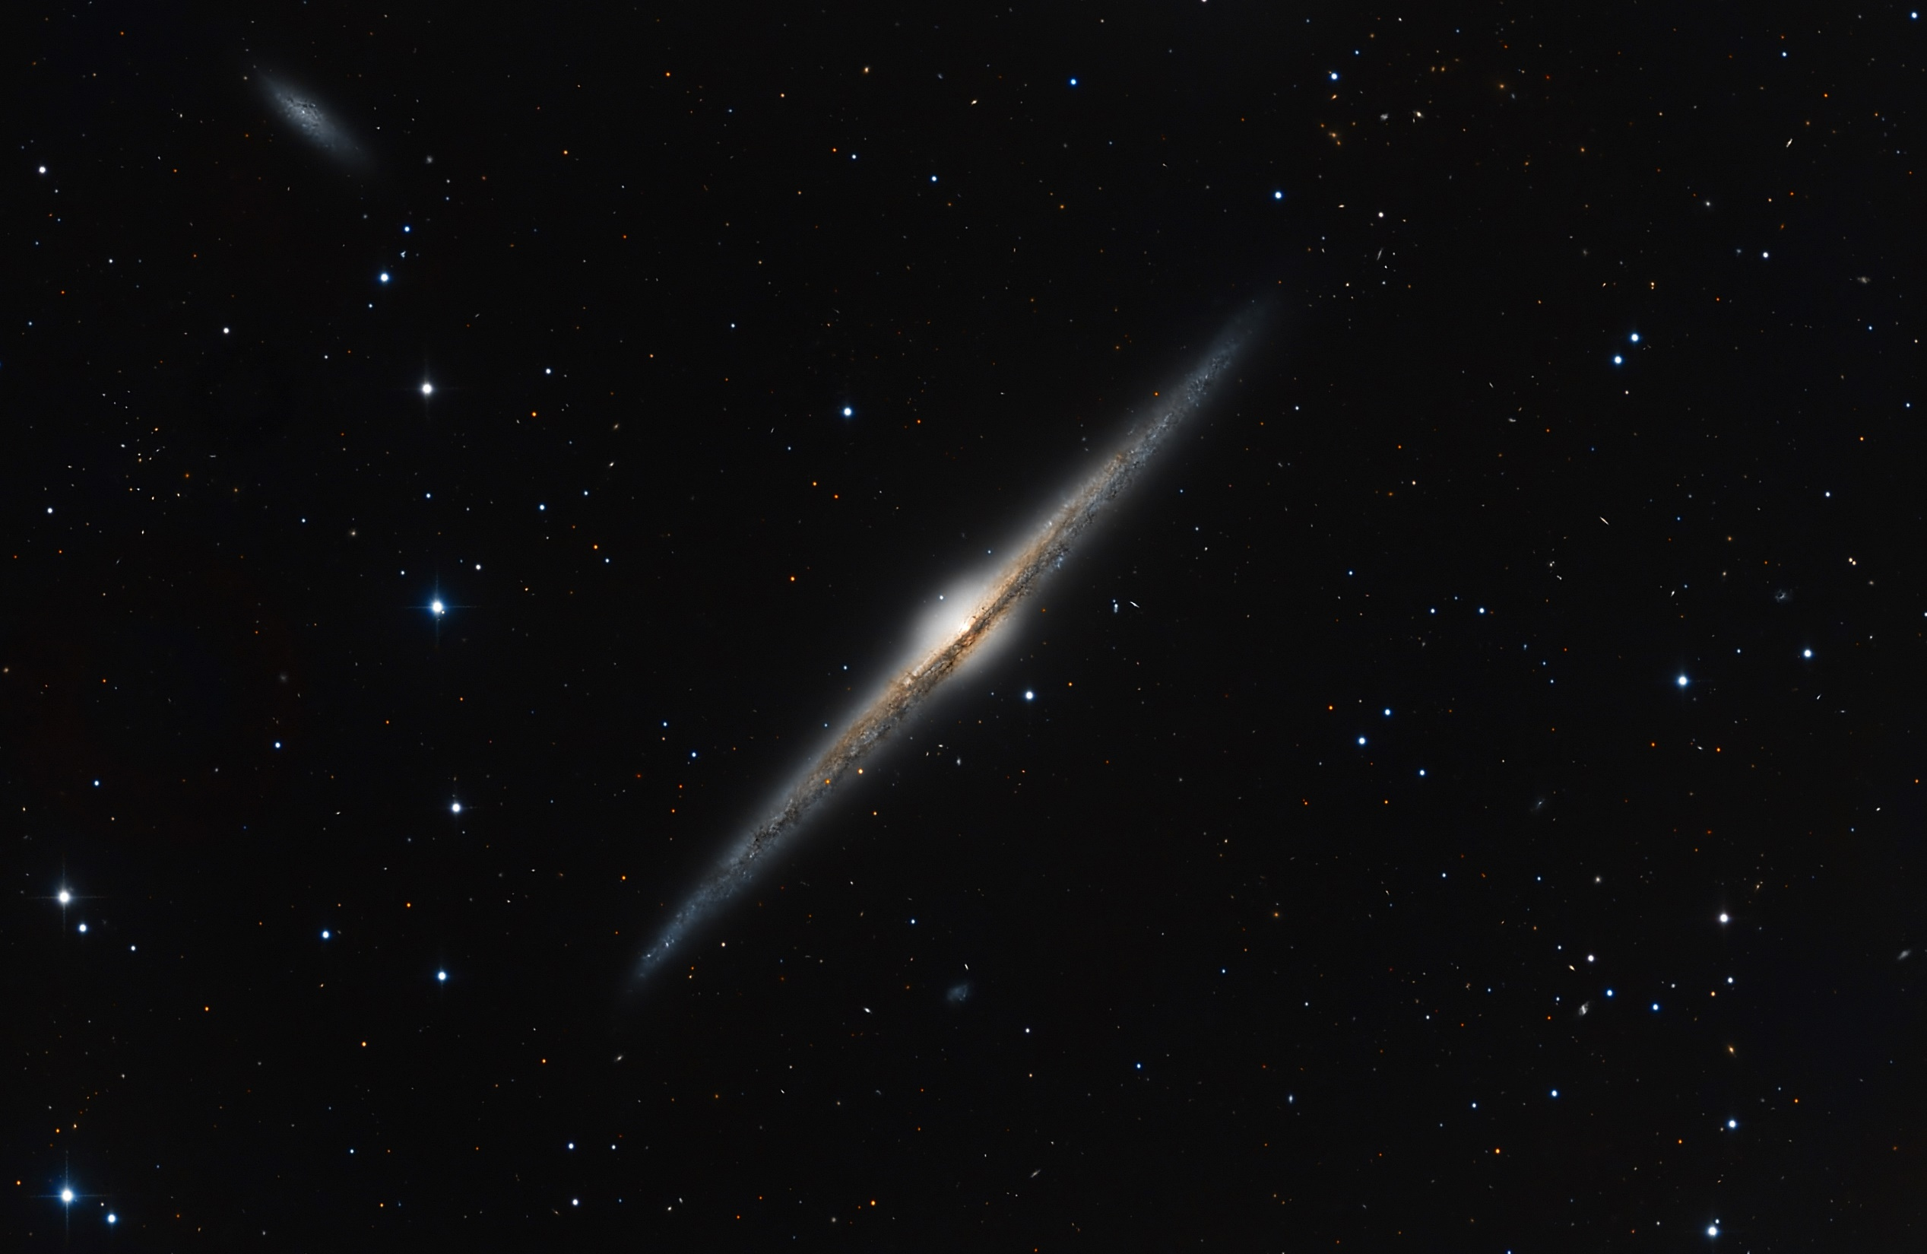
We have had a room change. We now will be meeting in the
OC Multi-media Room which is right across the hallway
from our old room.

Slide 37

We have had a room change. We now will be meeting in the
OC Multi-media Room which is right across the hallway
from our old room.

Slide 38
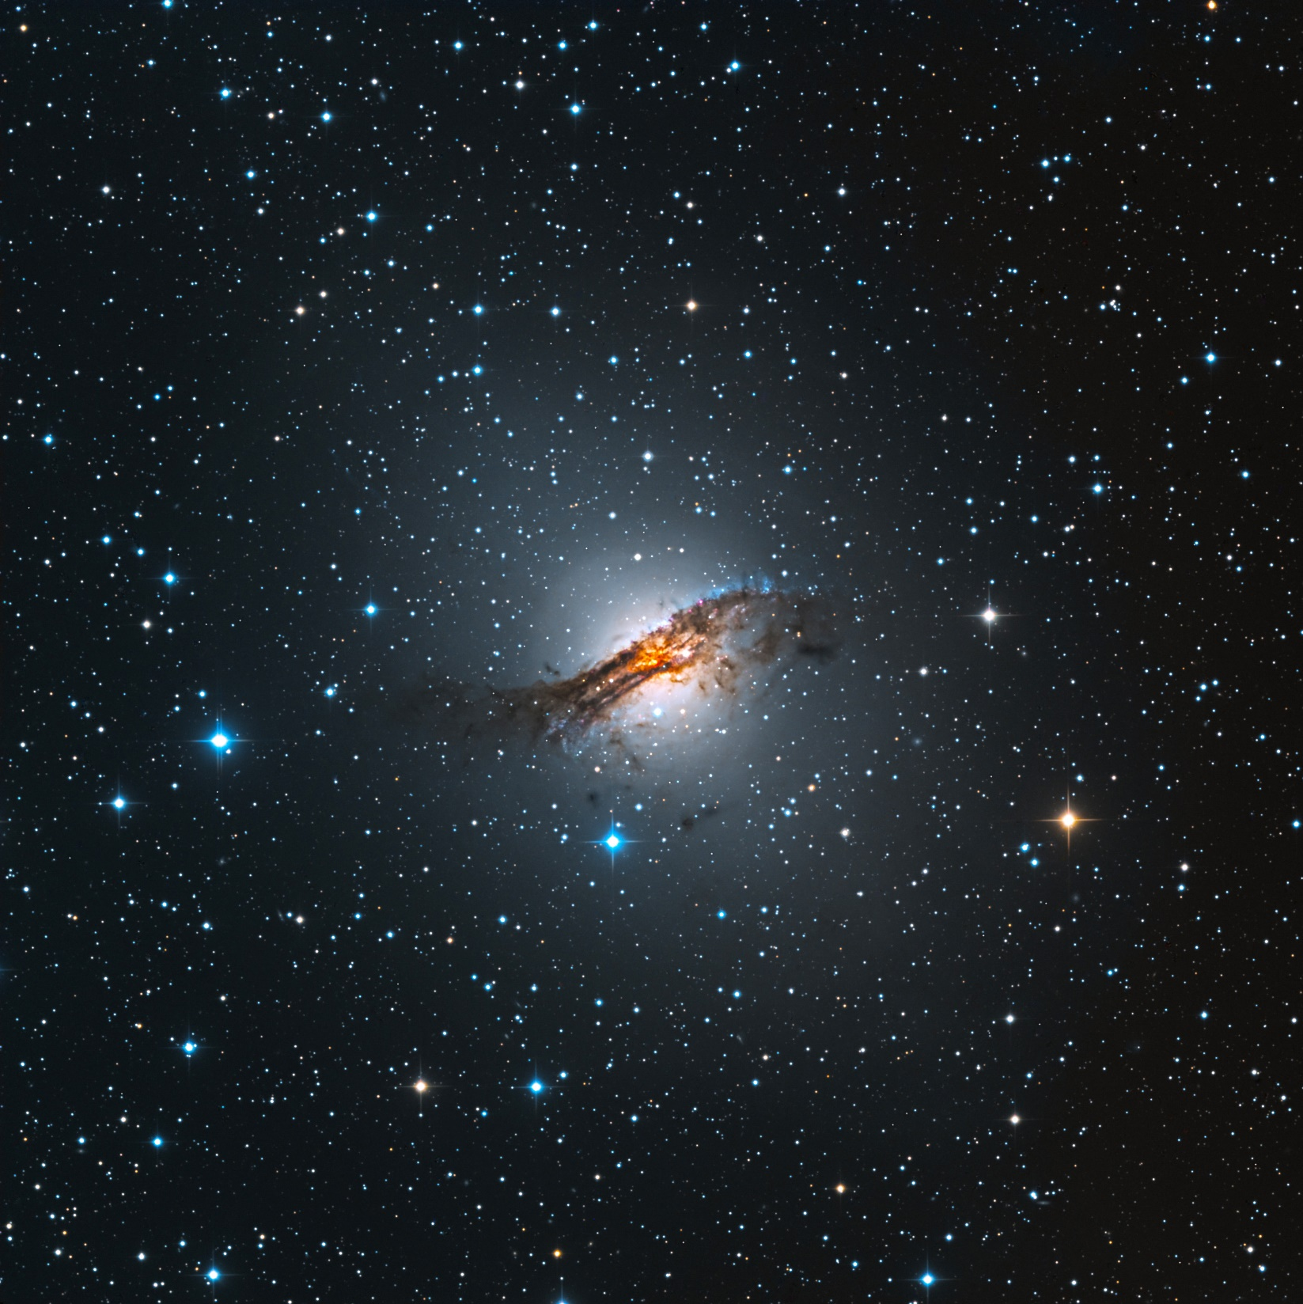
We have had a room change. We now will be meeting in the
OC Multi-media Room which is right across the hallway
from our old room.

Slide 39

We have had a room change. We now will be meeting in the
OC Multi-media Room which is right across the hallway
from our old room.

Slide 40

We have had a room change. We now will be meeting in the
OC Multi-media Room which is right across the hallway
from our old room.

Slide 41
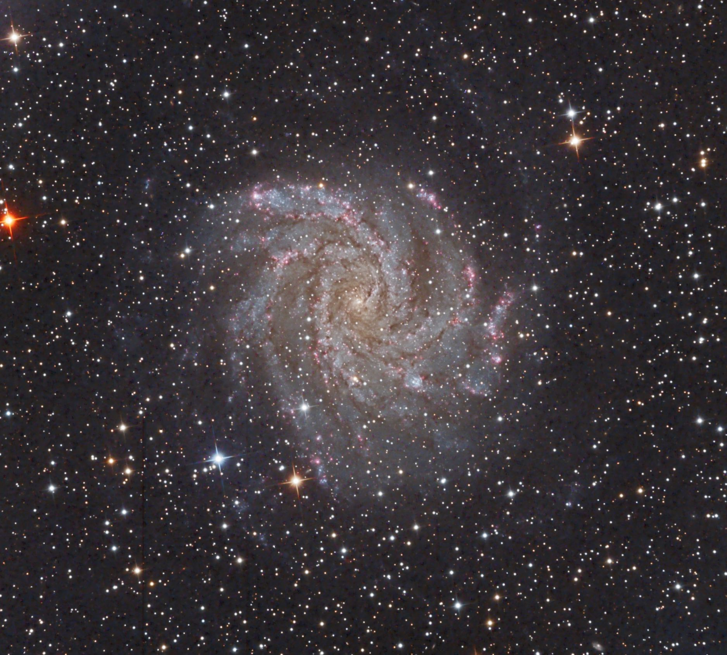
We have had a room change. We now will be meeting in the
OC Multi-media Room which is right across the hallway
from our old room.

Slide 42
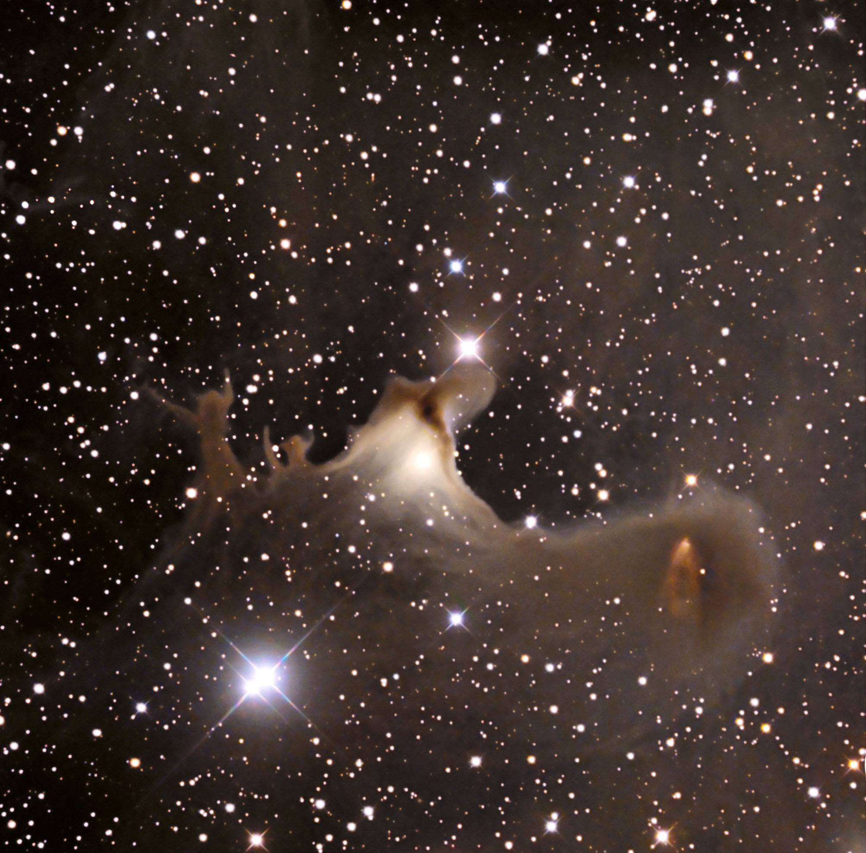
We have had a room change. We now will be meeting in the
OC Multi-media Room which is right across the hallway
from our old room.

Slide 43
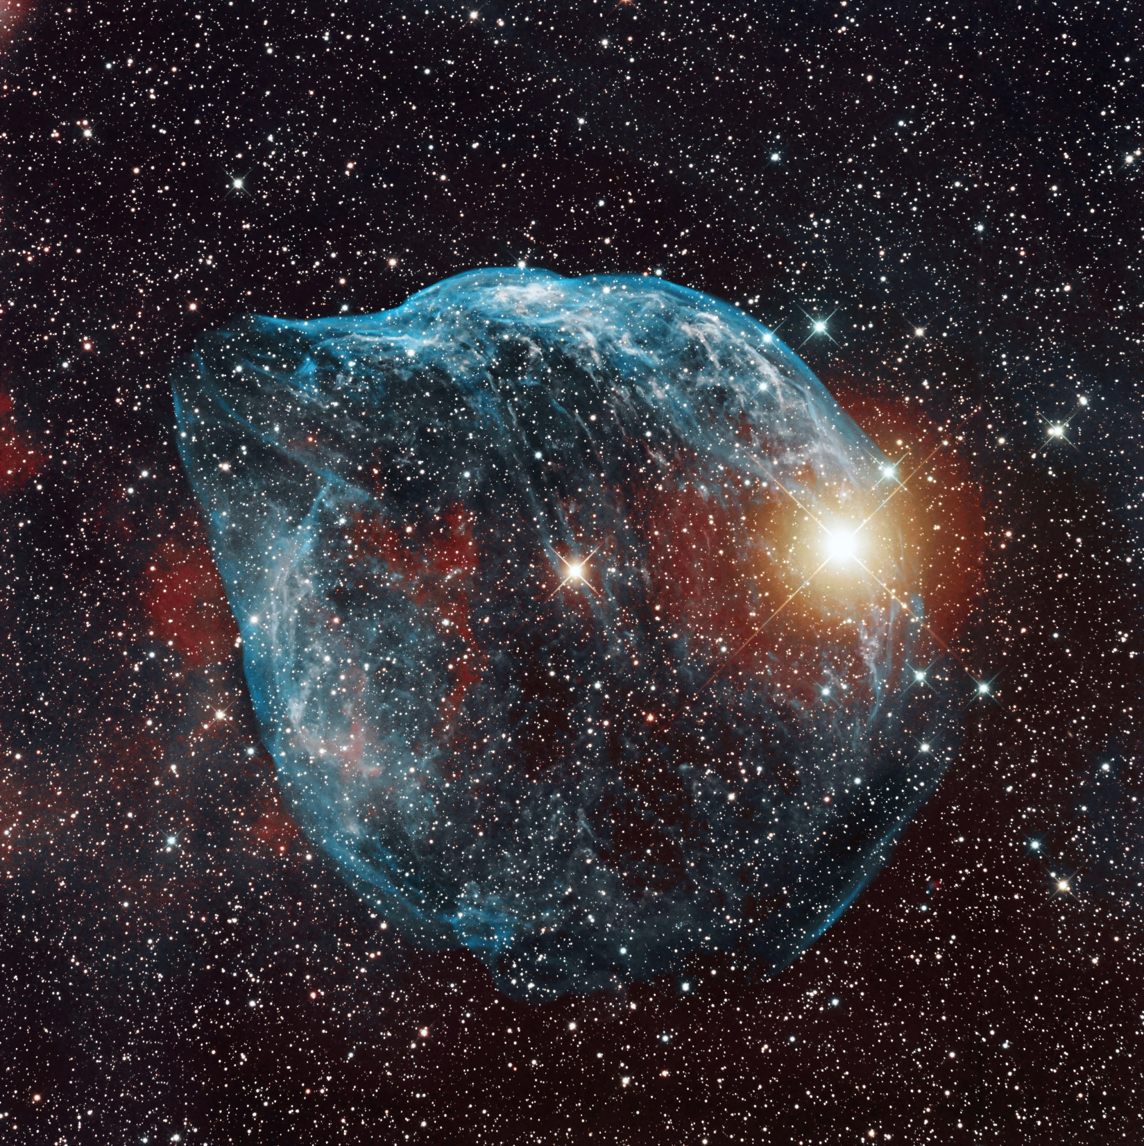
We have had a room change. We now will be meeting in the
OC Multi-media Room which is right across the hallway
from our old room.

Slide 44
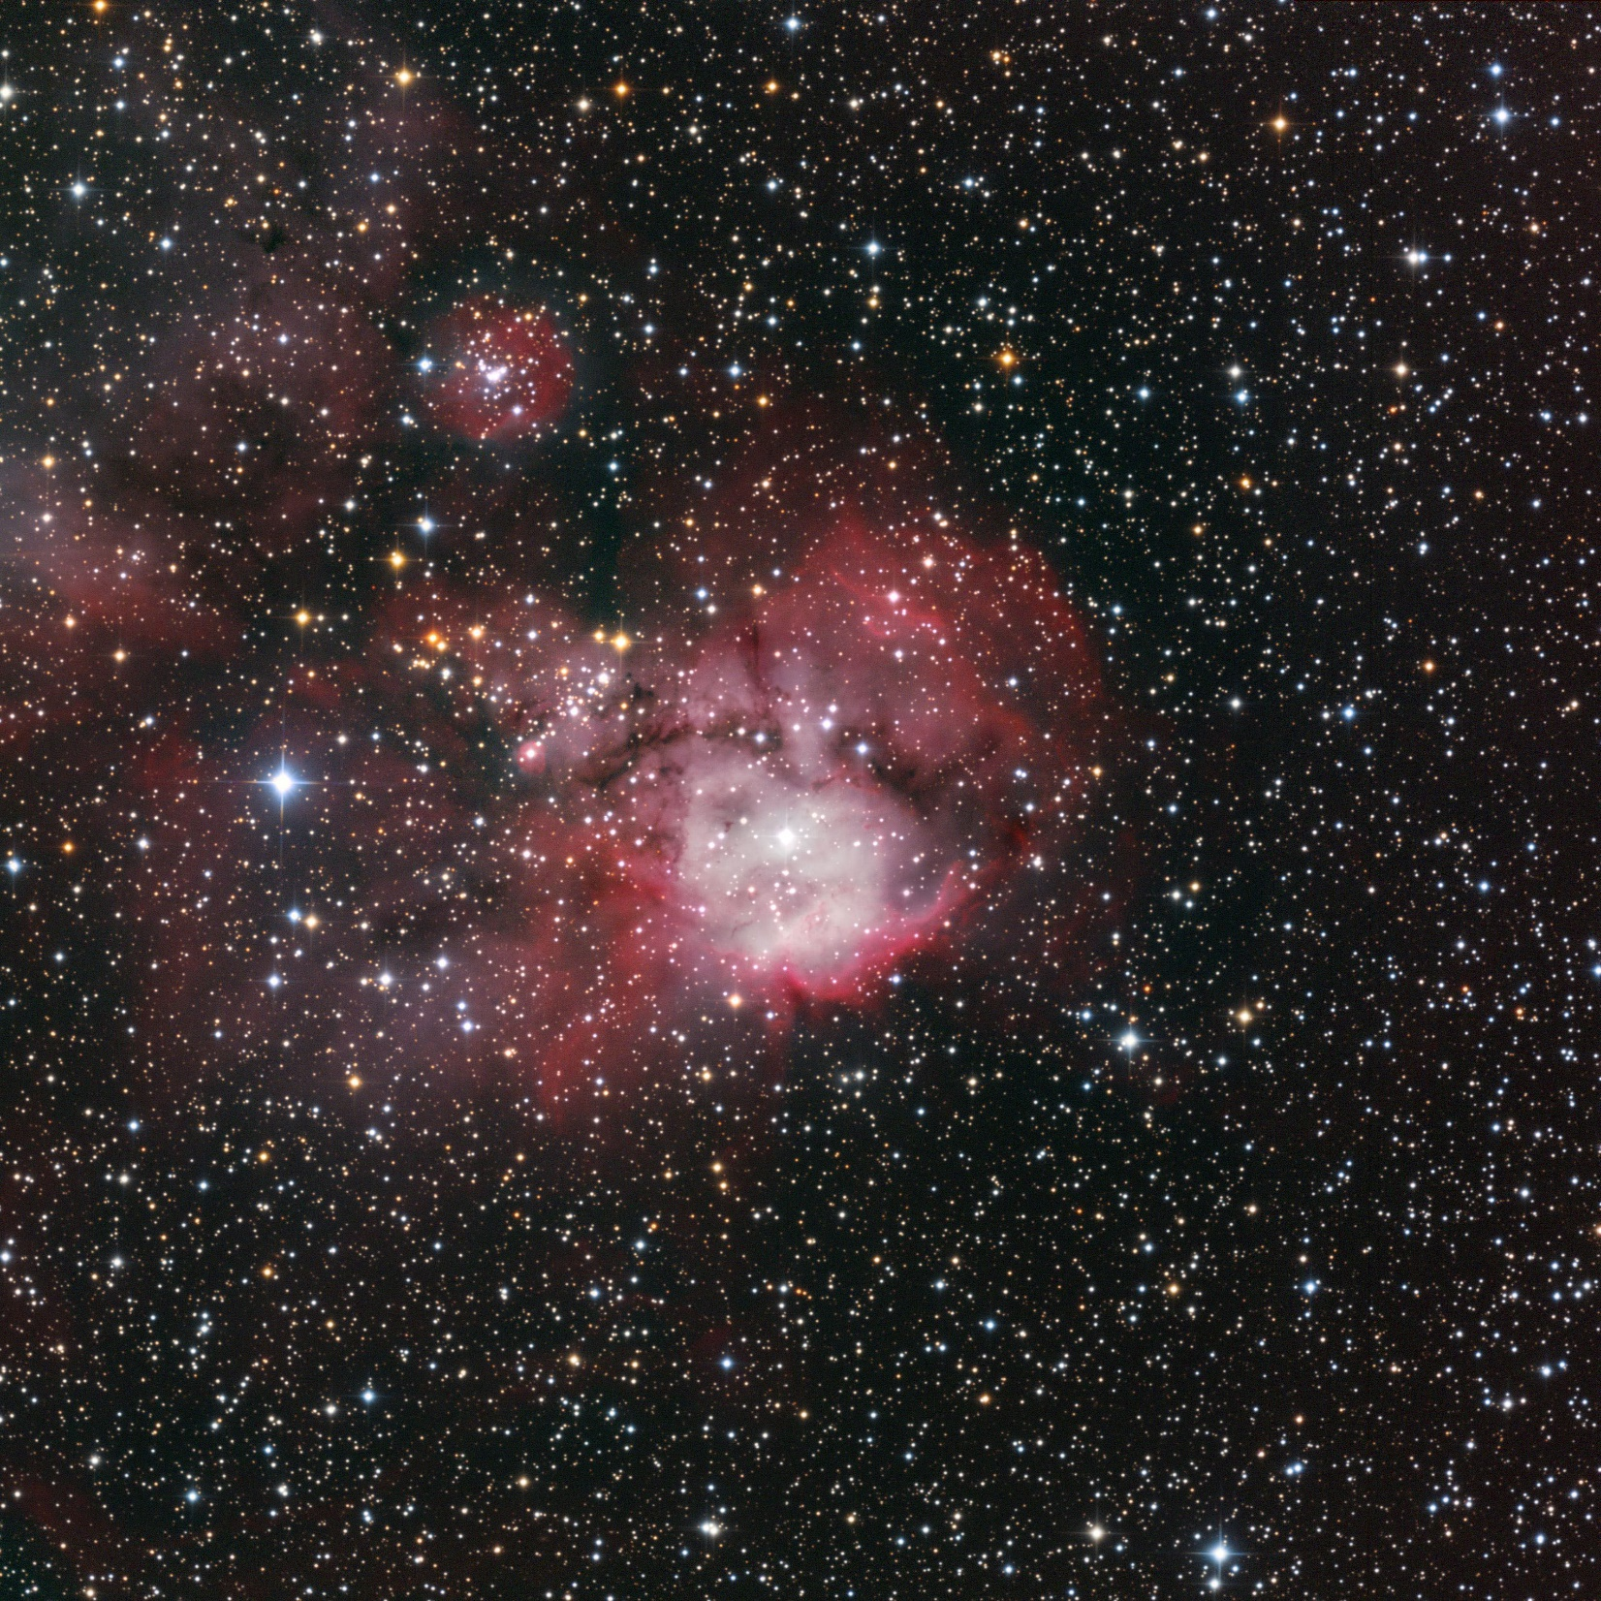
We have had a room change. We now will be meeting in the
OC Multi-media Room which is right across the hallway
from our old room.

Slide 45
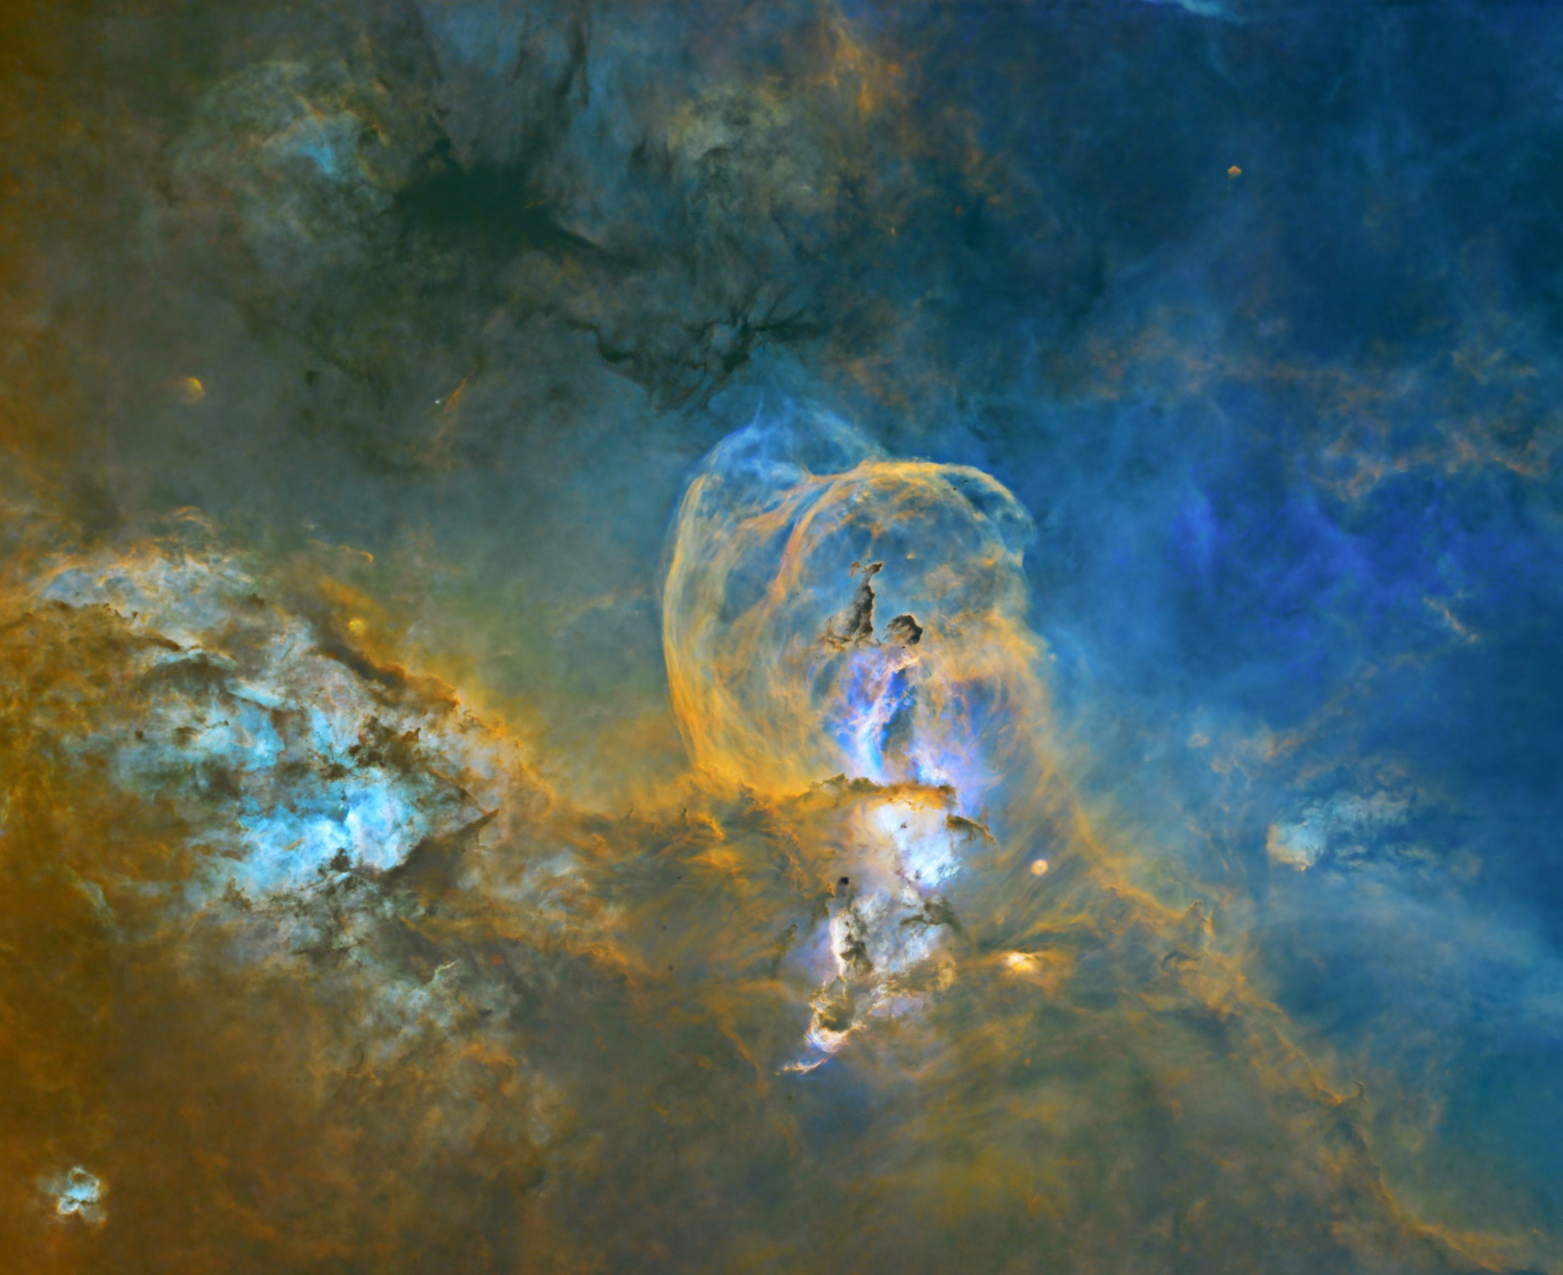
We have had a room change. We now will be meeting in the
OC Multi-media Room which is right across the hallway
from our old room.

Slide 46
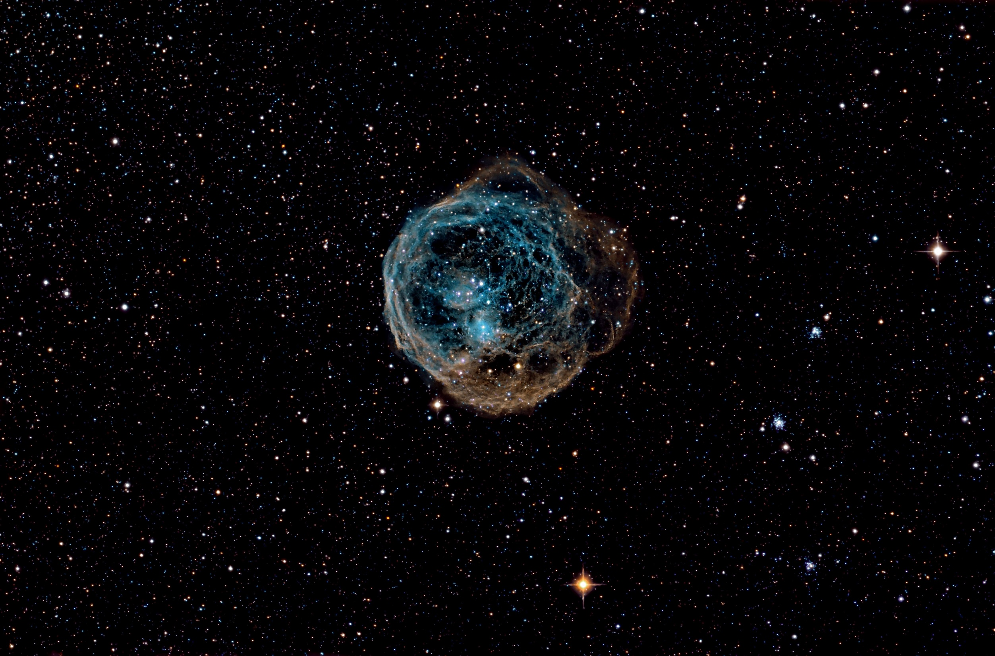
We have had a room change. We now will be meeting in the
OC Multi-media Room which is right across the hallway
from our old room.

Slide 47
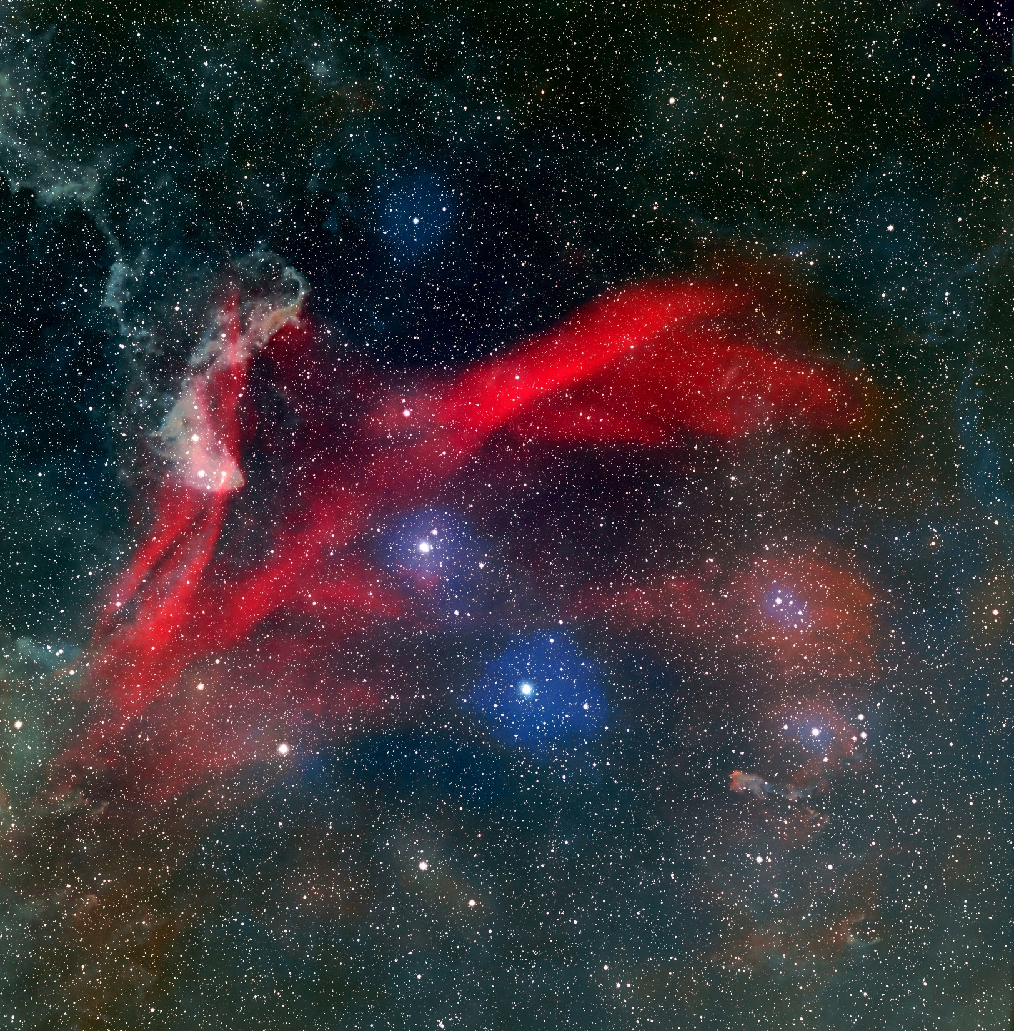
We have had a room change. We now will be meeting in the
OC Multi-media Room which is right across the hallway
from our old room.

Slide 48
The End
Thanks For Watching
OC Multi-media Room which is right across the hallway
from our old room.

