Slide 1
Nightfall Star Party
Borrego Springs, CA
597’
A 3-night event
Thursday, Friday and Saturday
Sponsored and organized by the Riverside Astronomical Society since 1993
Usually held during the New Moon closest to the end of October.

Slide 2
Borrego Springs
A small community right in the heart of the
Anzo-Borrego Desert State Park
About 3500 people in the winter – very popular with folks
from the N.W.
(almost a ghost town during the summer)
In the 50’s and 60’s was an alternative getaway for
celebrities and the rich and famous who did not want the
hustle and bustle of Palm Springs
Famous for its pueblo, ranch and modern-style homes
Lots of hiking trails within a short drive

Slide 3
Borrego Springs
Designated as the first Dark Sky Site in 2009 by the International Dark-Sky Association
No stop lights
Only 12 street lights along the main street
Some good restaurants – Pizza, Mexican, Italian, burgers, restaurants at country clubs,
ice cream, a grocery store, S.D. county library branch
Great Mexican food and fantastic margaritas at Carmelita’s
Excellent meals at Kendal’s Café and Ram’s Hill Country Club (Ram’s Hill opens Nov. 1st)
Airport: International Aerobatic Club – practices and competitions in April and October
Palm Canyon Resort and RV Camp
Western-most edge of town
Set up in RV park and sleep in a comfortable resort room
The hotel changes out EVERY exterior white light for a red light
Very astronomy friendly
Light Domes from Palm Springs, Yuma and San Diego
East and overhead (Zenith) are excellent

Slide 4
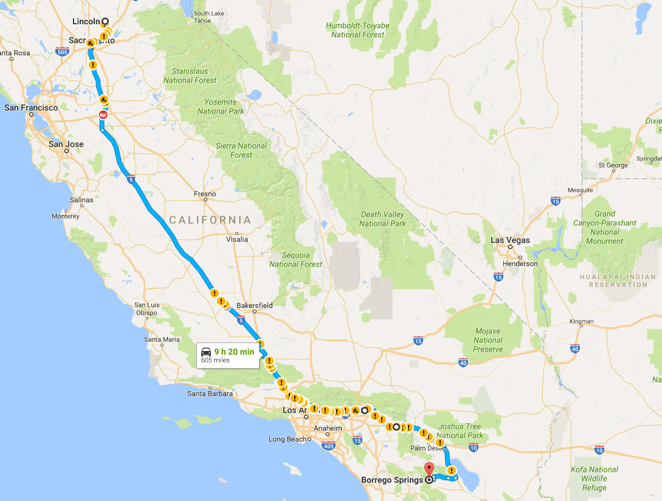
605 Miles
9 hrs 20 min (no Traffic)
Usually a two-day trip, stopping in Valencia (six flags)
Makes the second day about 3 hrs

Slide 5
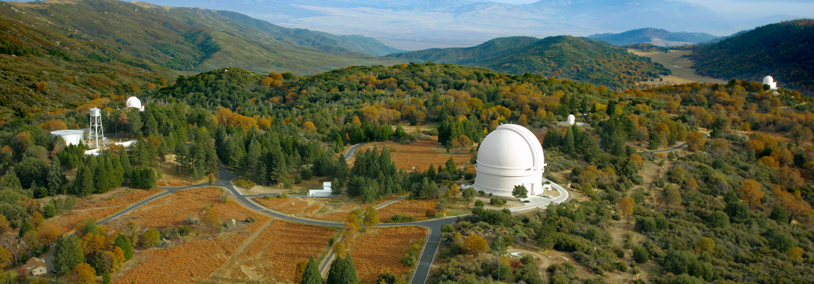
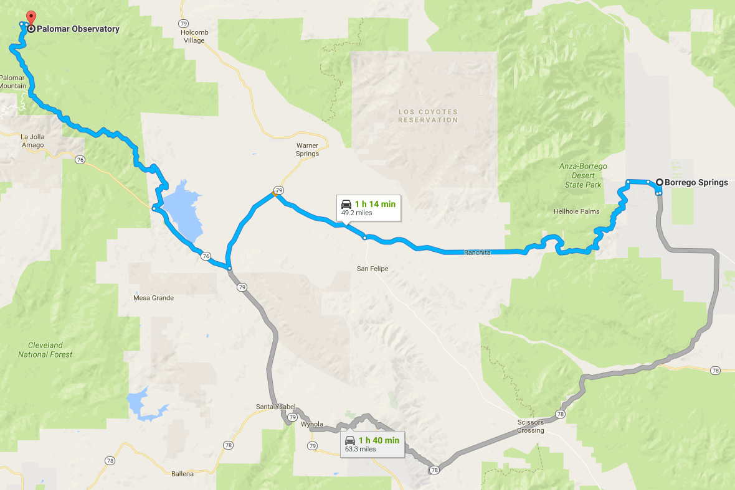
Mt. Palomar Observatory
Operated by CalTech.
Conceived almost 100 yrs ago
Was started in early 1930s. Was put on hold during the war. Constr. Completed in 1949.
49 Miles
1 hr 15 min
200” Hale Telescope
48” Samuel Oschin Telescope
60” Telescope
Self-guided tours or scheduled tours – check website
http://www.astro.caltech.edu/palomar/visitor/
or
Just do it the easy way and “Google”

Slide 6
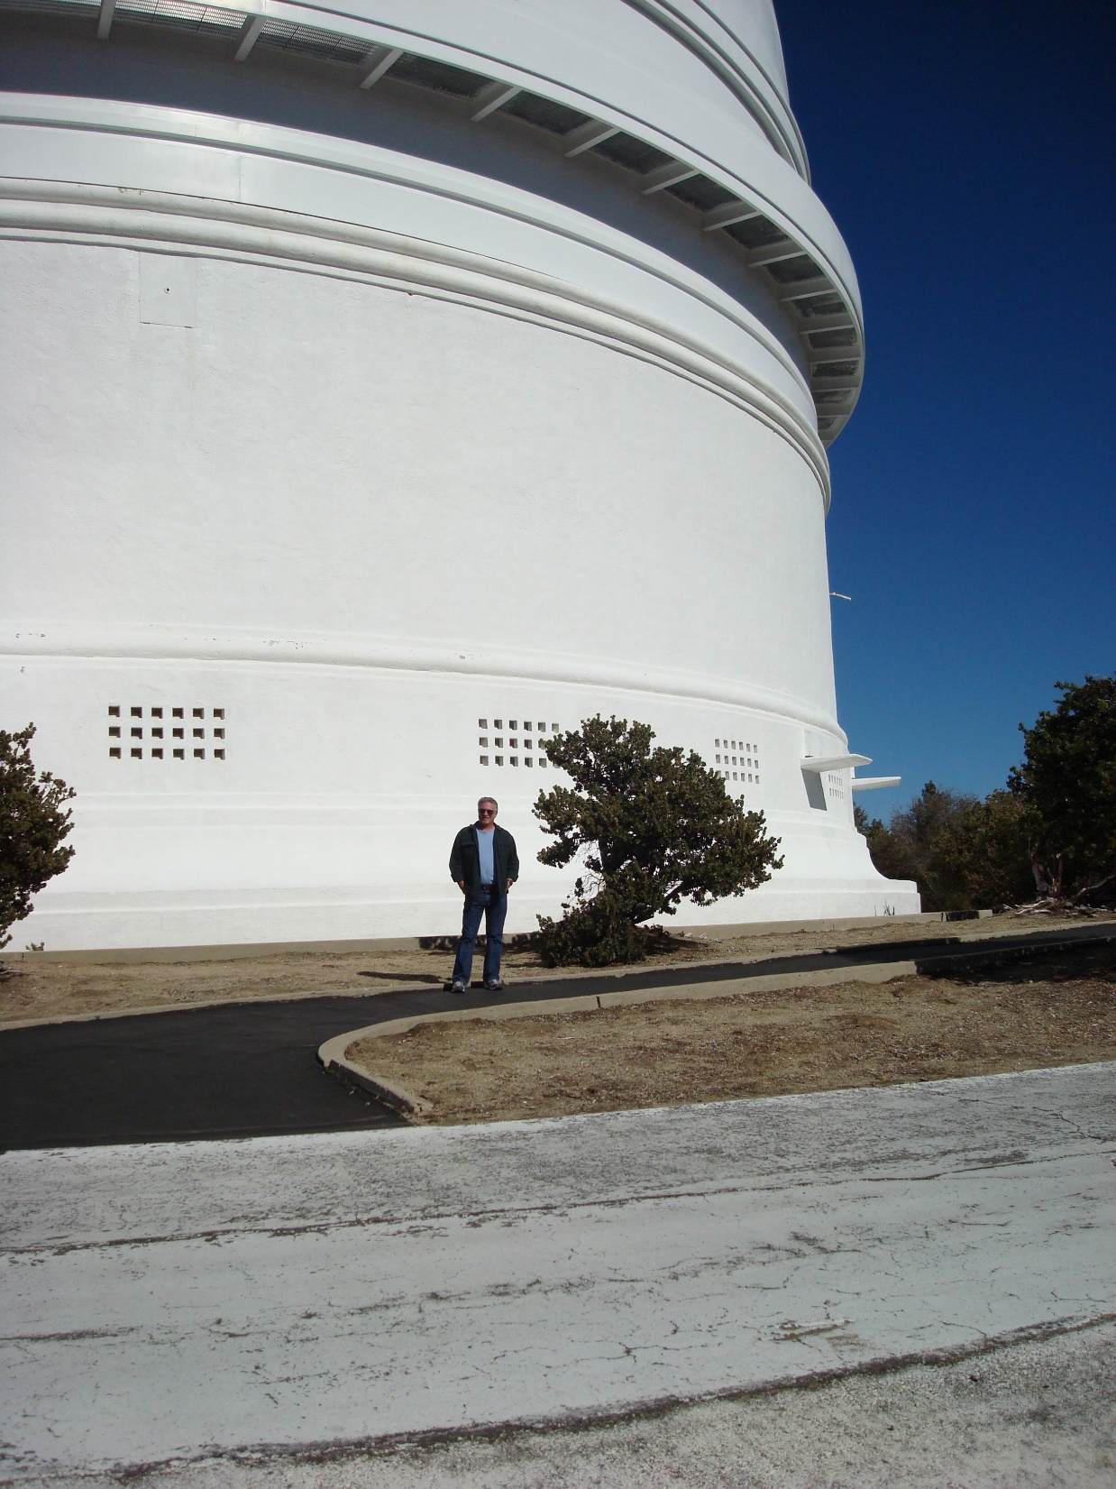

Slide 7
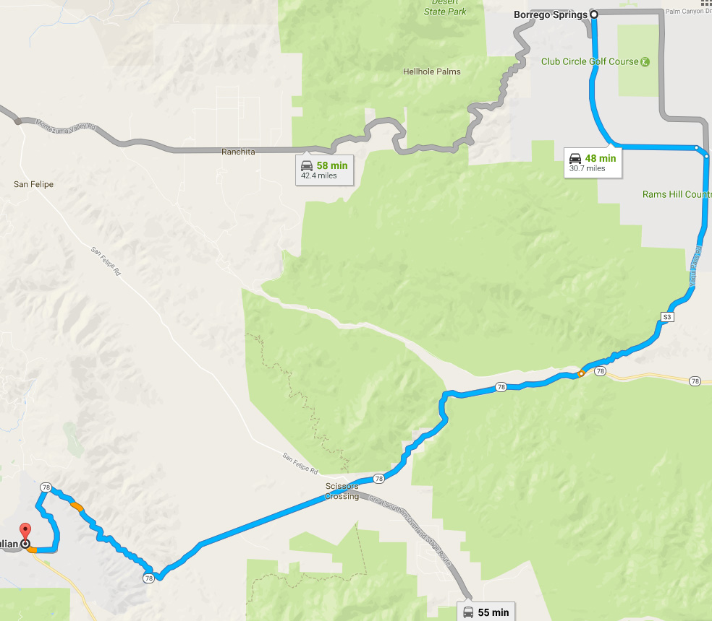
Julian, CA
31 Miles
45-50 min
Gold discovered by former slave
Fred Coleman in about 1869
During the gold rush of 1870, James
Madison brought in apples which became (and still are) the famous Julian Apple
Has an excellent gold rush museum, good restaurants and fun for a great day trip
Similar to the gold rush community of Murphys, CA

Slide 8
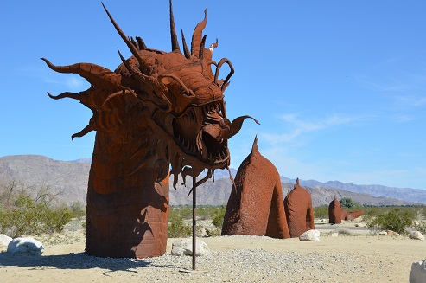
The Metal Sculptures of Ricardo Breceda

Slide 9
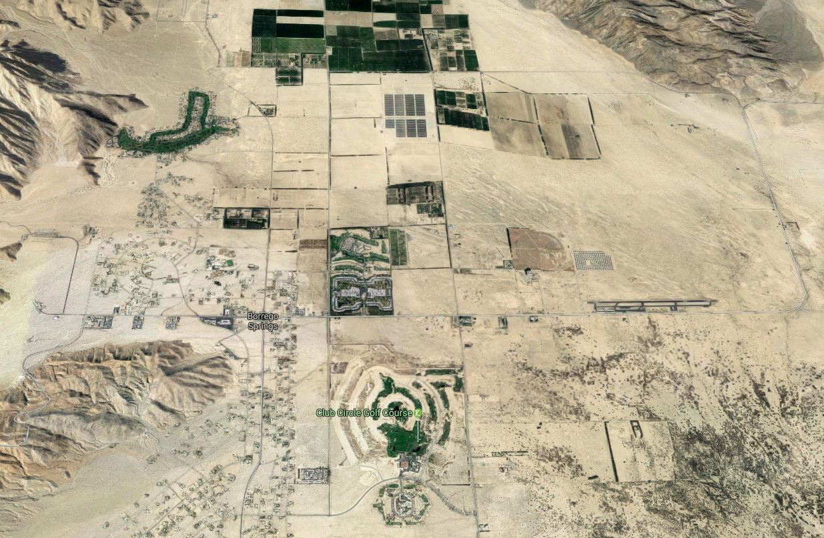
View of Borrego Springs

Slide 10
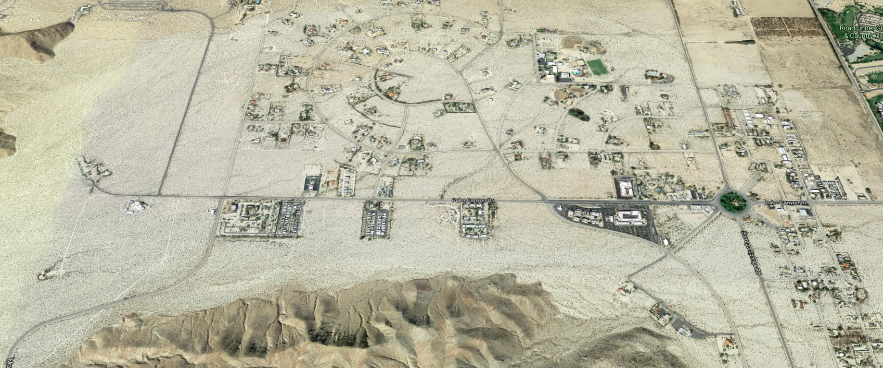

Slide 11
Borrego Springs
and
Nightfall

Slide 12
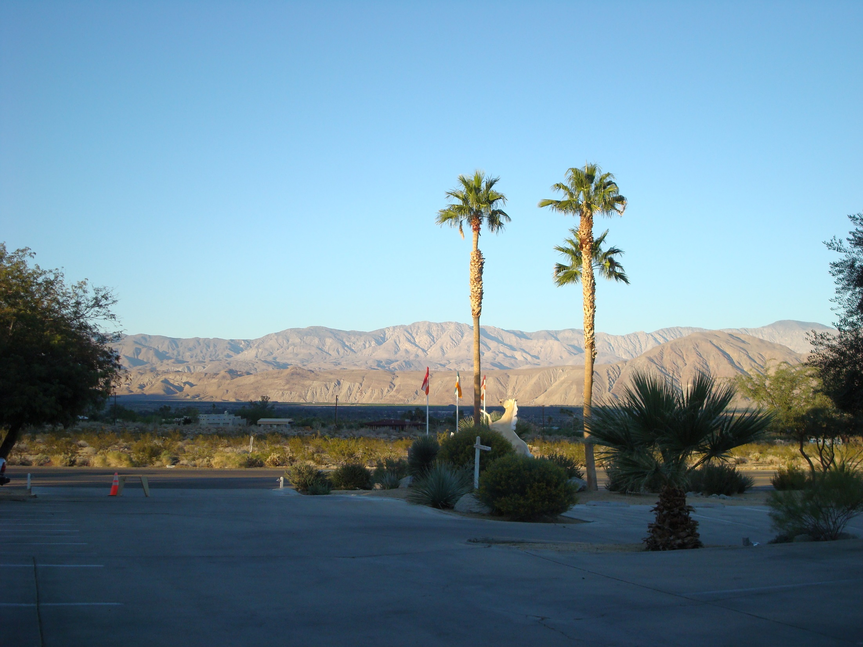
Looking North
to
Palm Springs

Slide 13
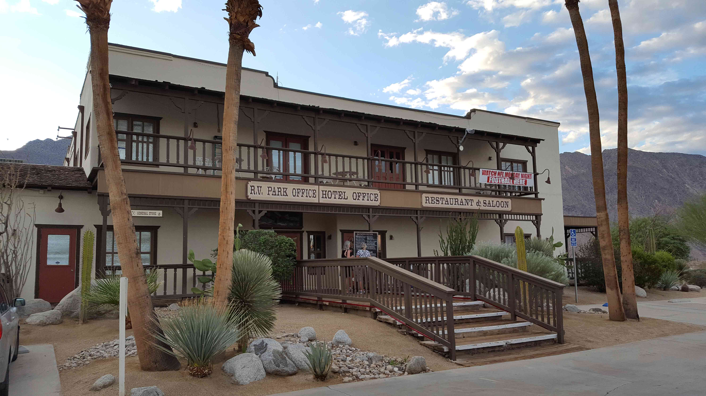

Slide 14
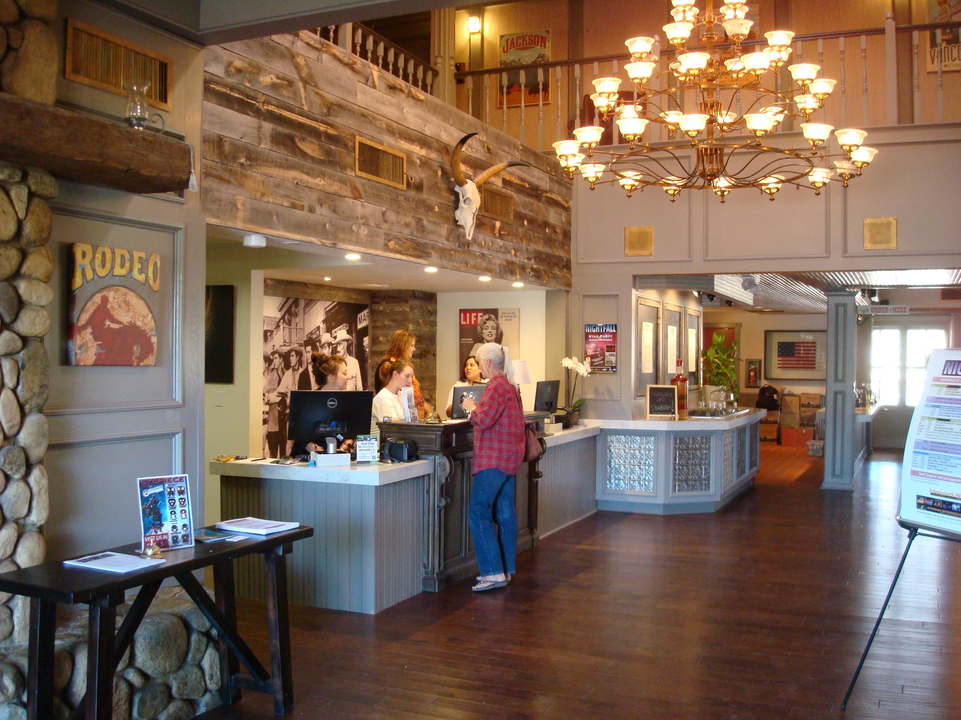

Slide 15
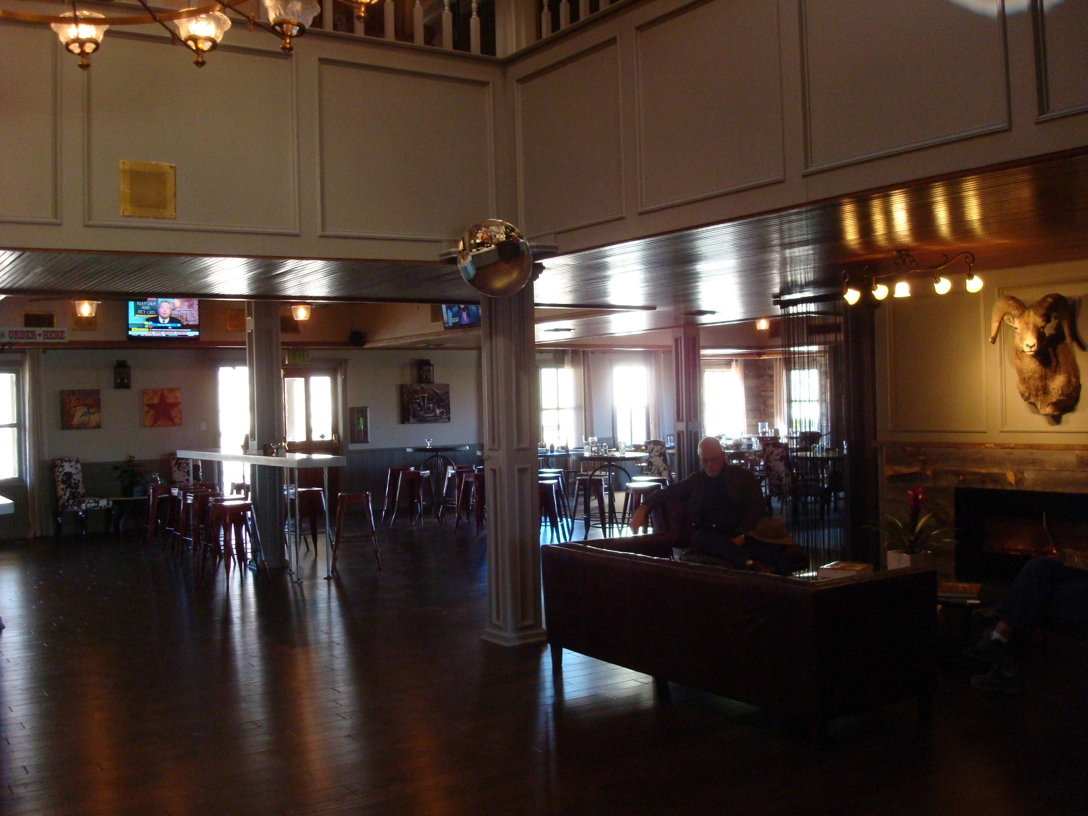
Big Horn restaurant

Slide 16
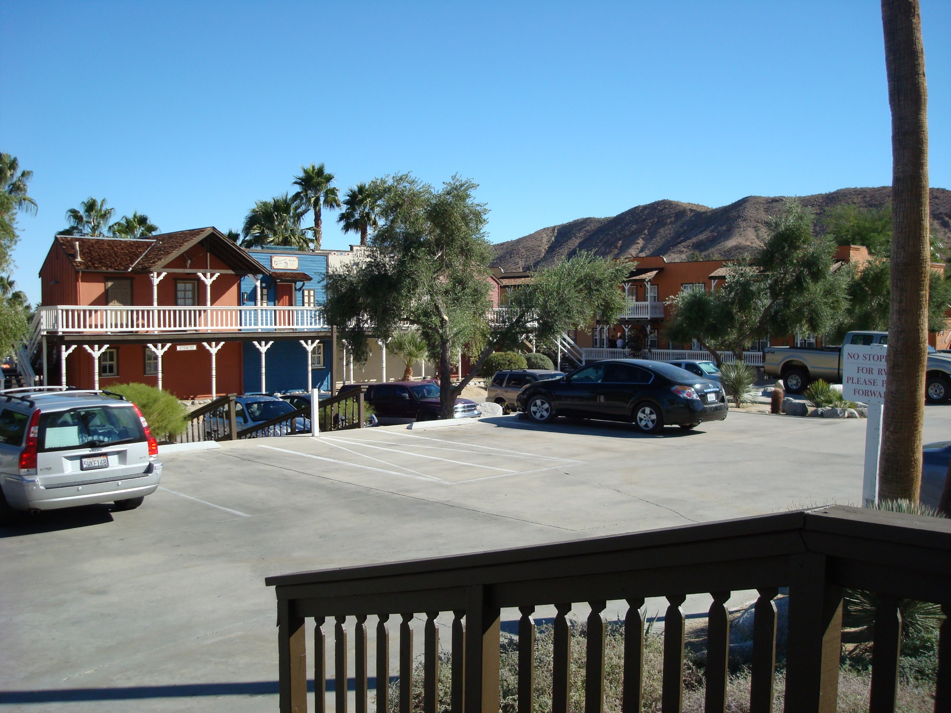

Slide 17
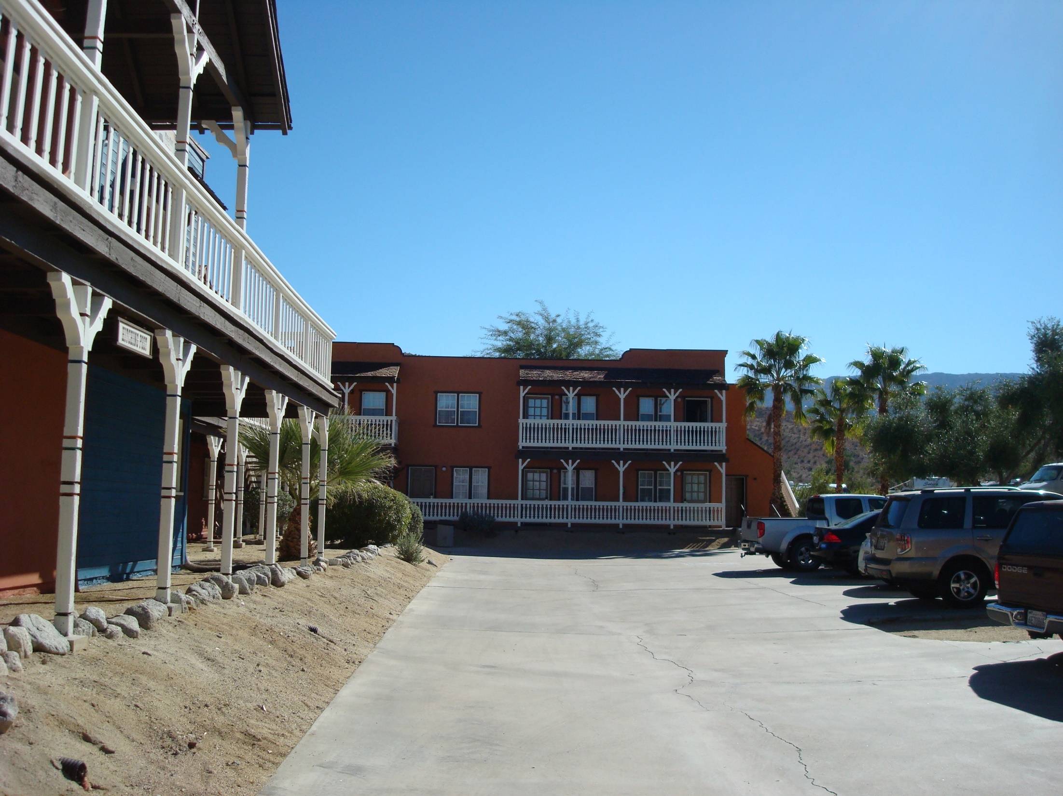

Slide 18
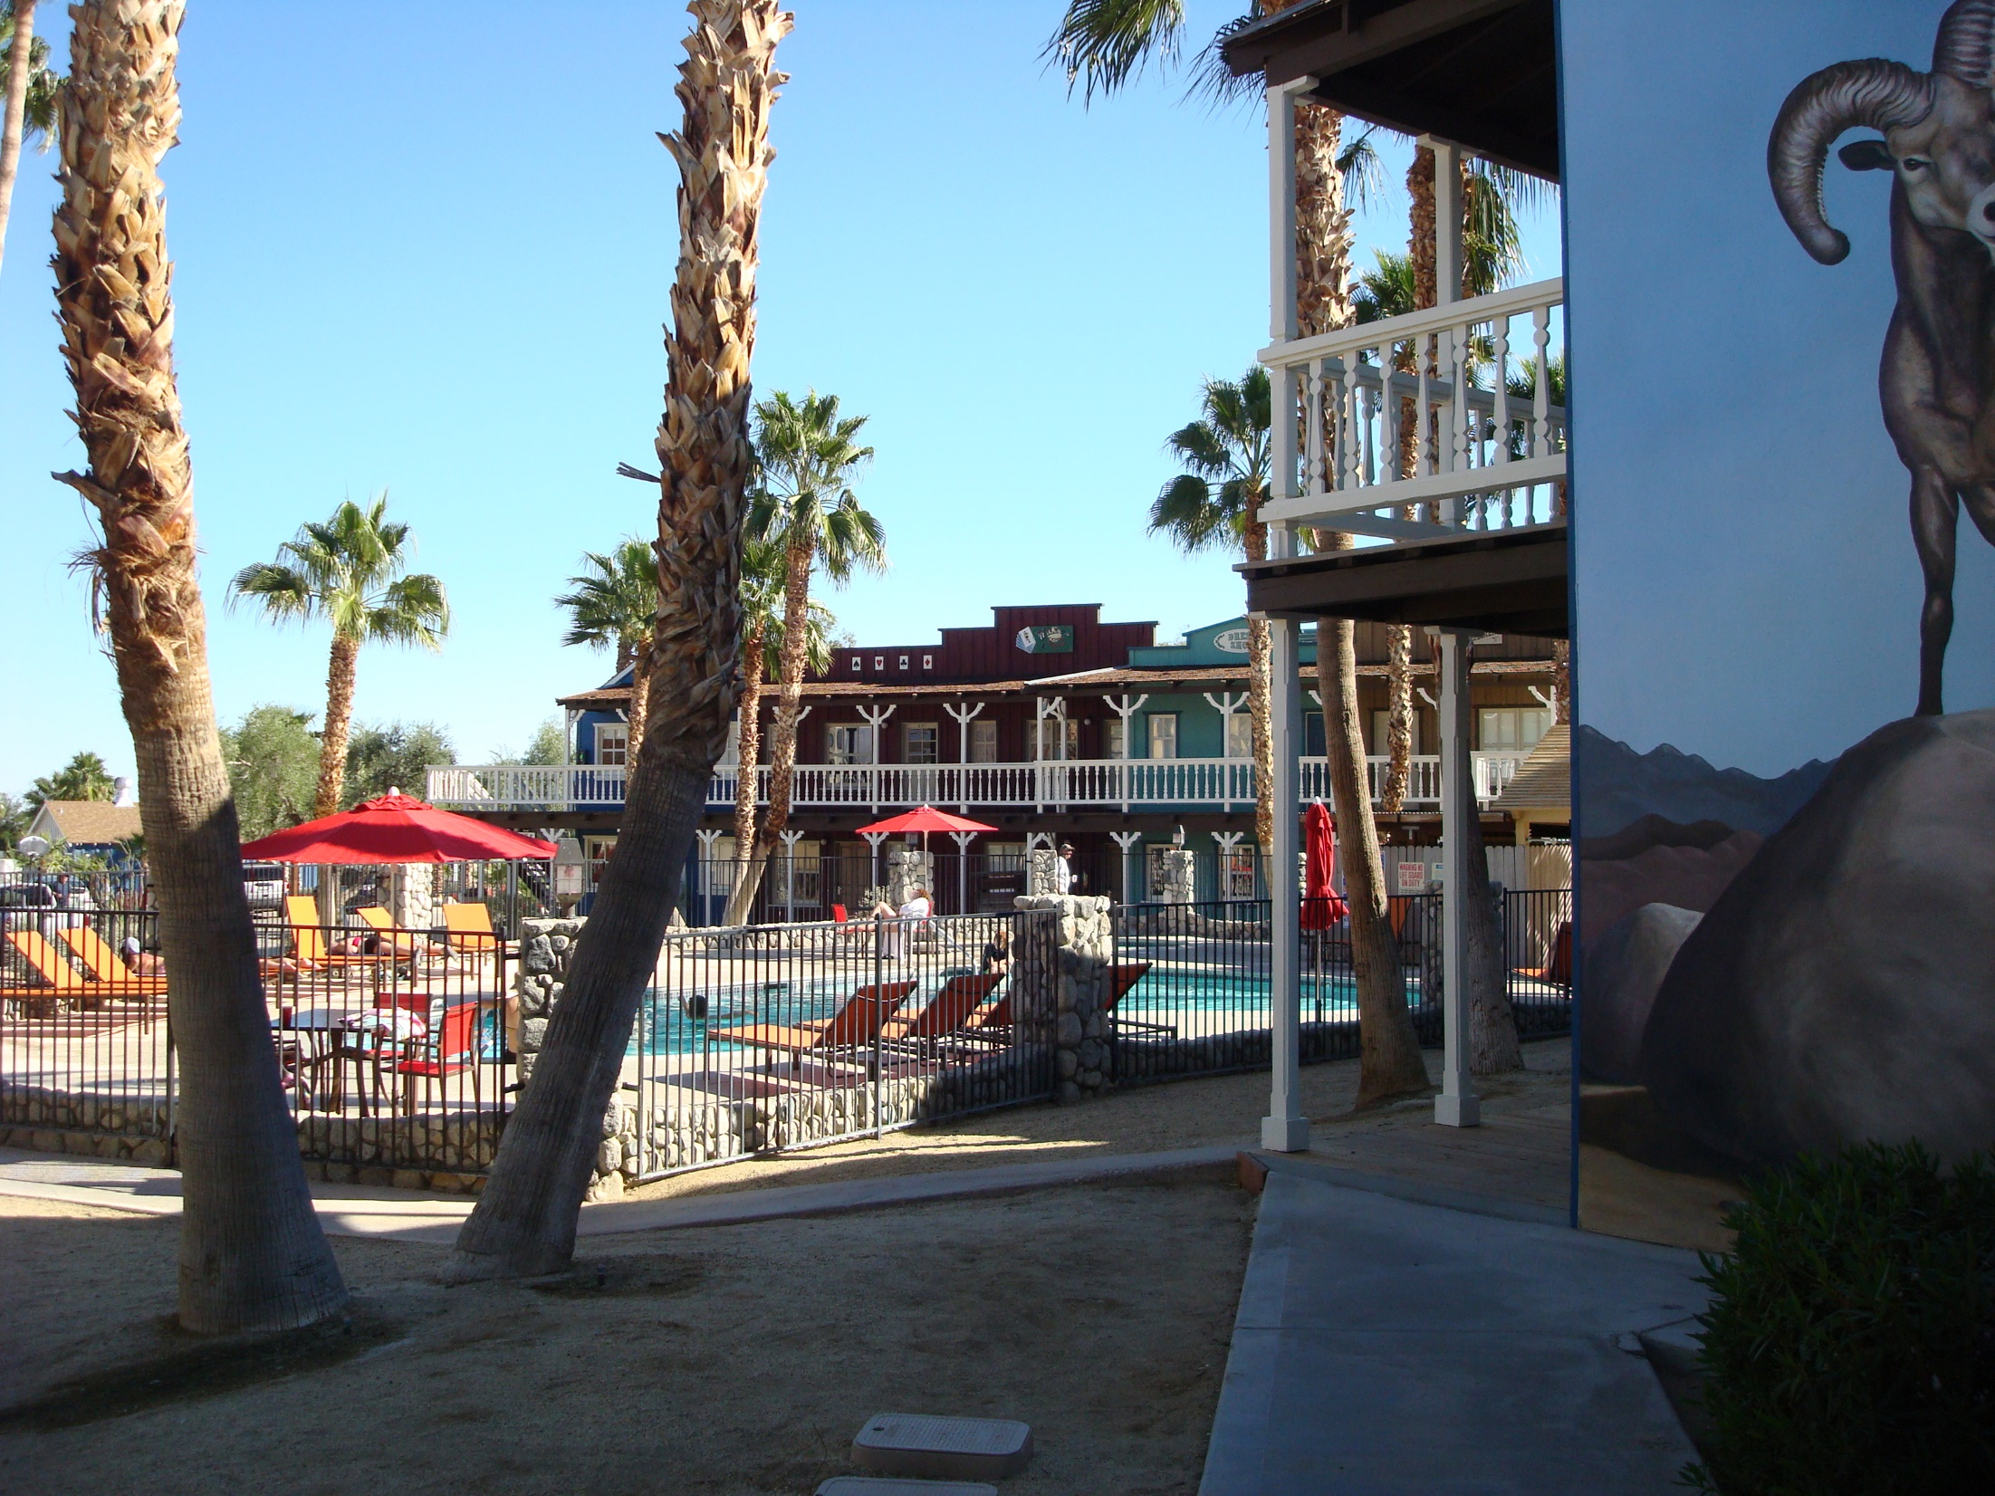

Slide 19
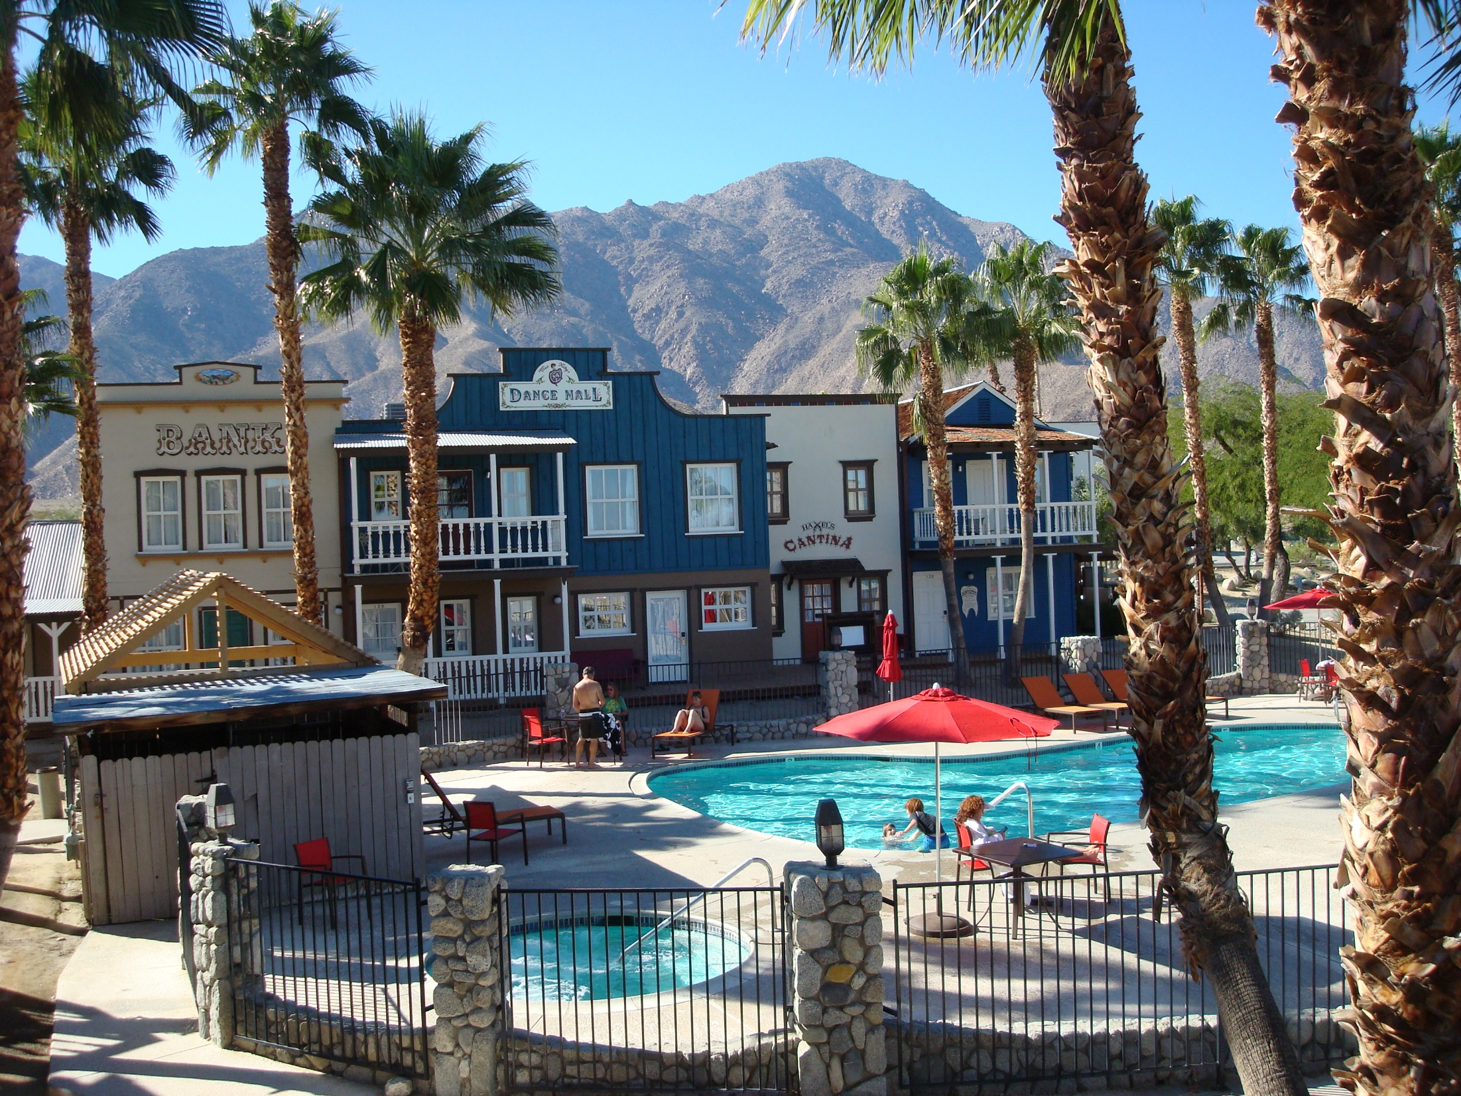

Slide 20
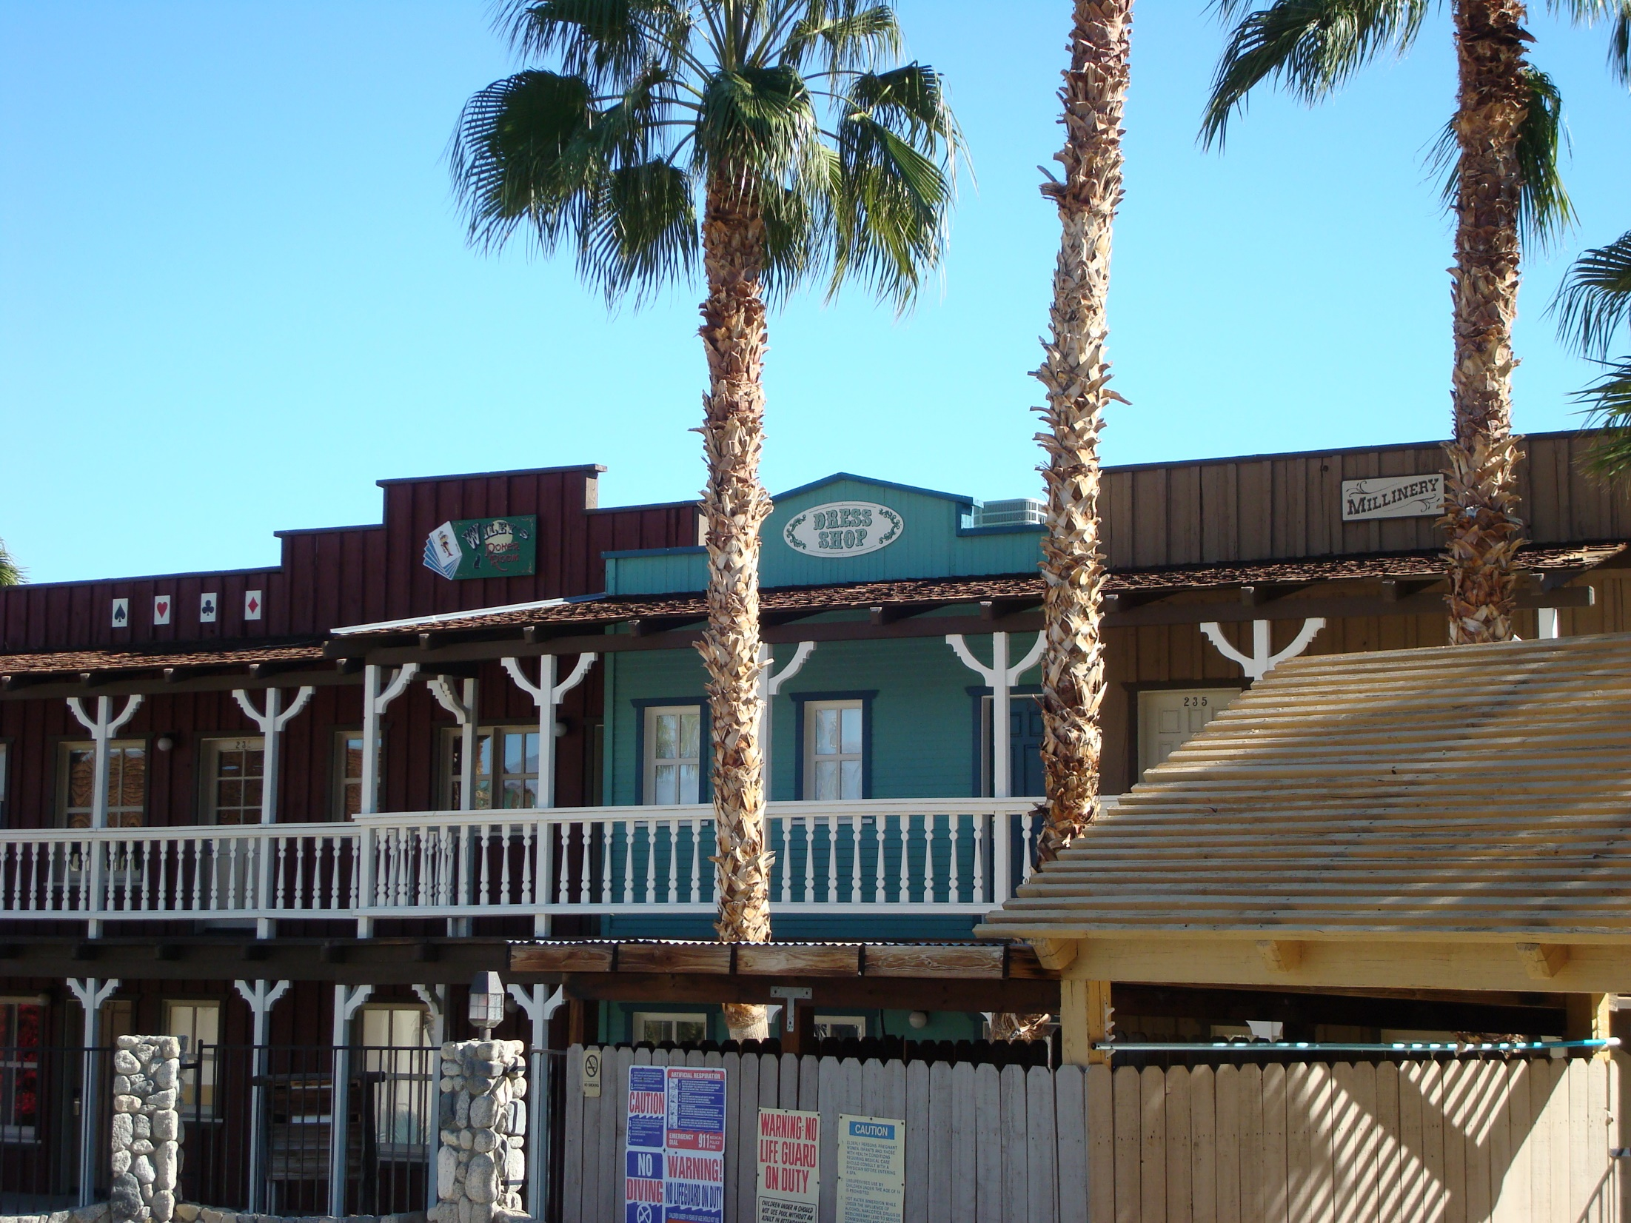

Slide 21
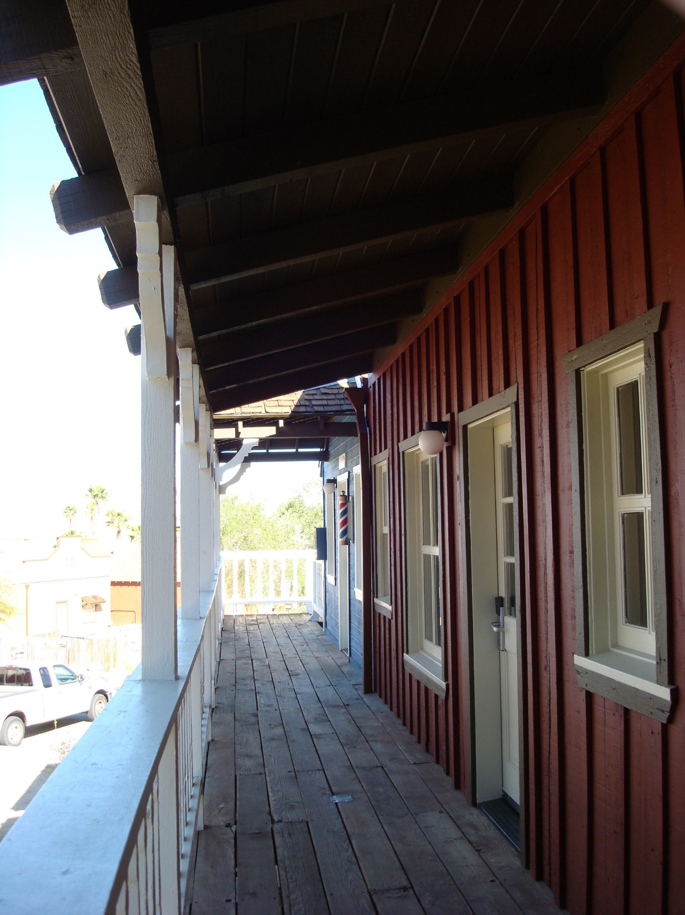

Slide 22
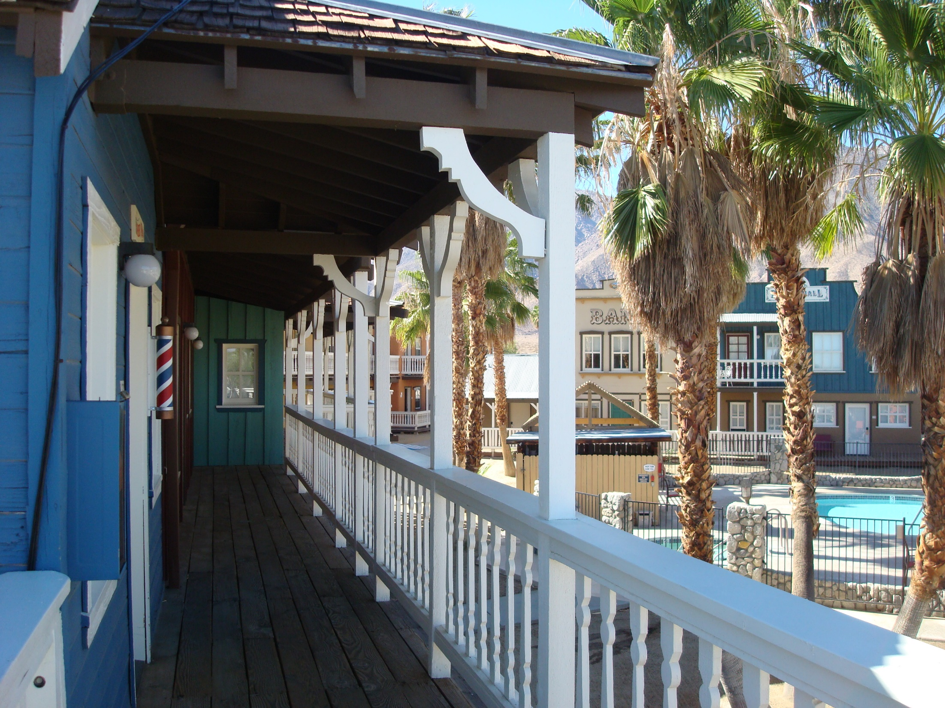

Slide 23
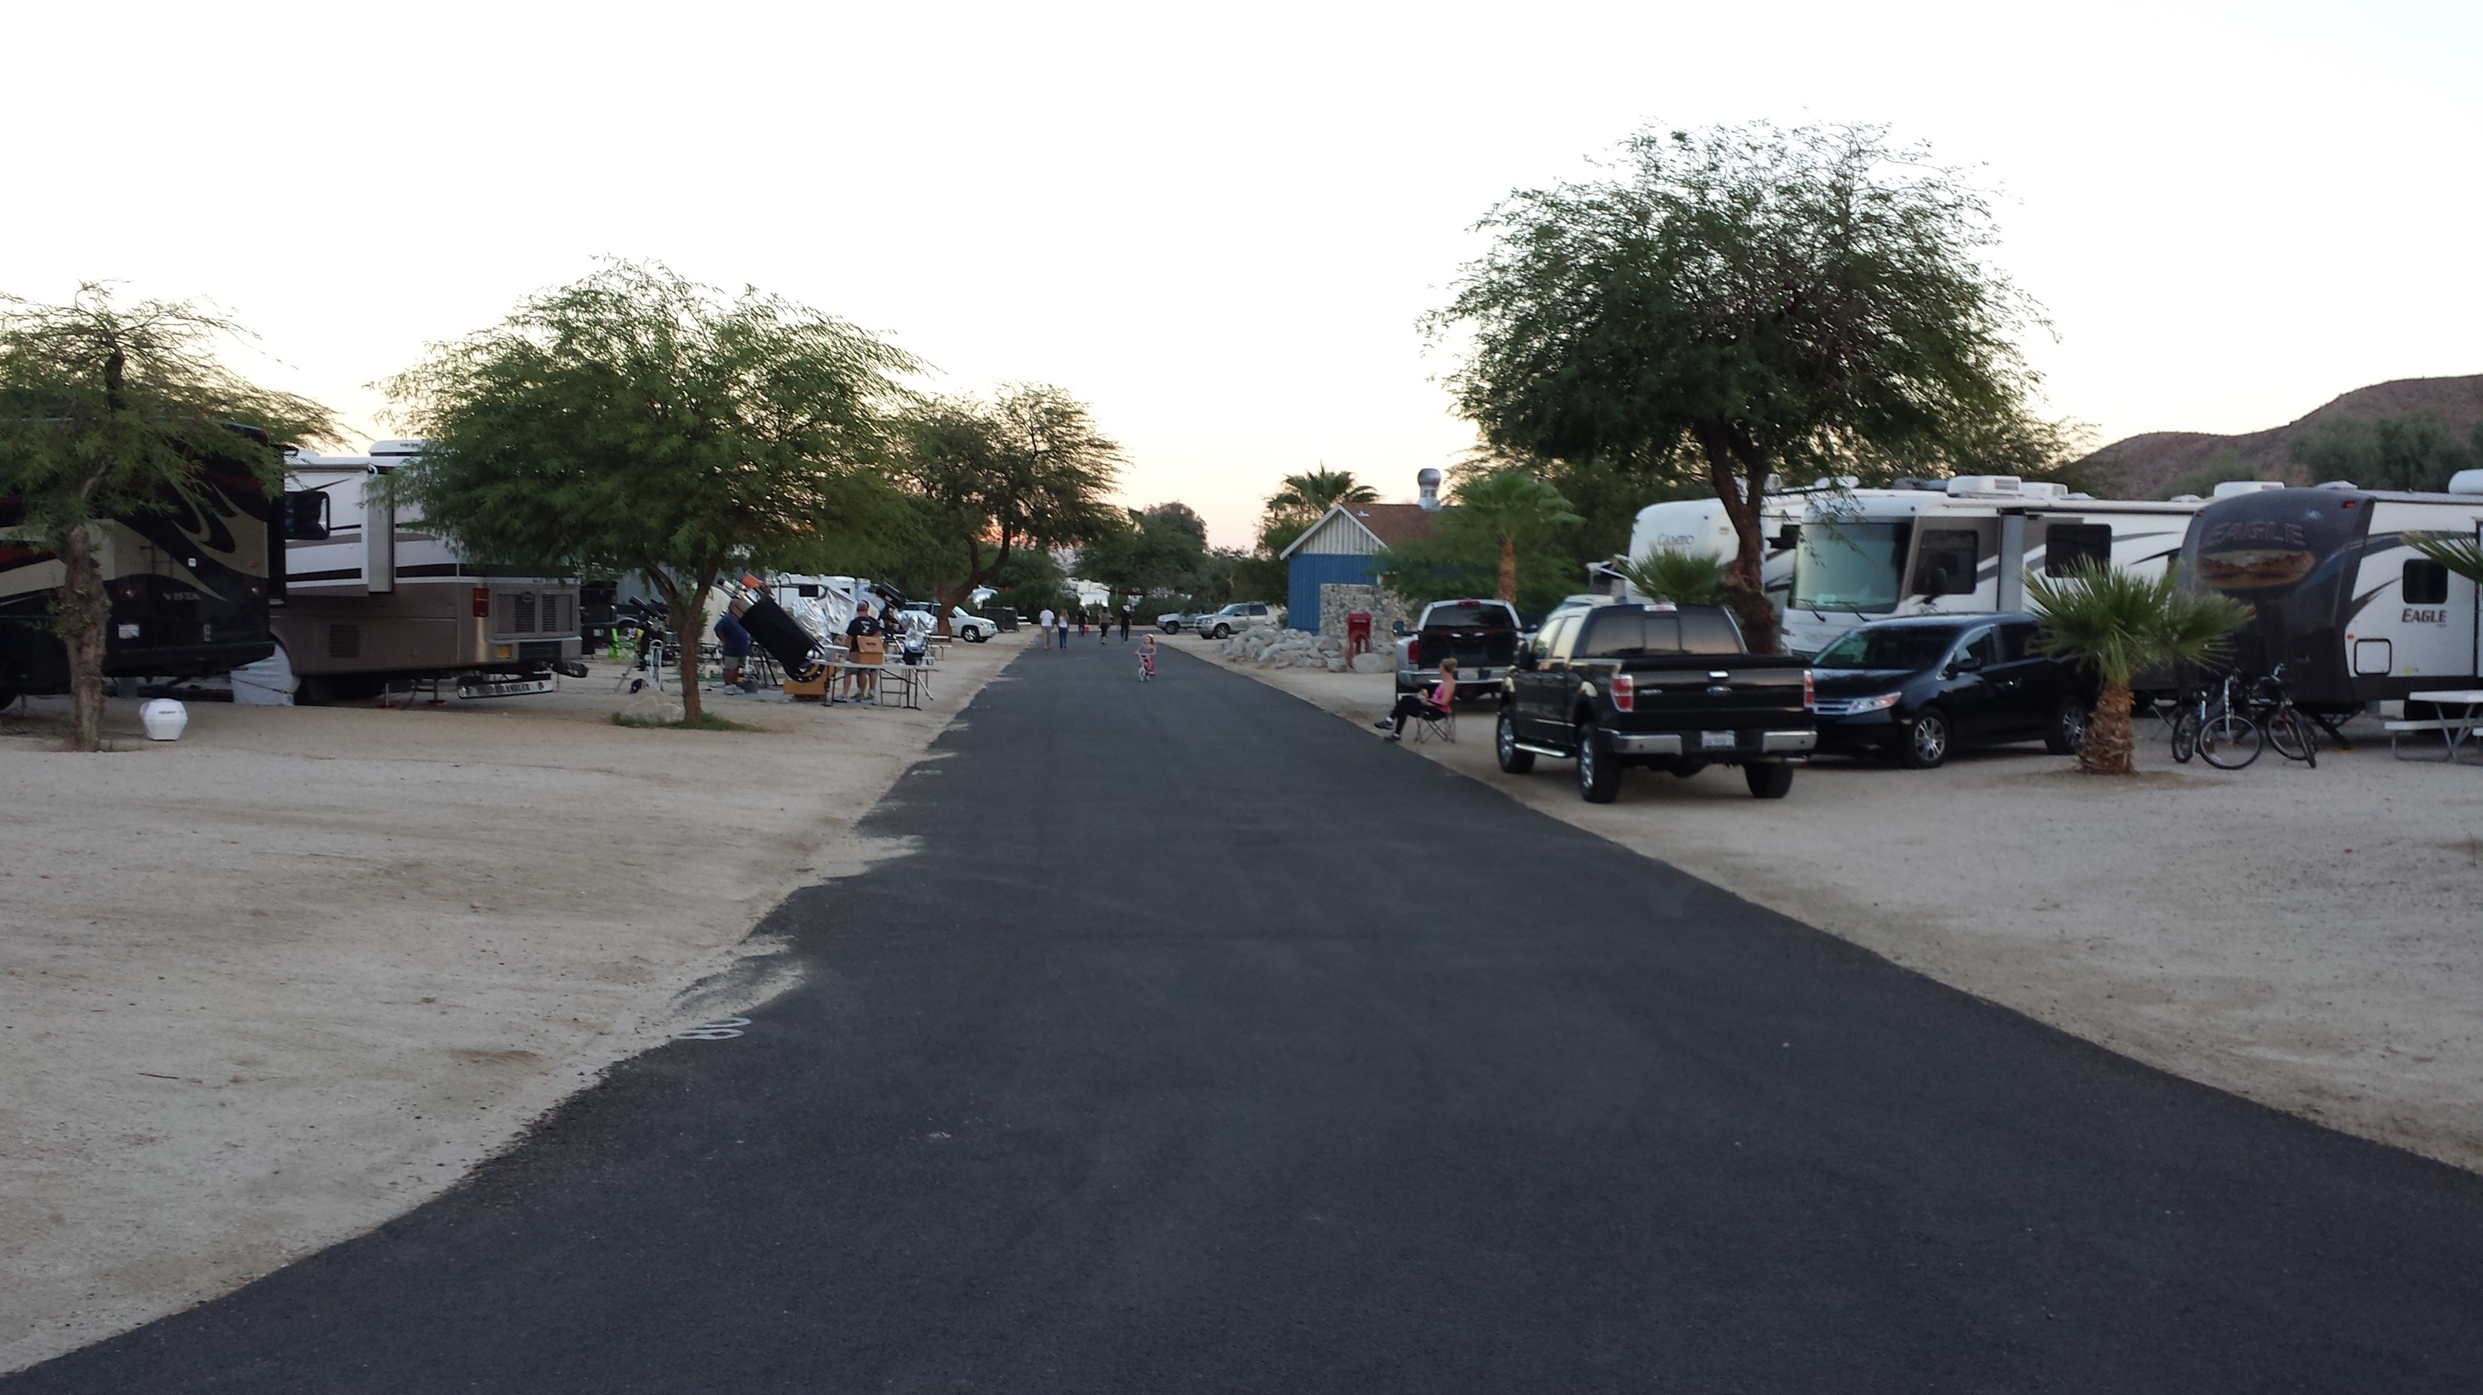

Slide 24
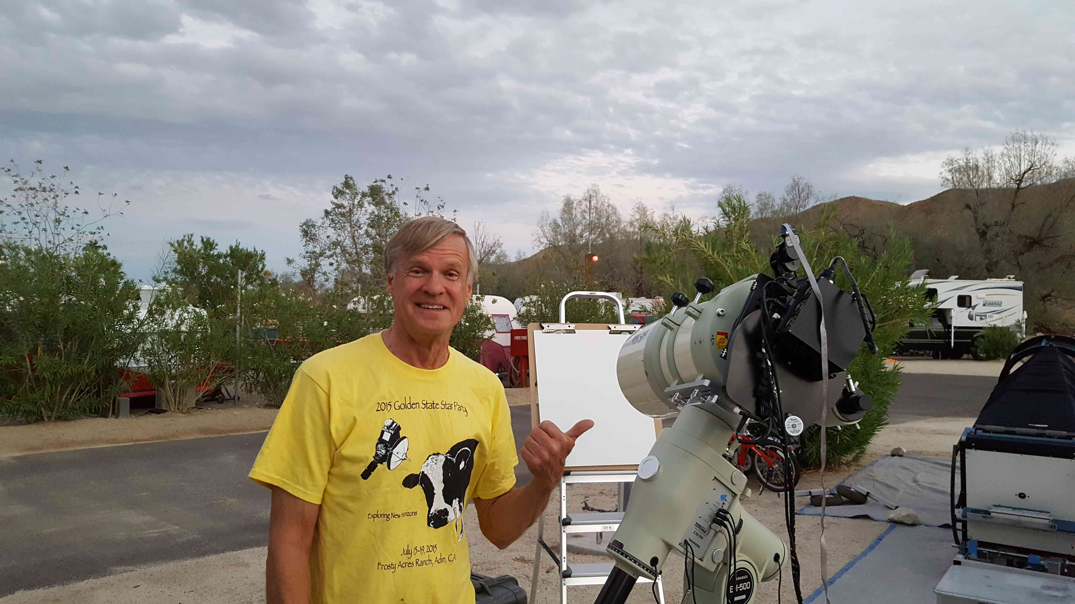

Slide 25
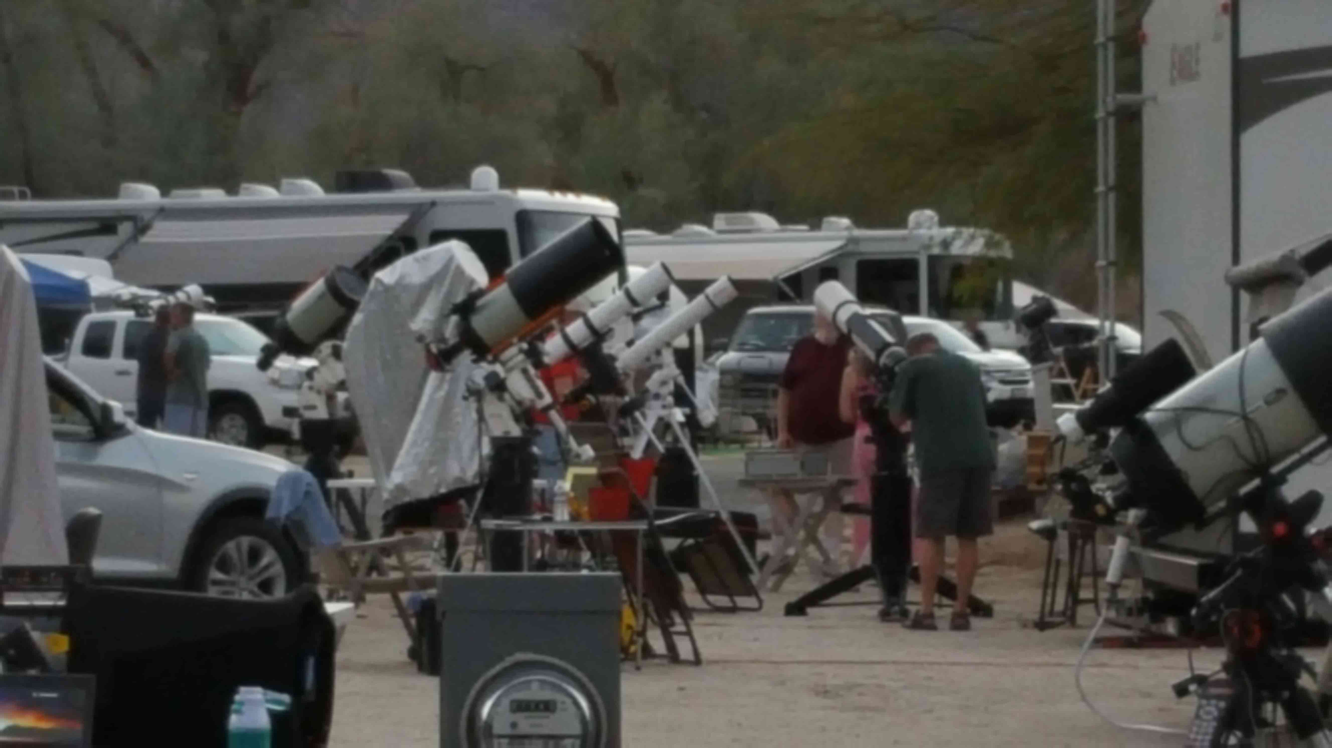

Slide 26
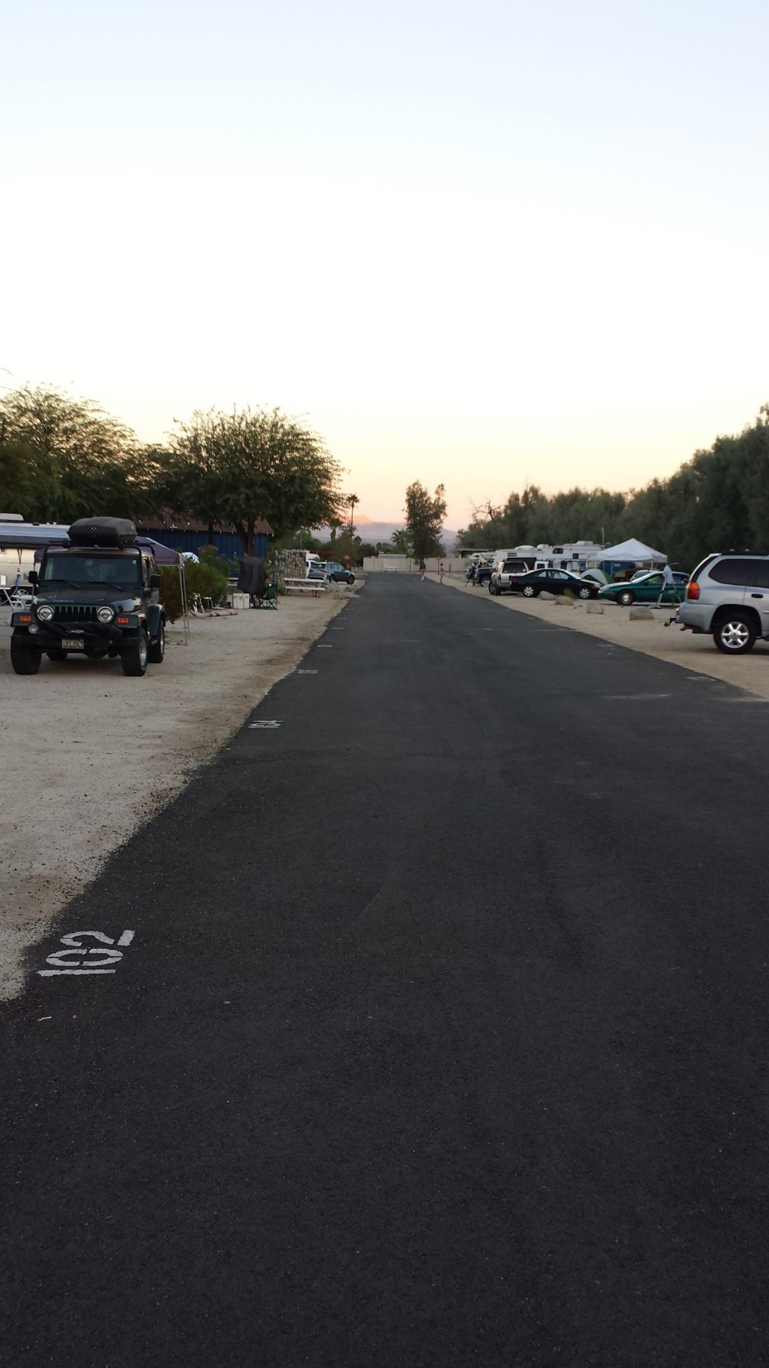
Looking East

Slide 27
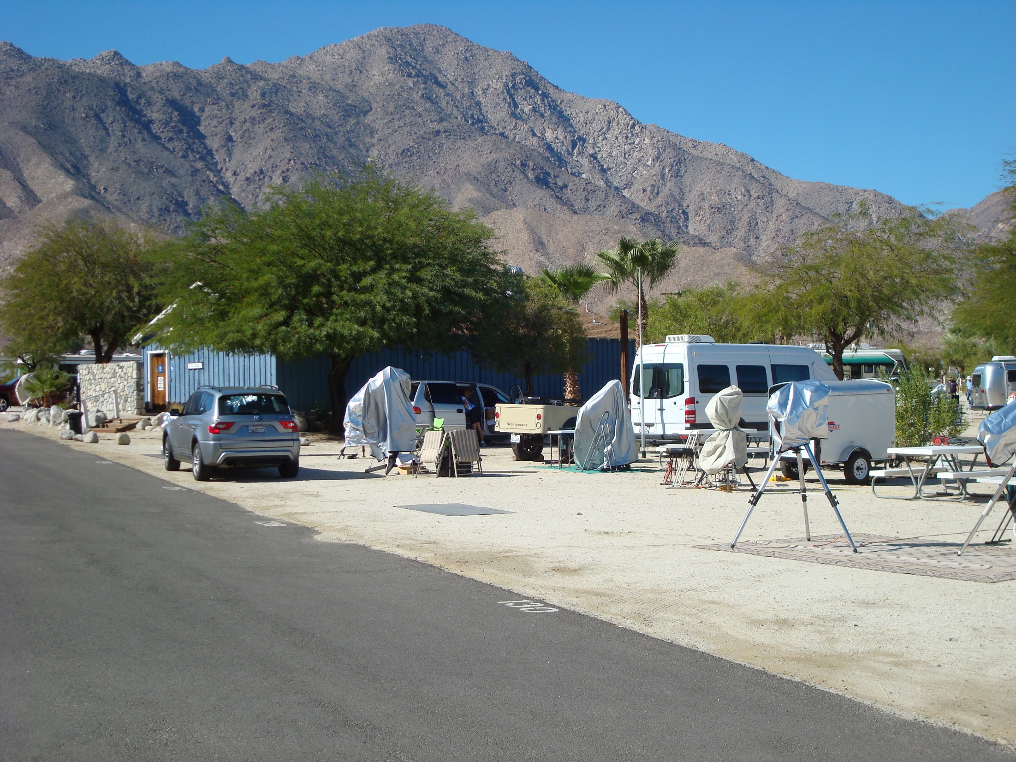

Slide 28
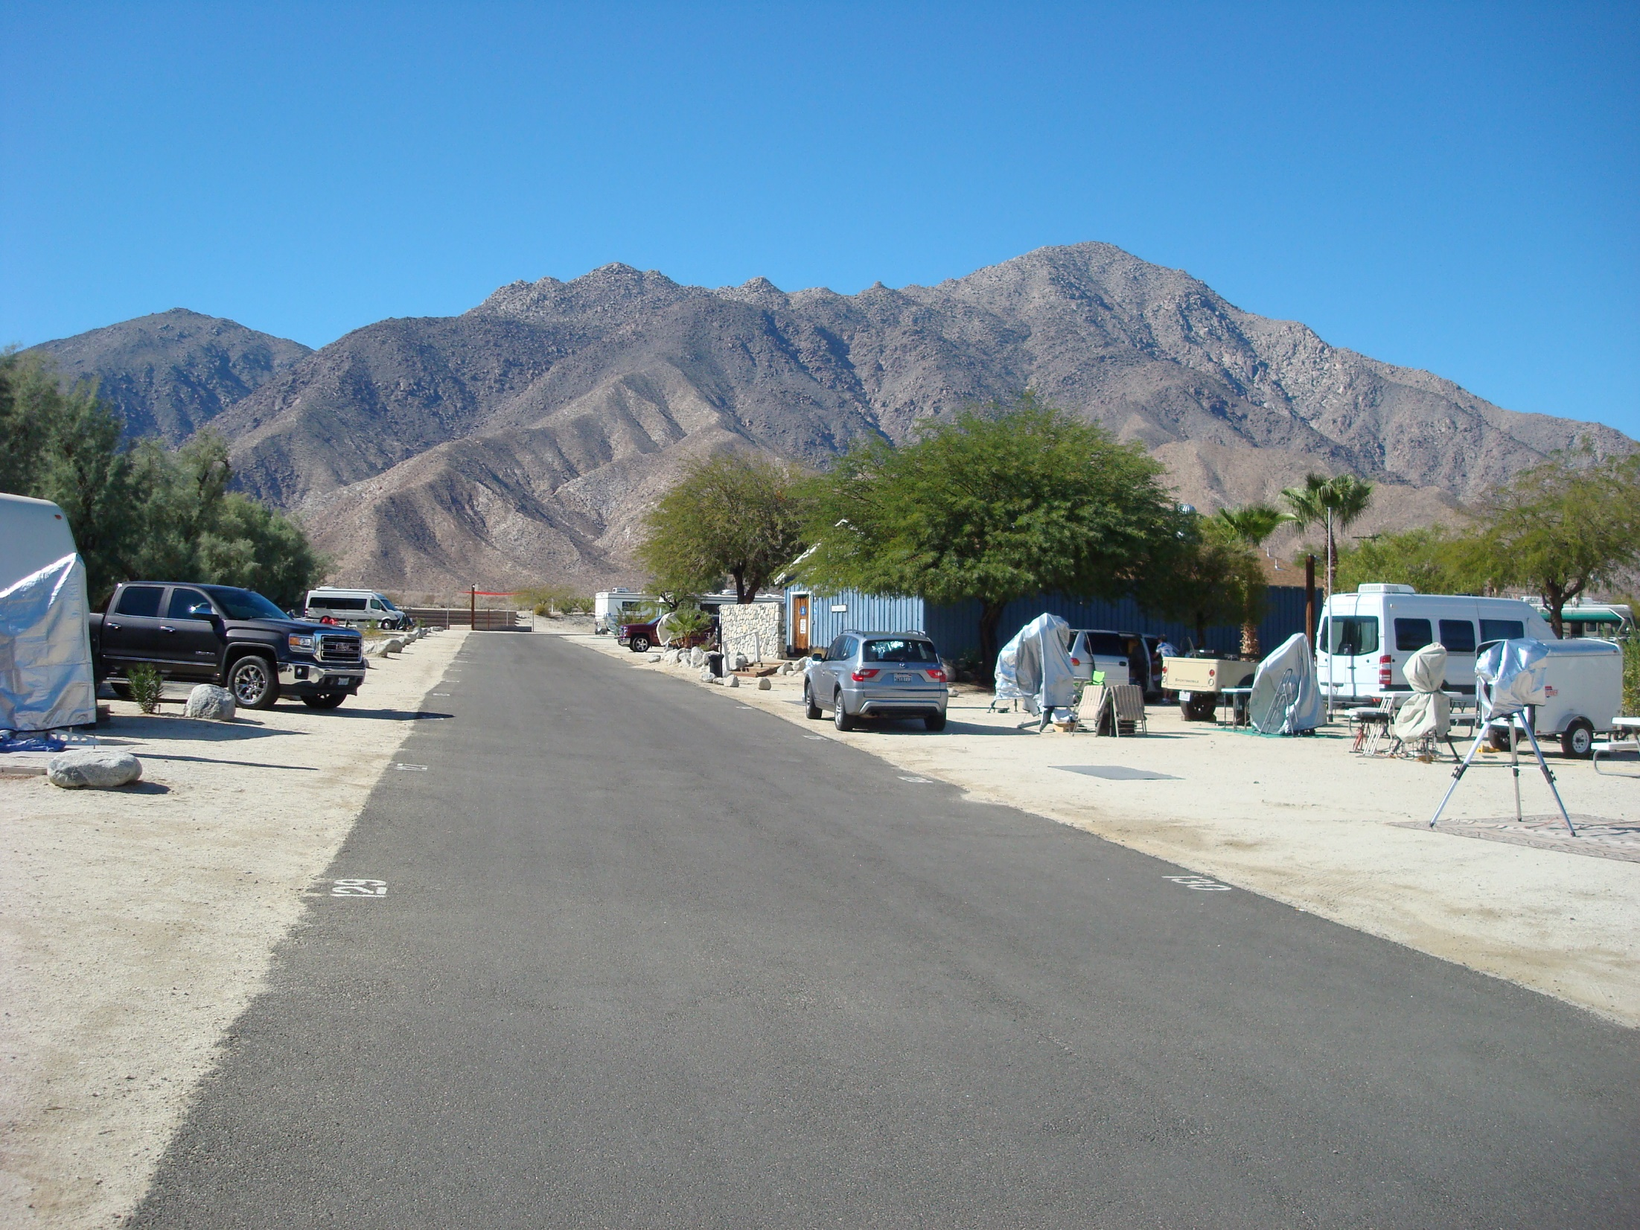
Looking West

Slide 29
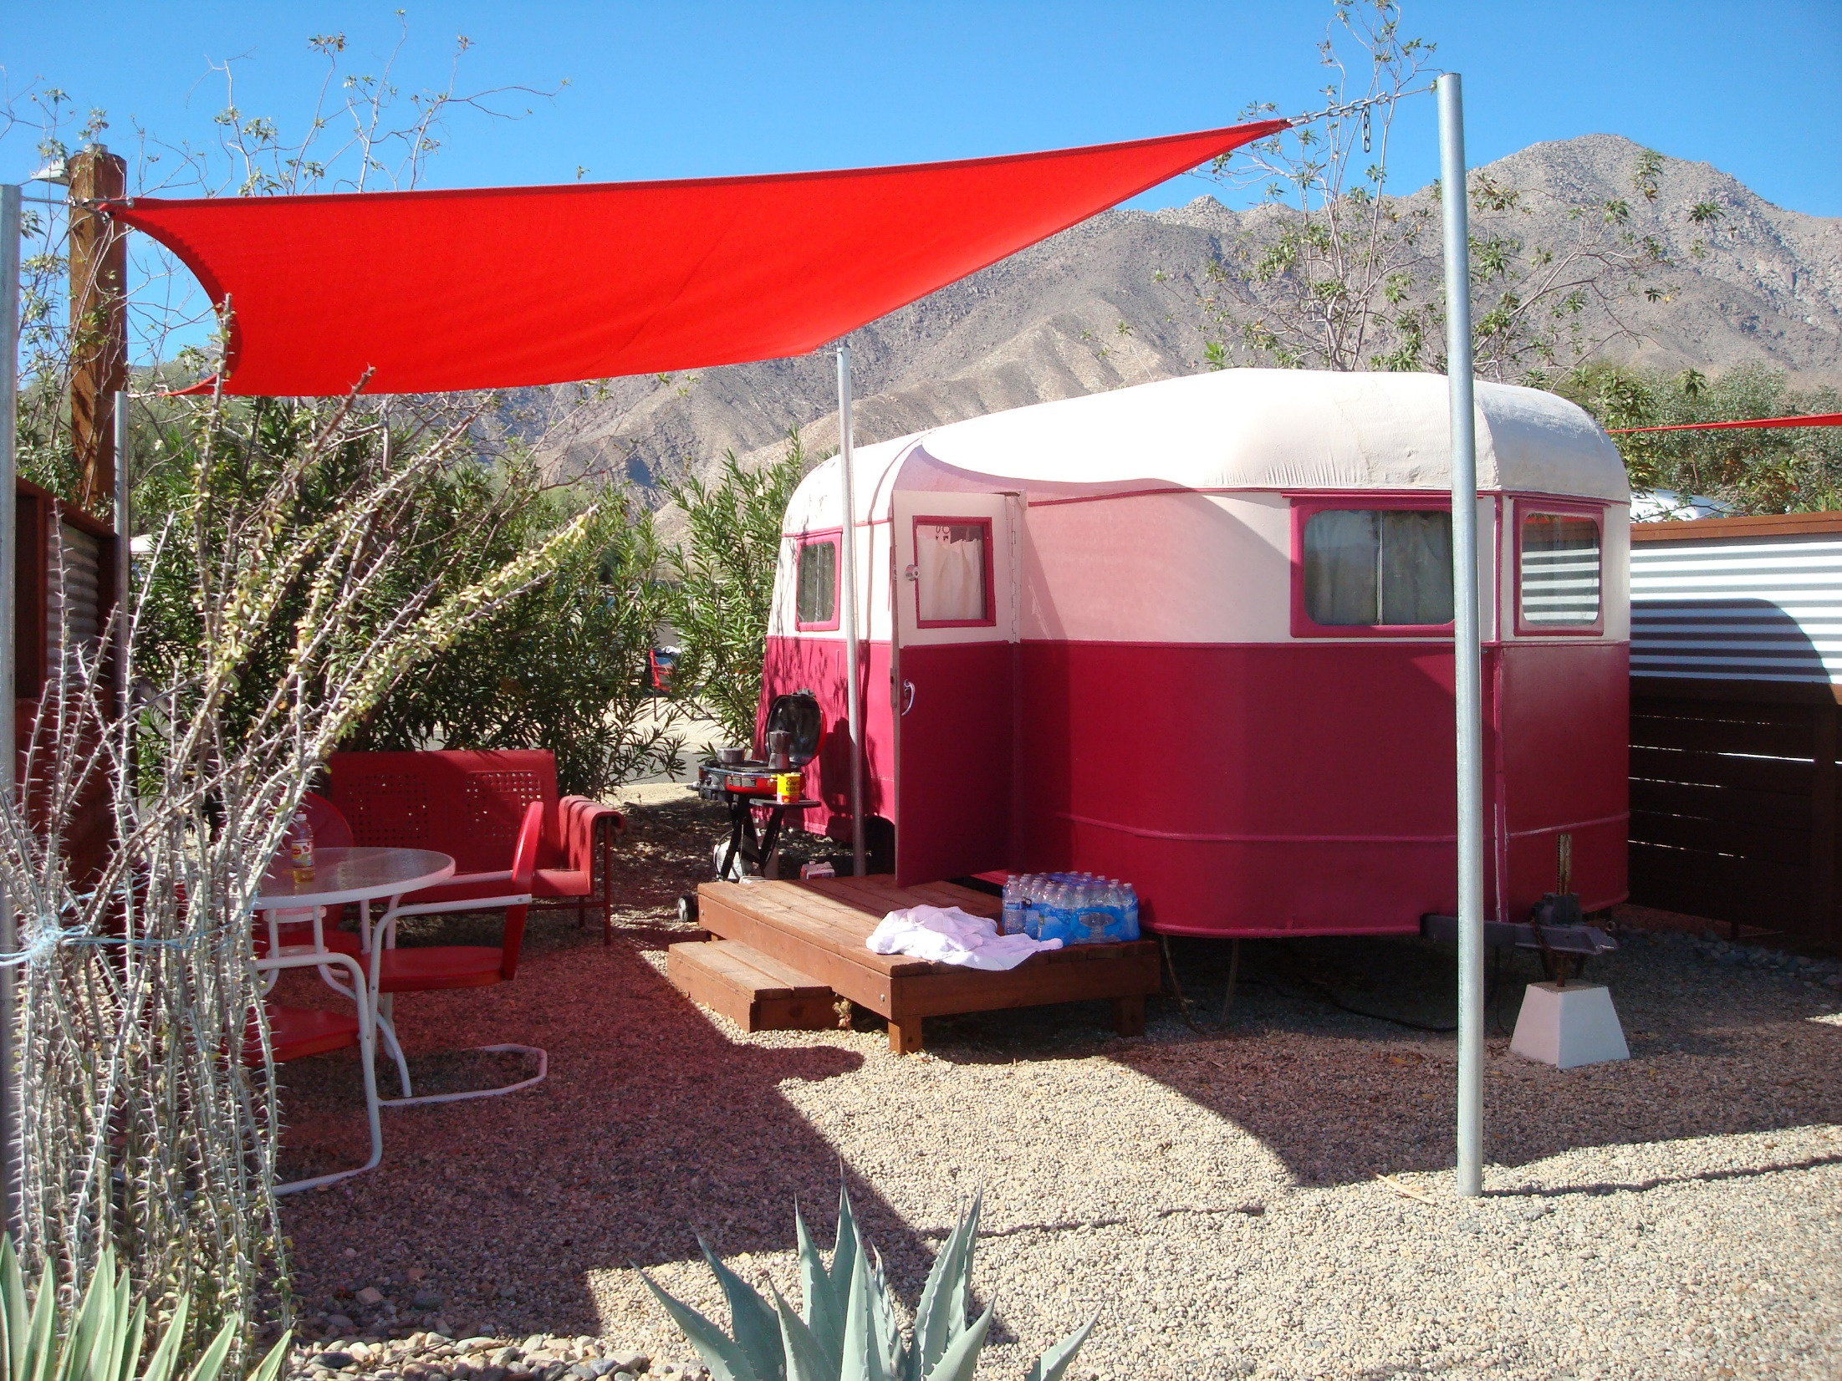

Slide 30
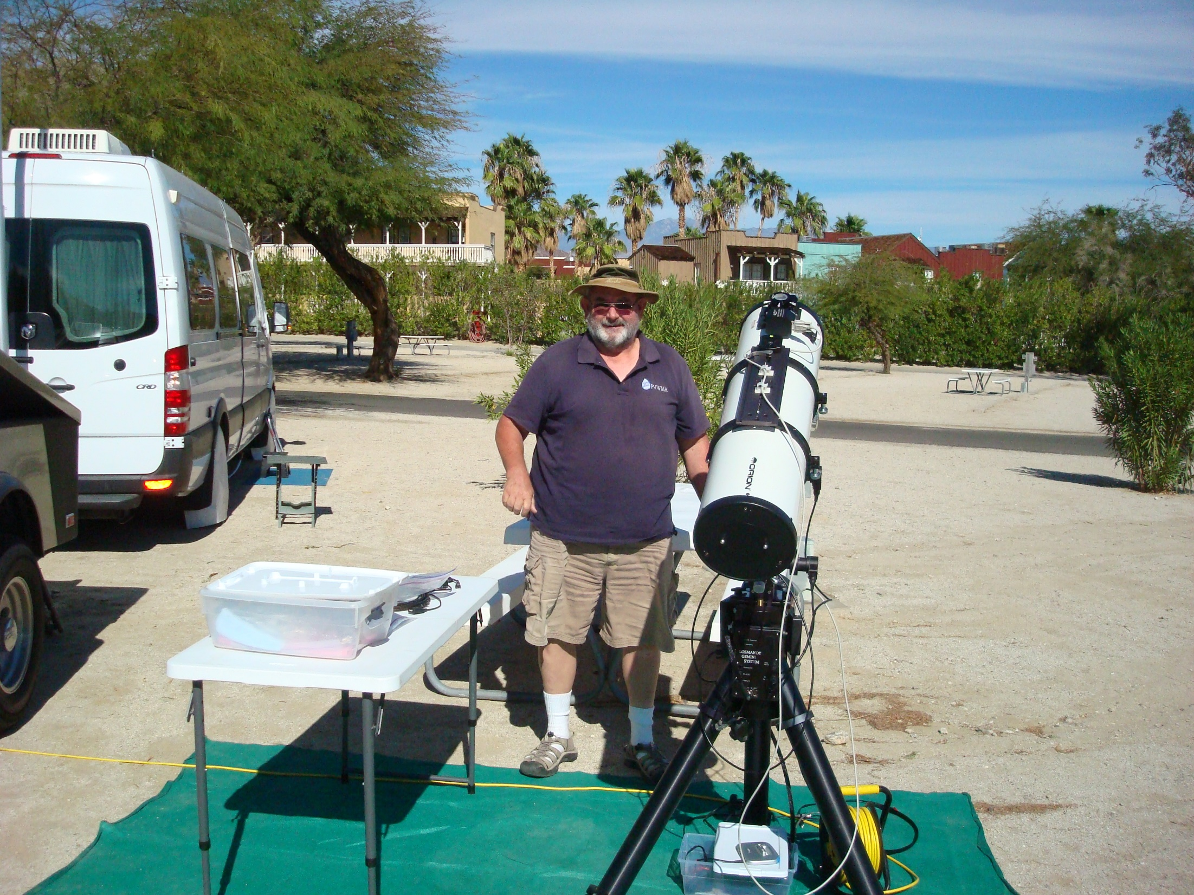
Looking North

Slide 31
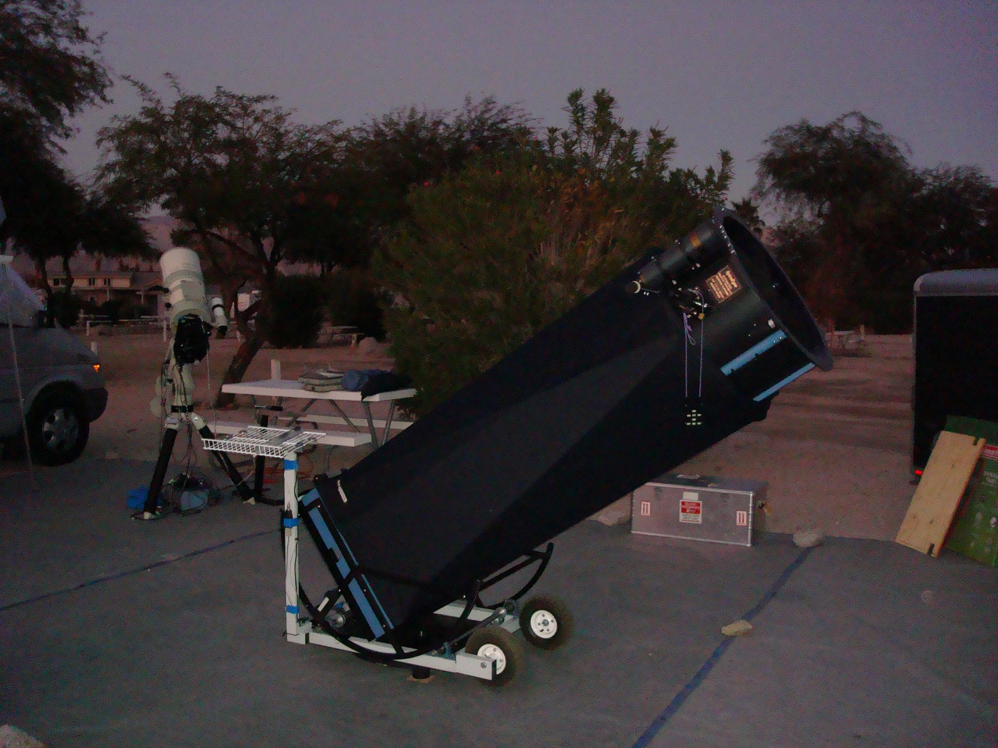

Slide 32
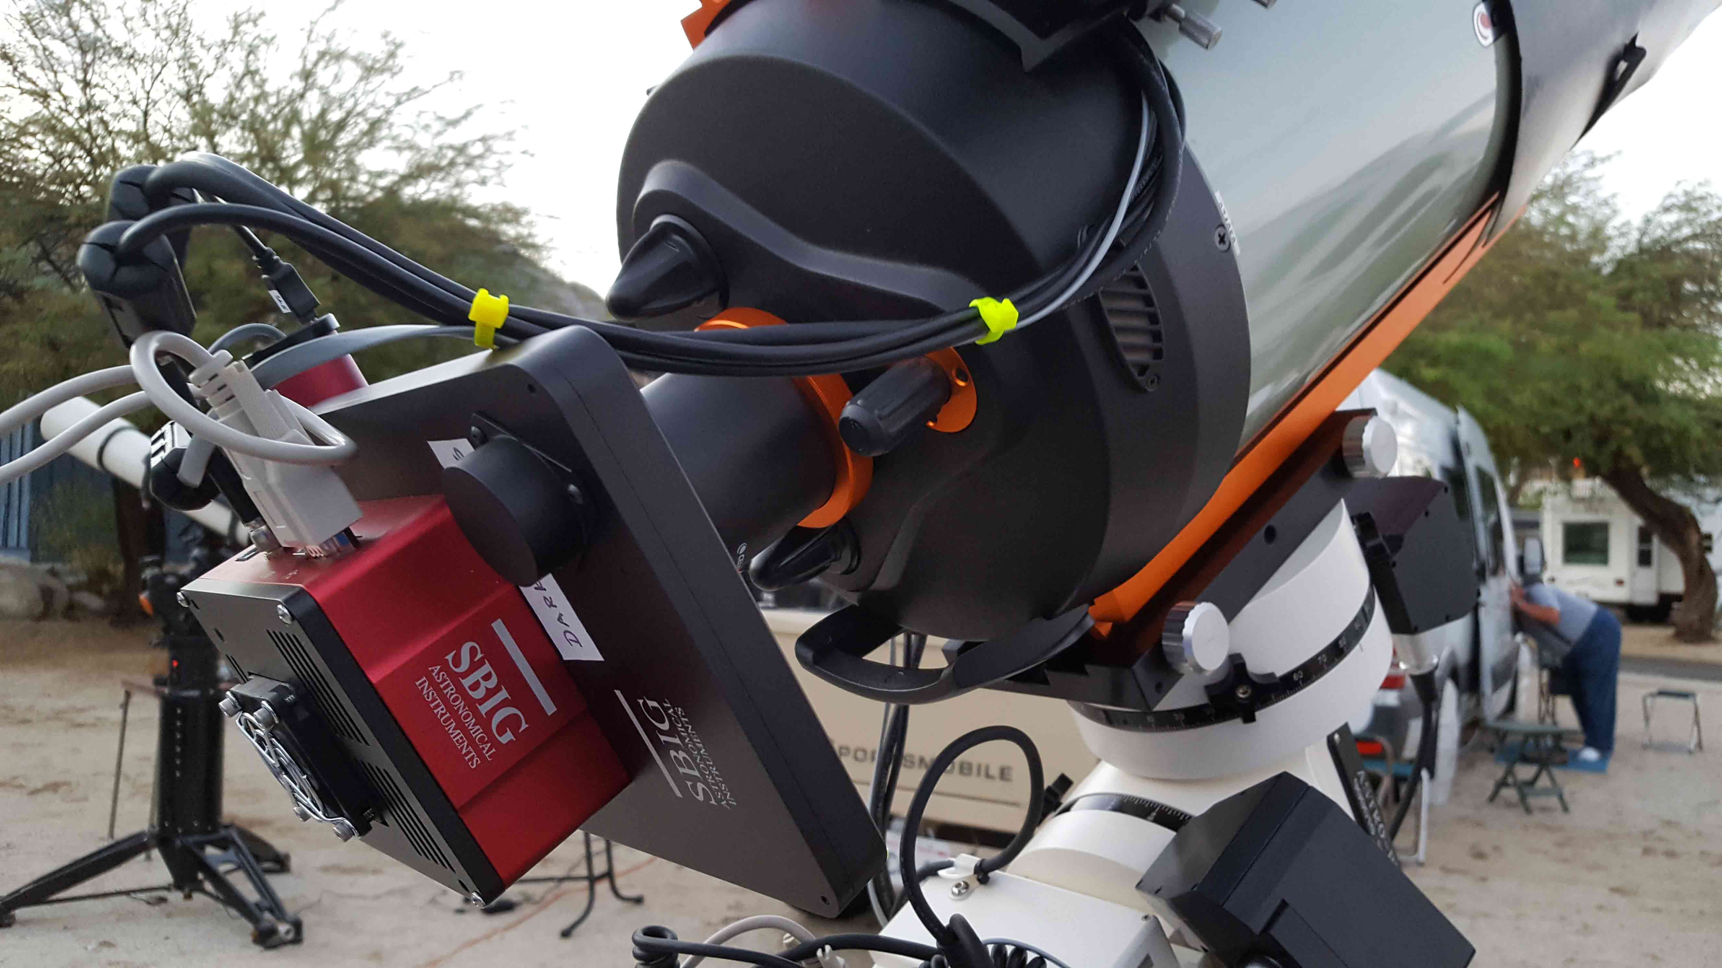

Slide 33
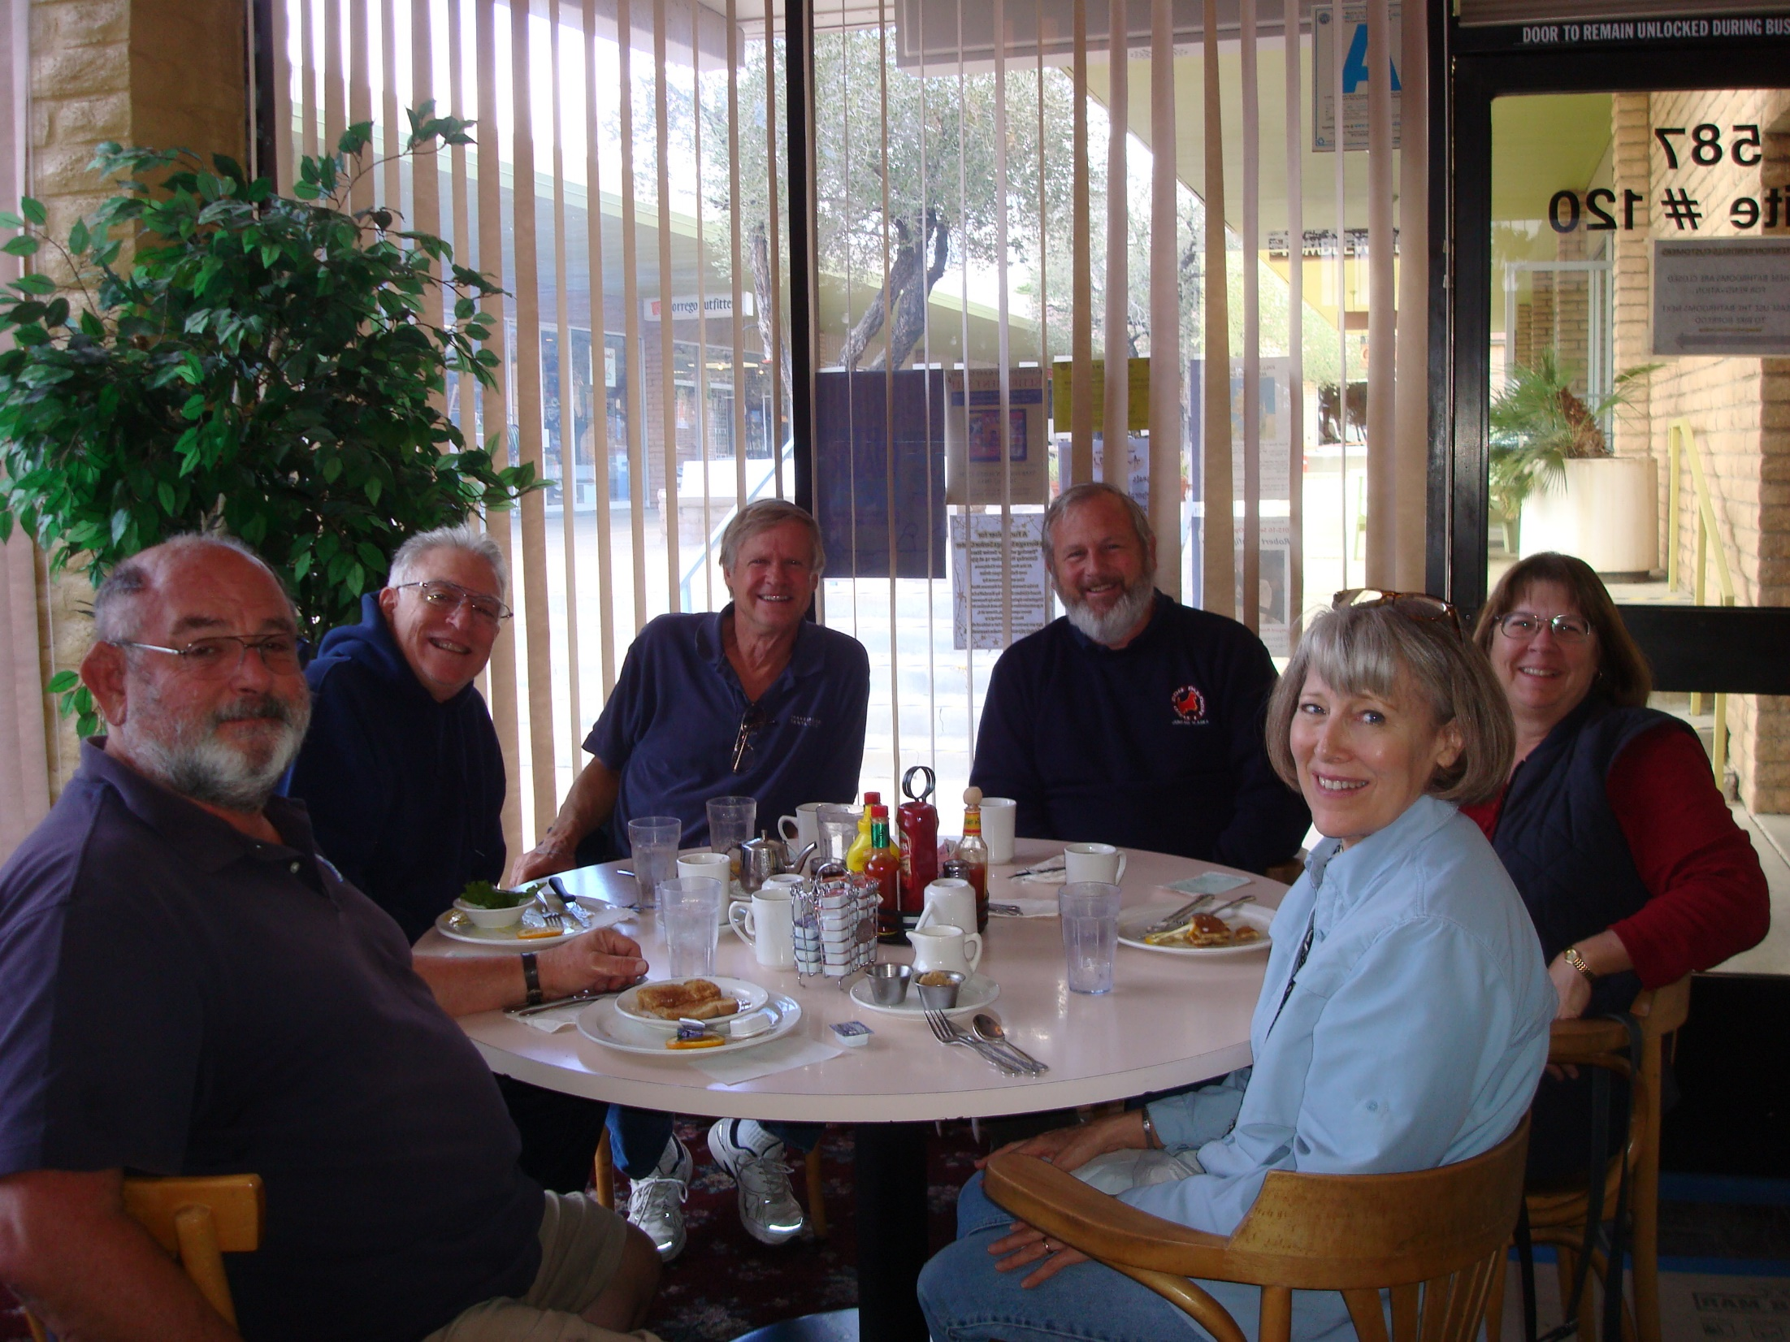
Breakfast at
Kendall’s

Slide 34
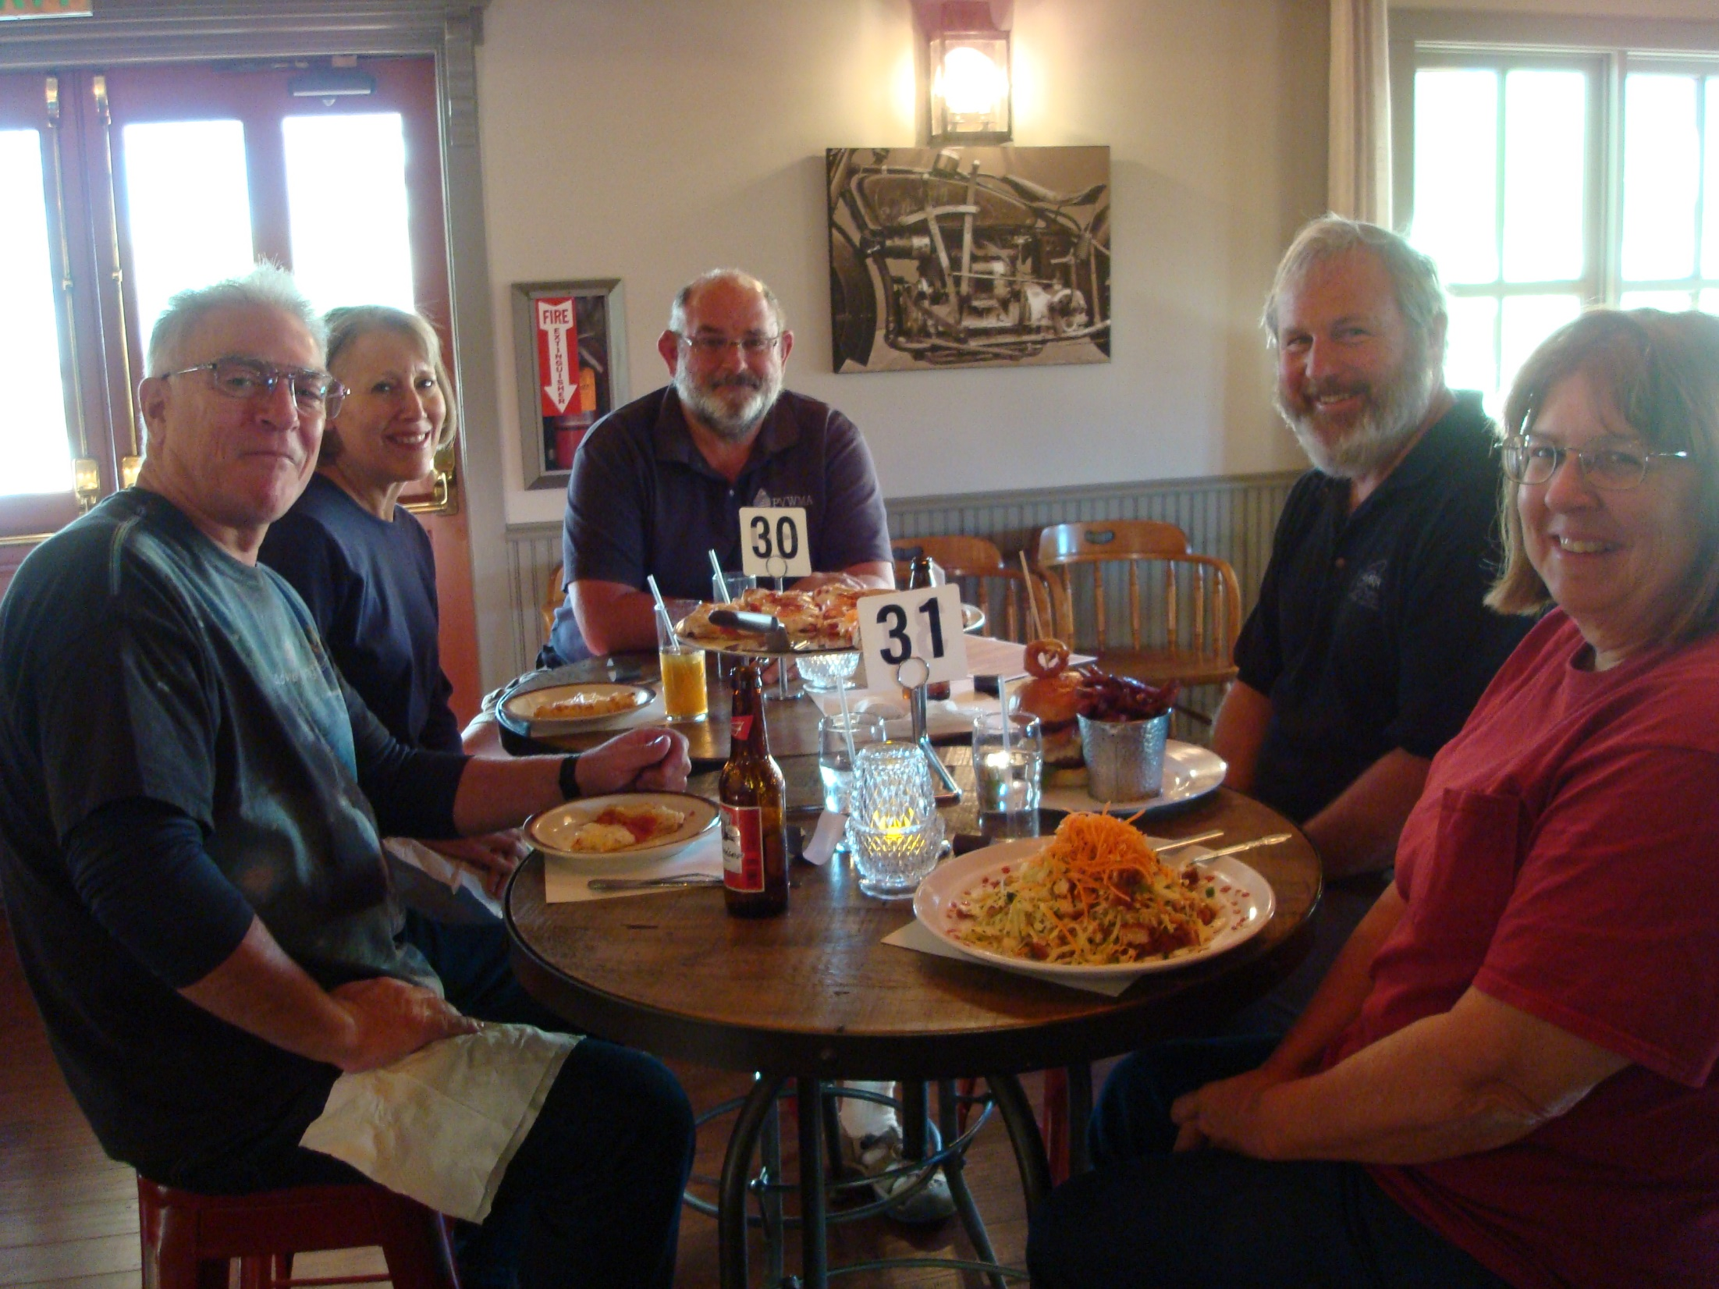
Big Horn Restaurant
and Bar

Slide 35
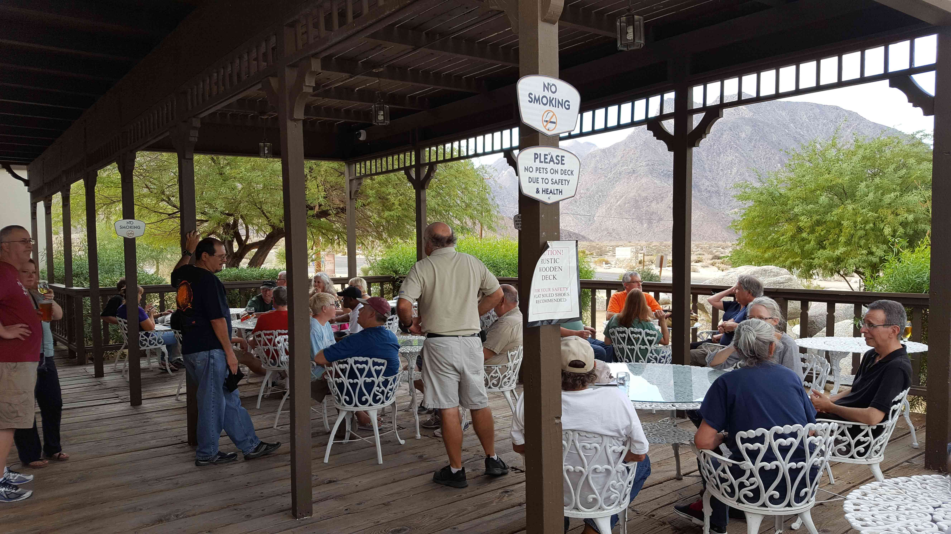

Slide 36
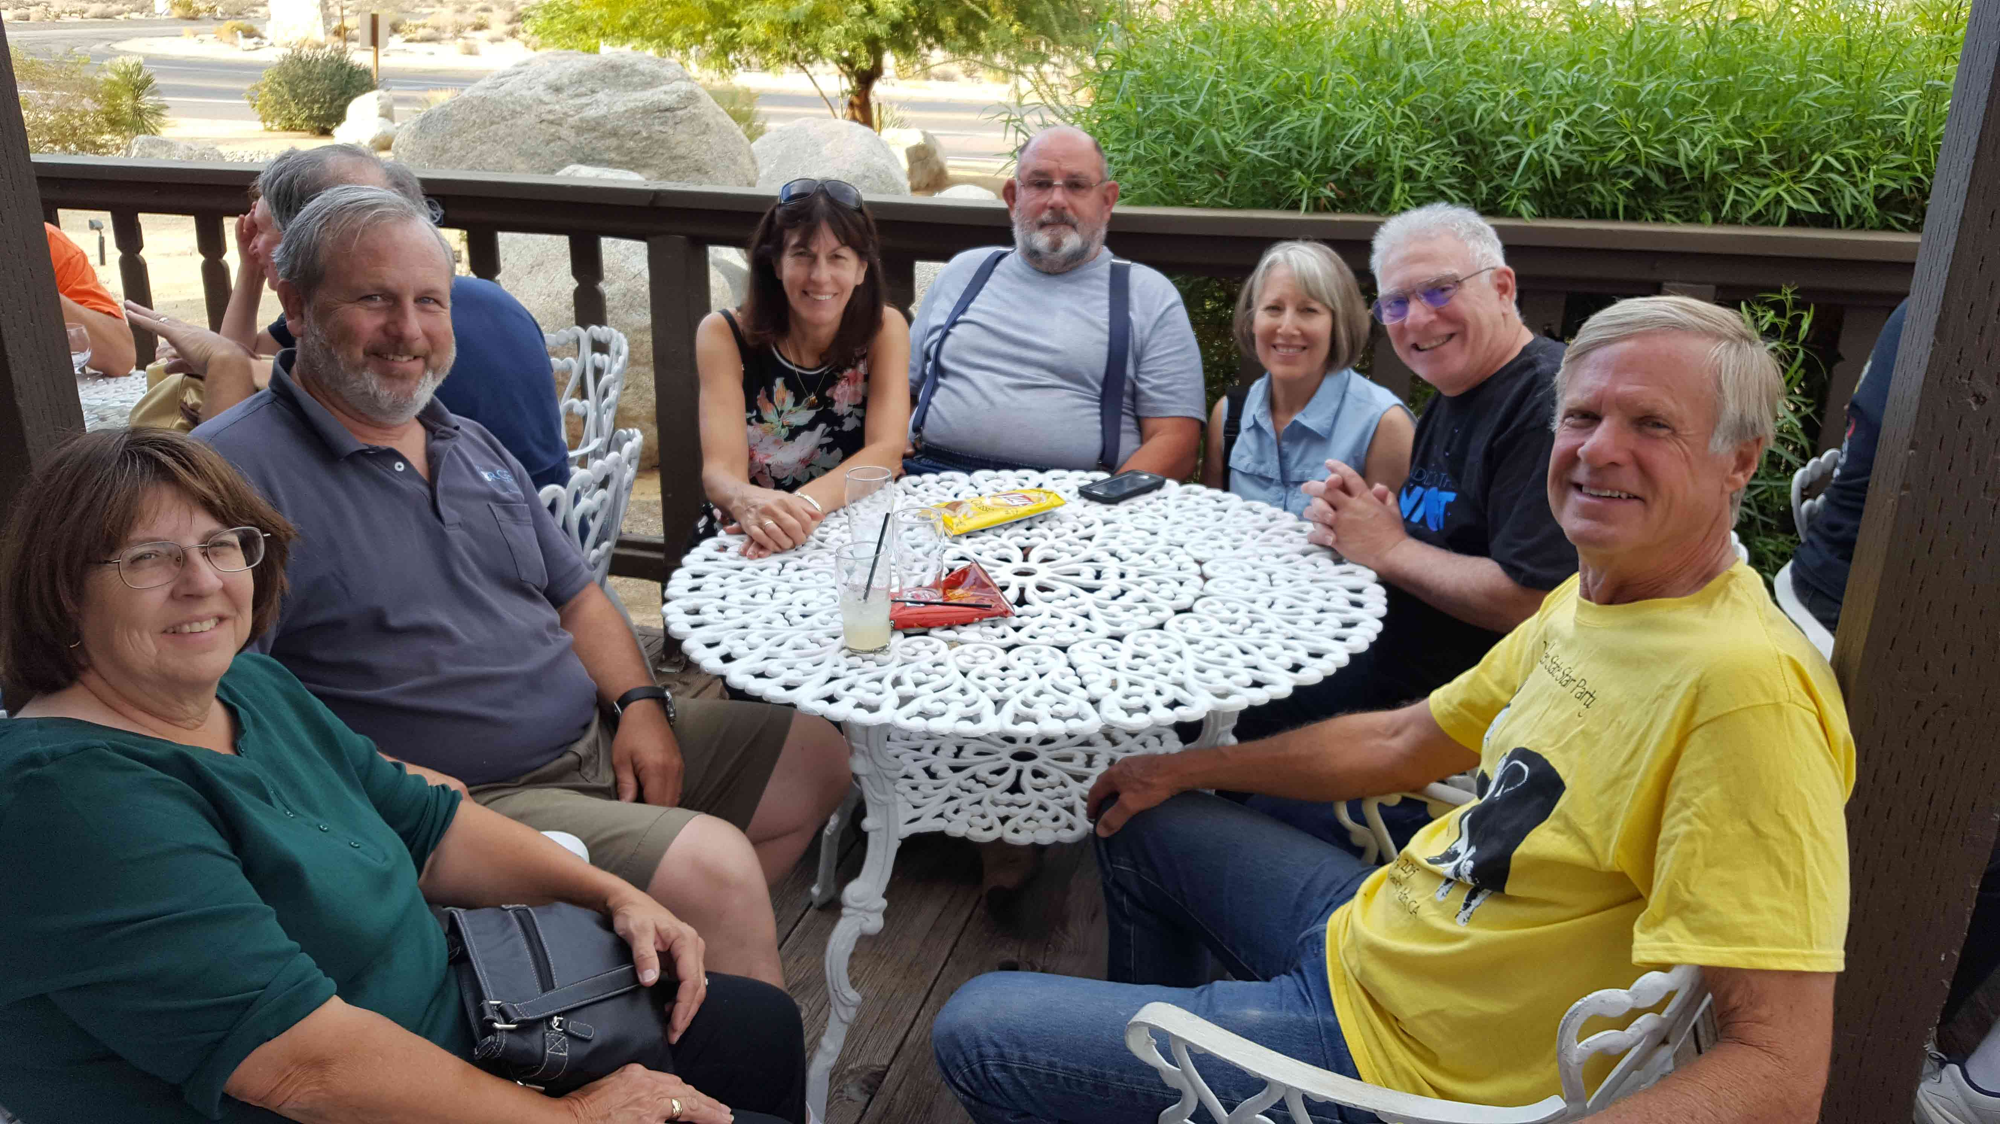

Slide 37
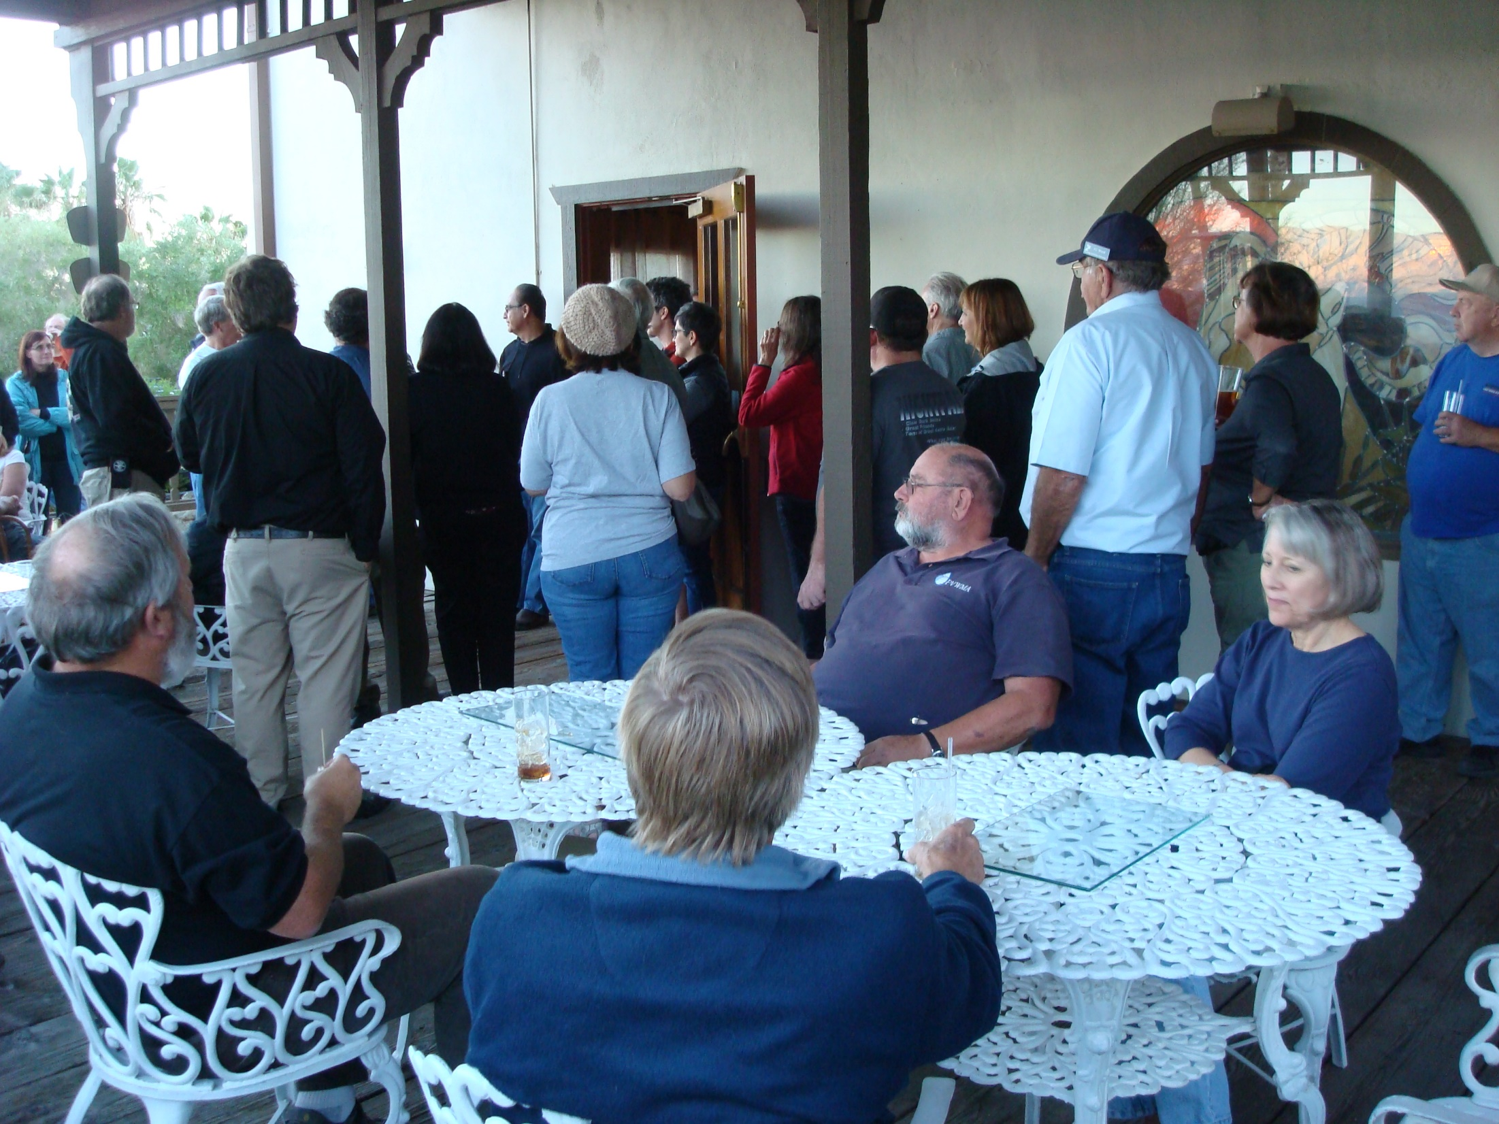

Slide 38
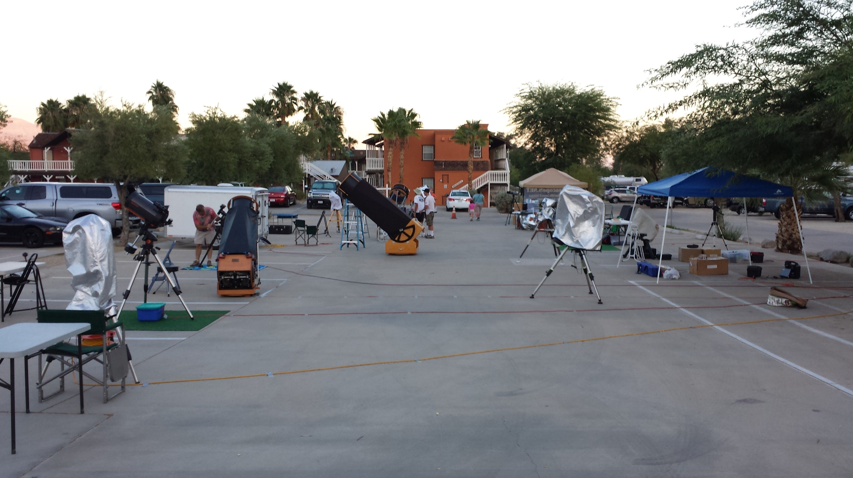

Slide 39
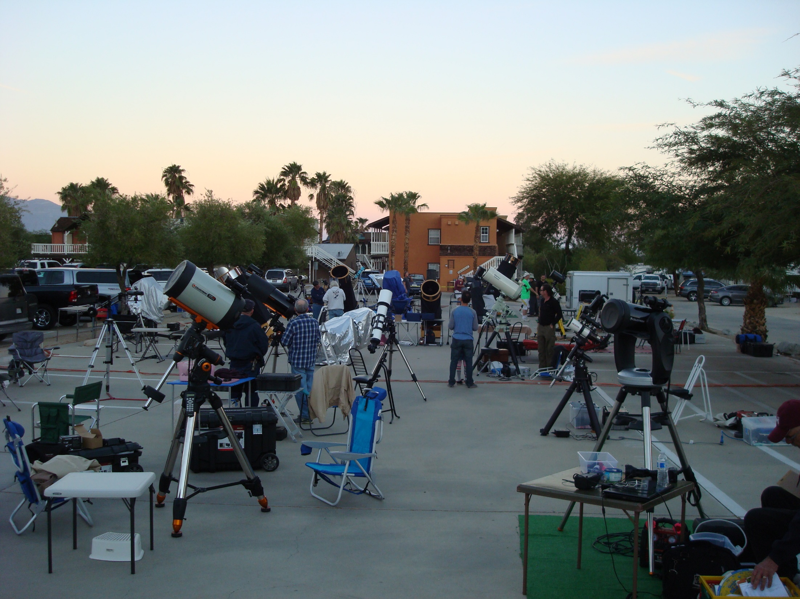

Slide 40
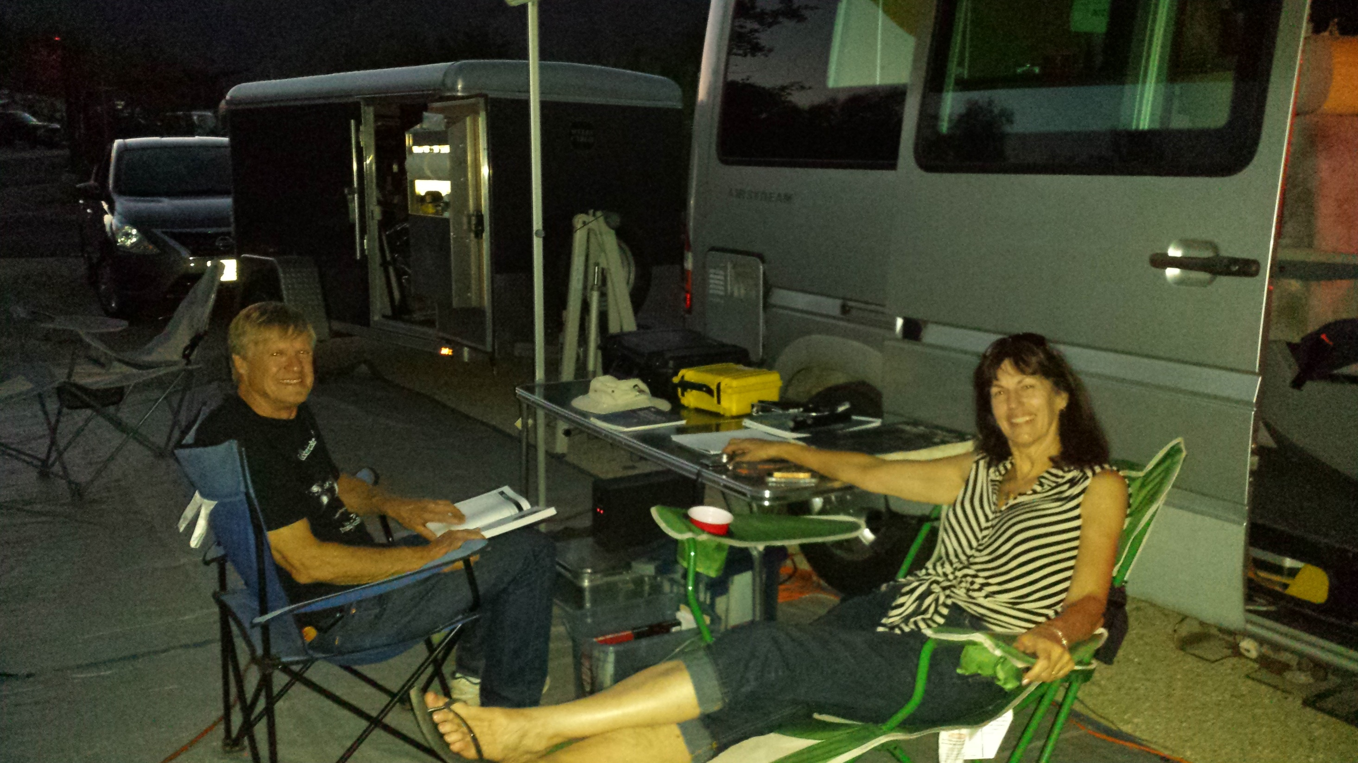

Slide 41
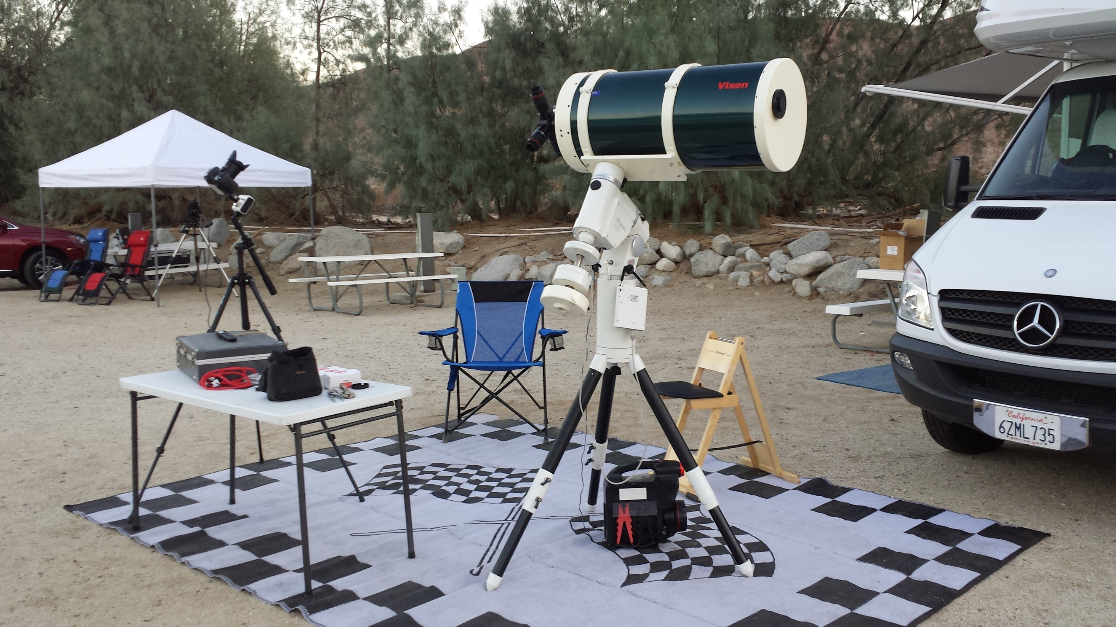

Slide 42
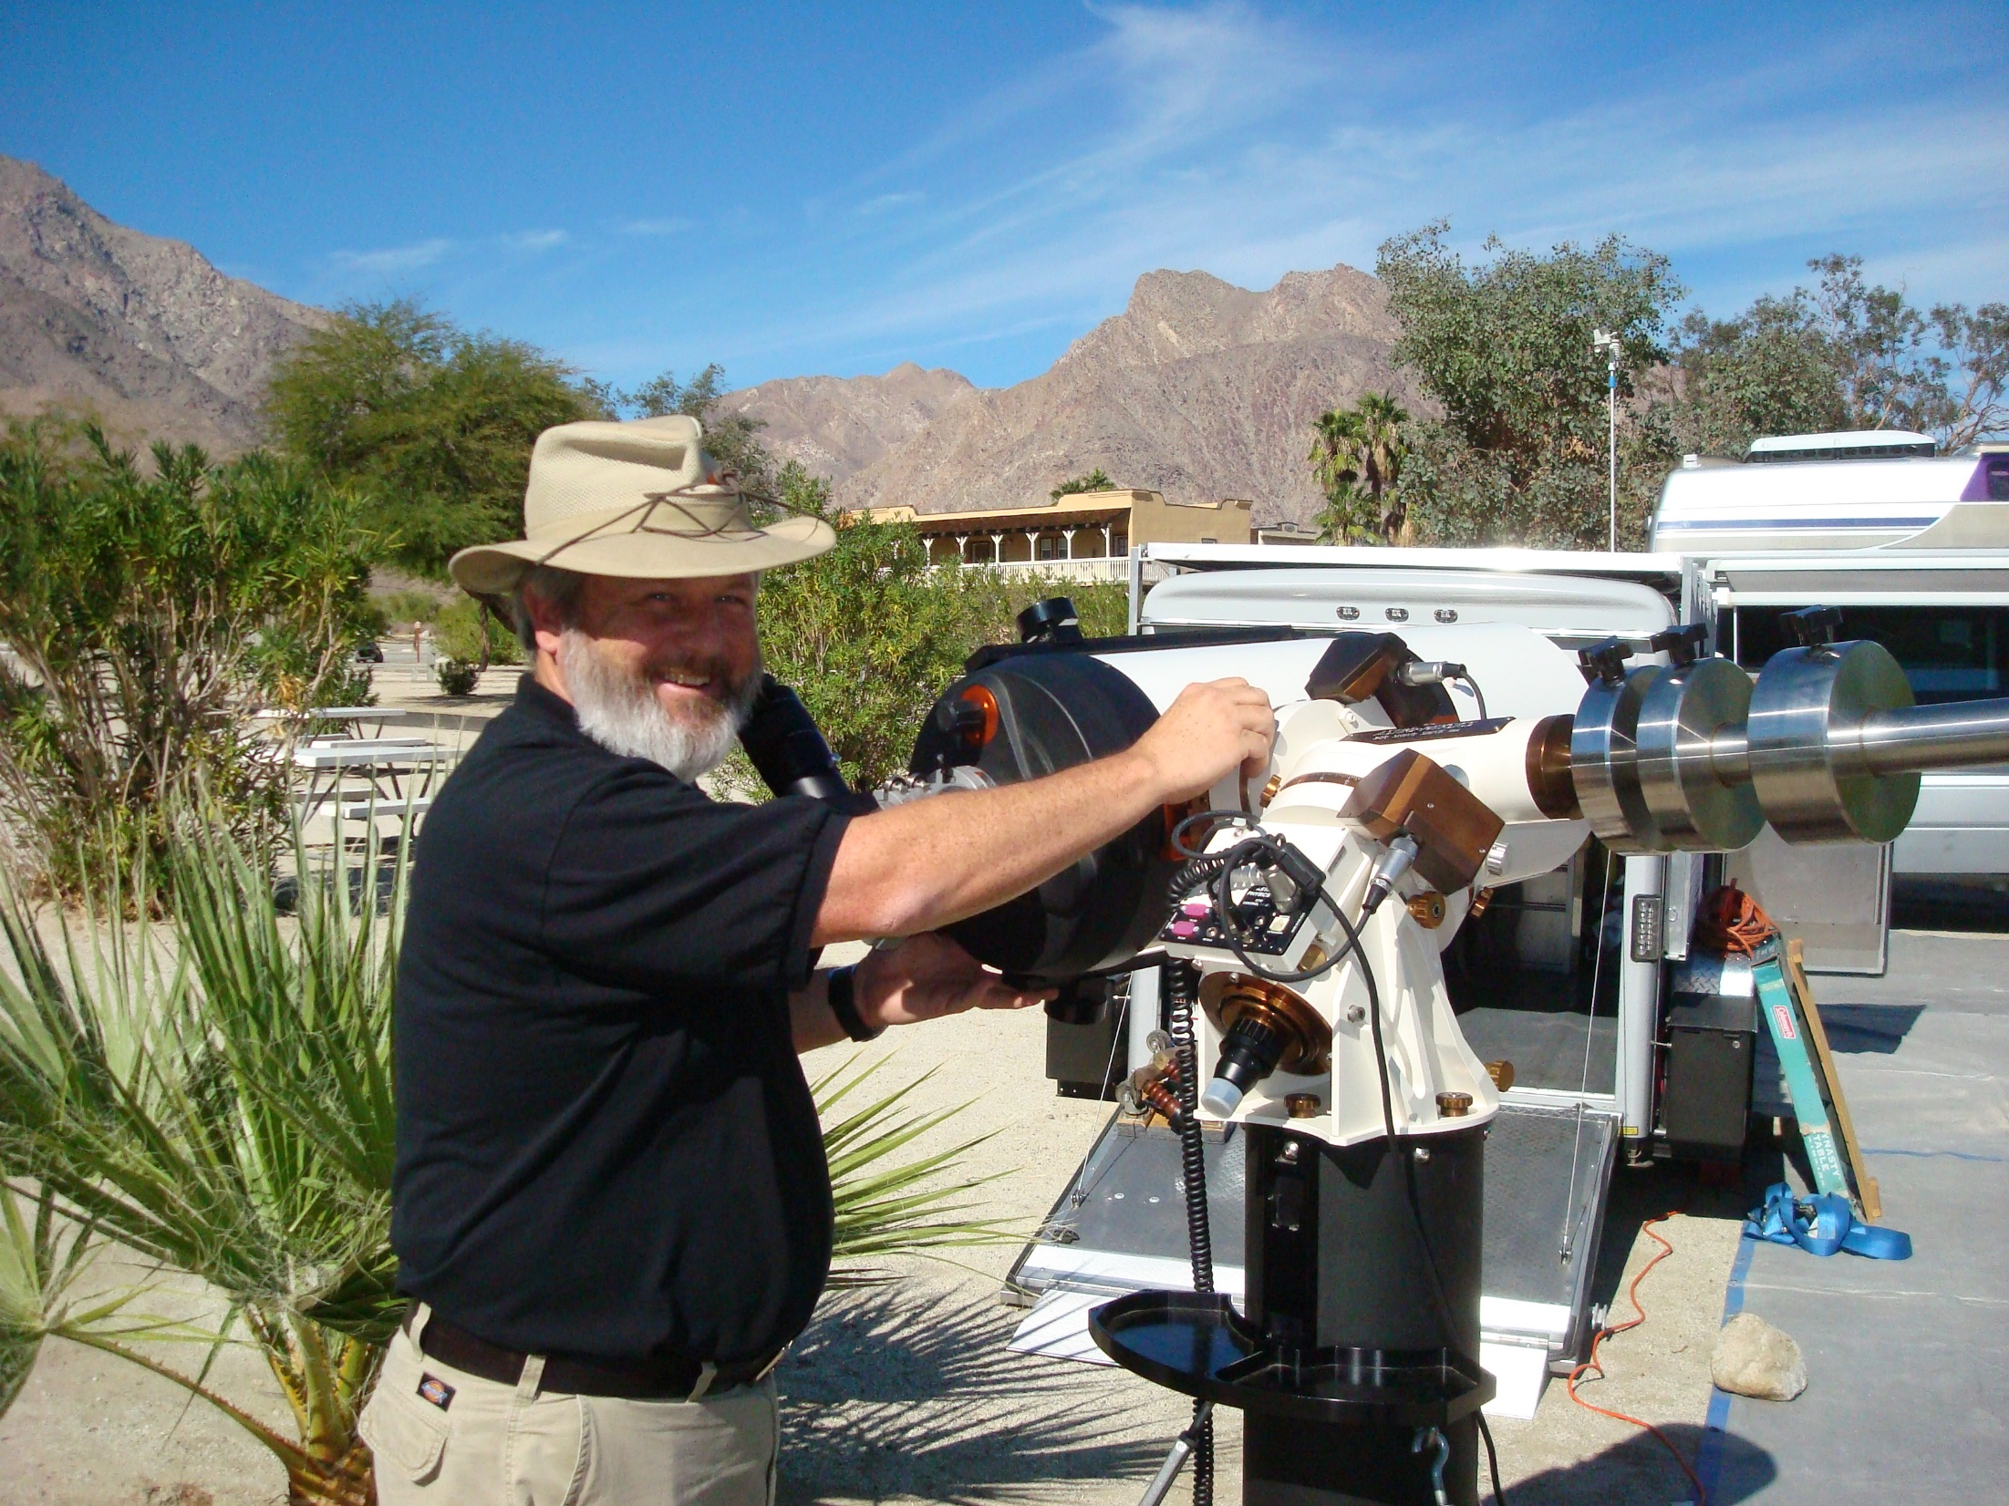

Slide 43
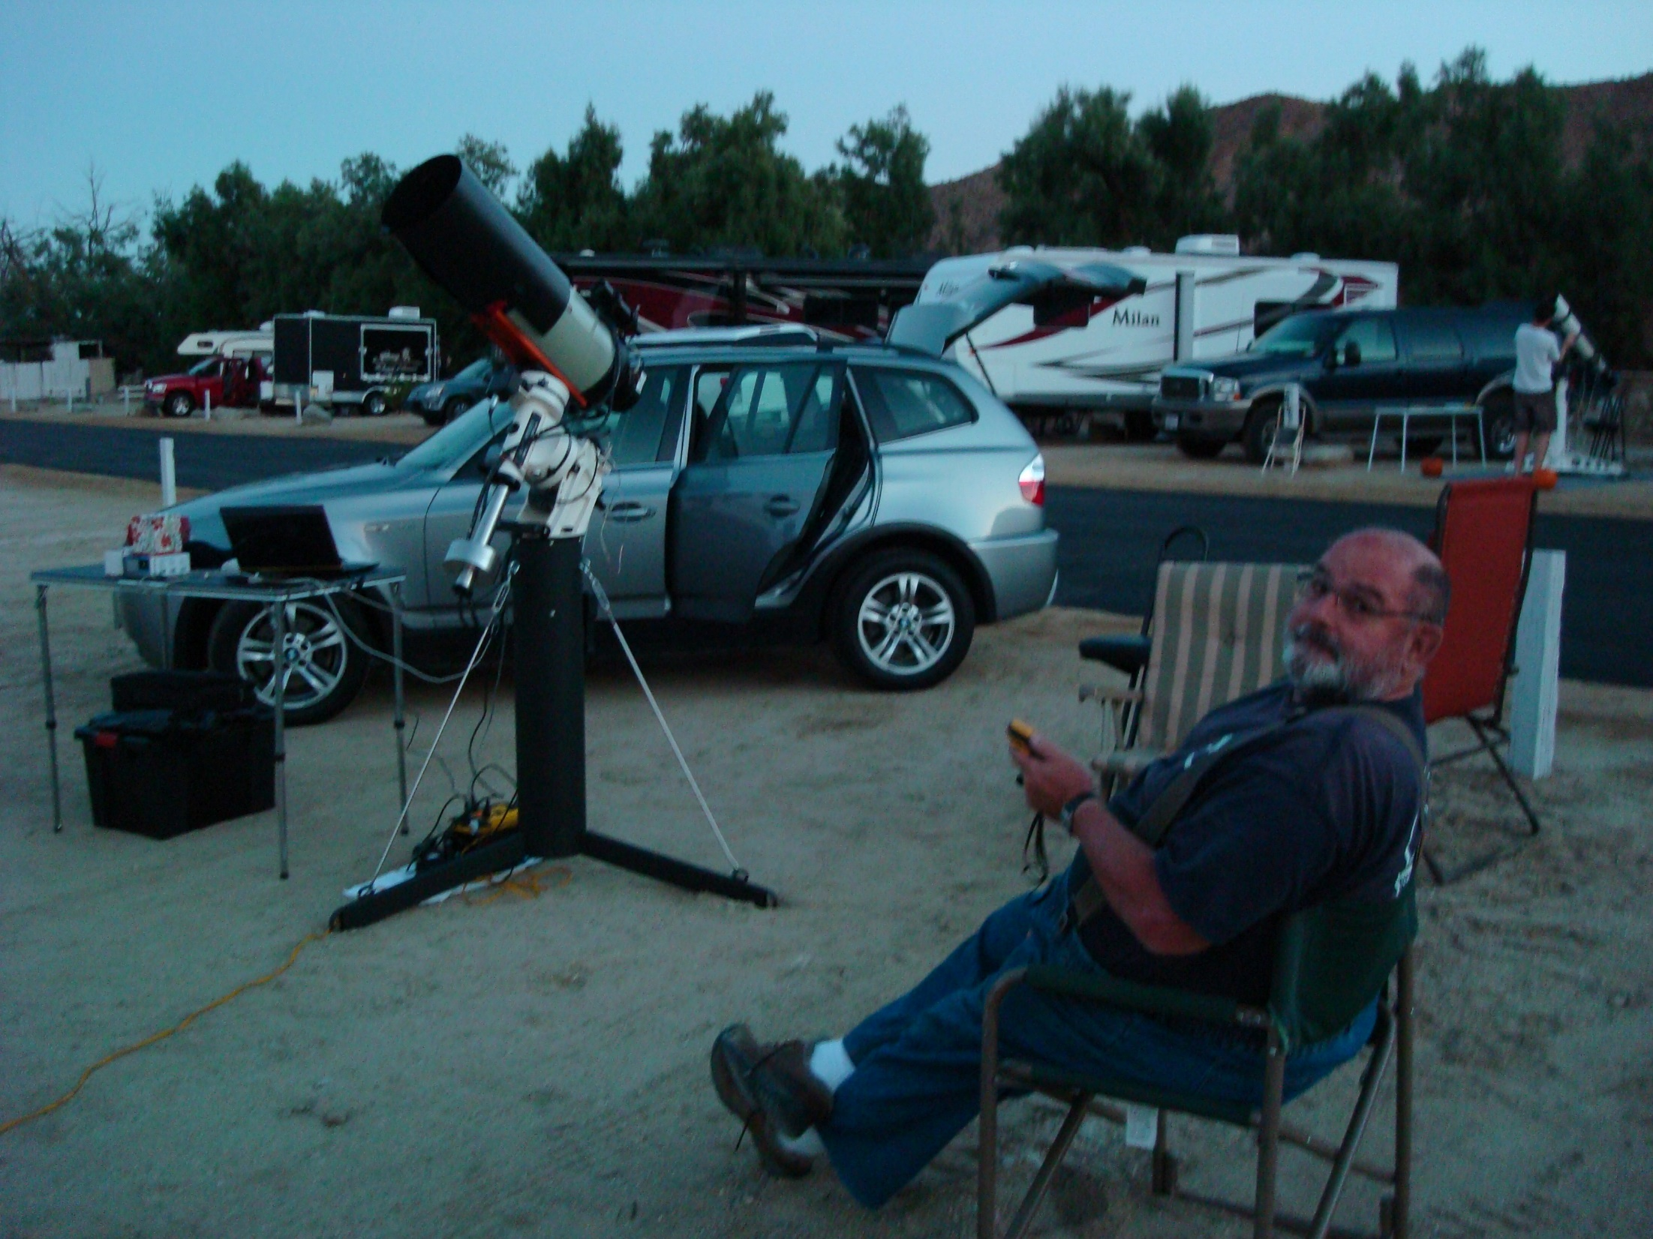
Yuma
Light Dome

Slide 44
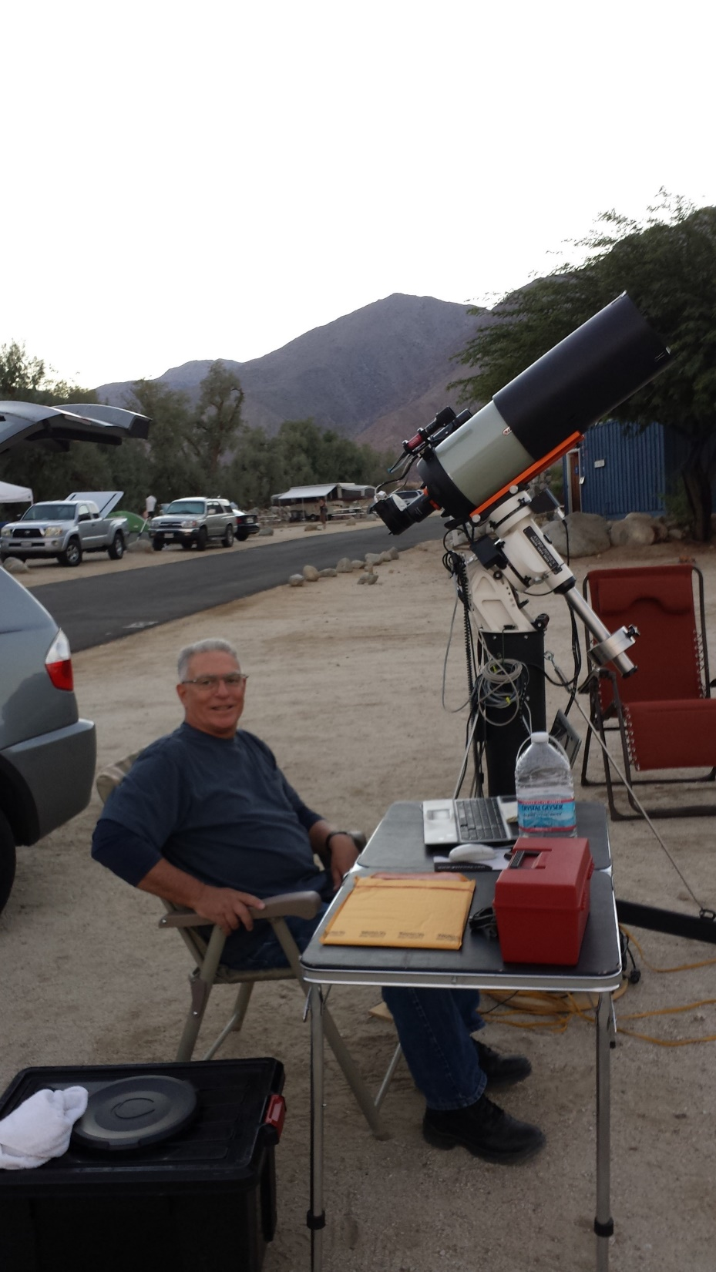
San Diego
Light Dome

Slide 45
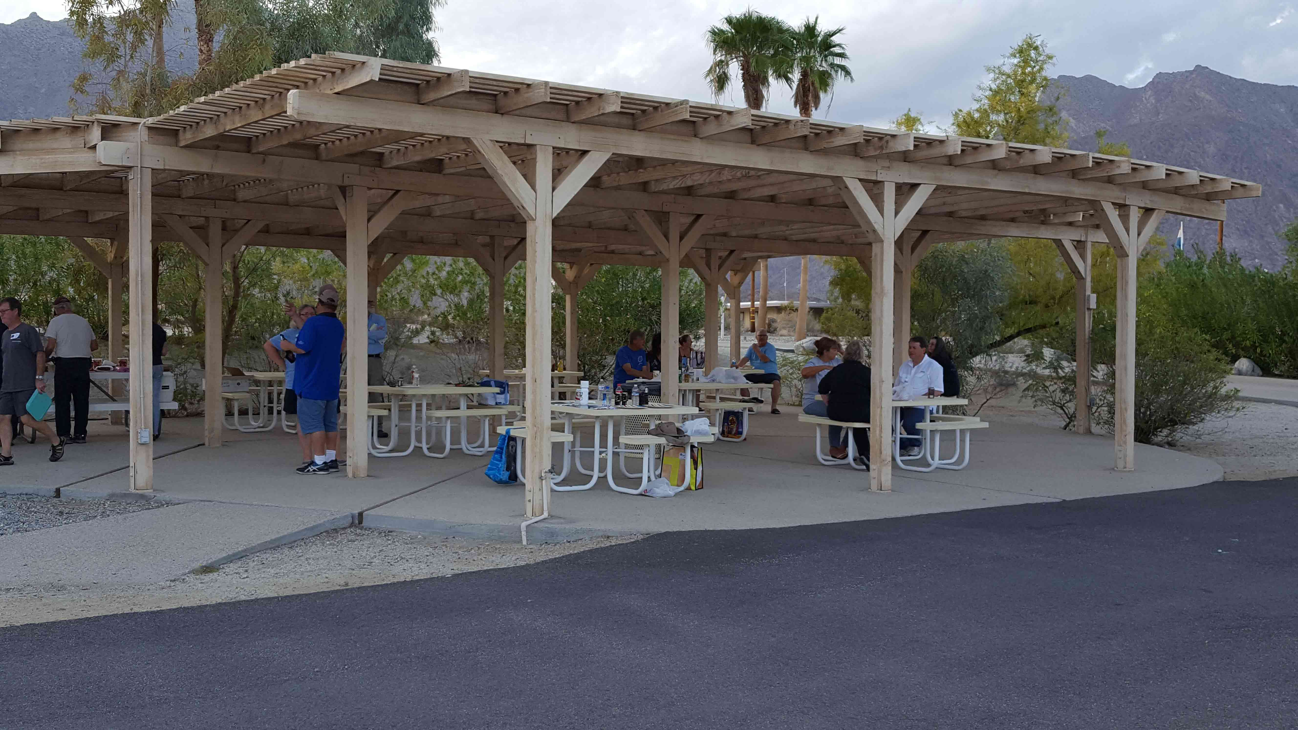

Slide 46
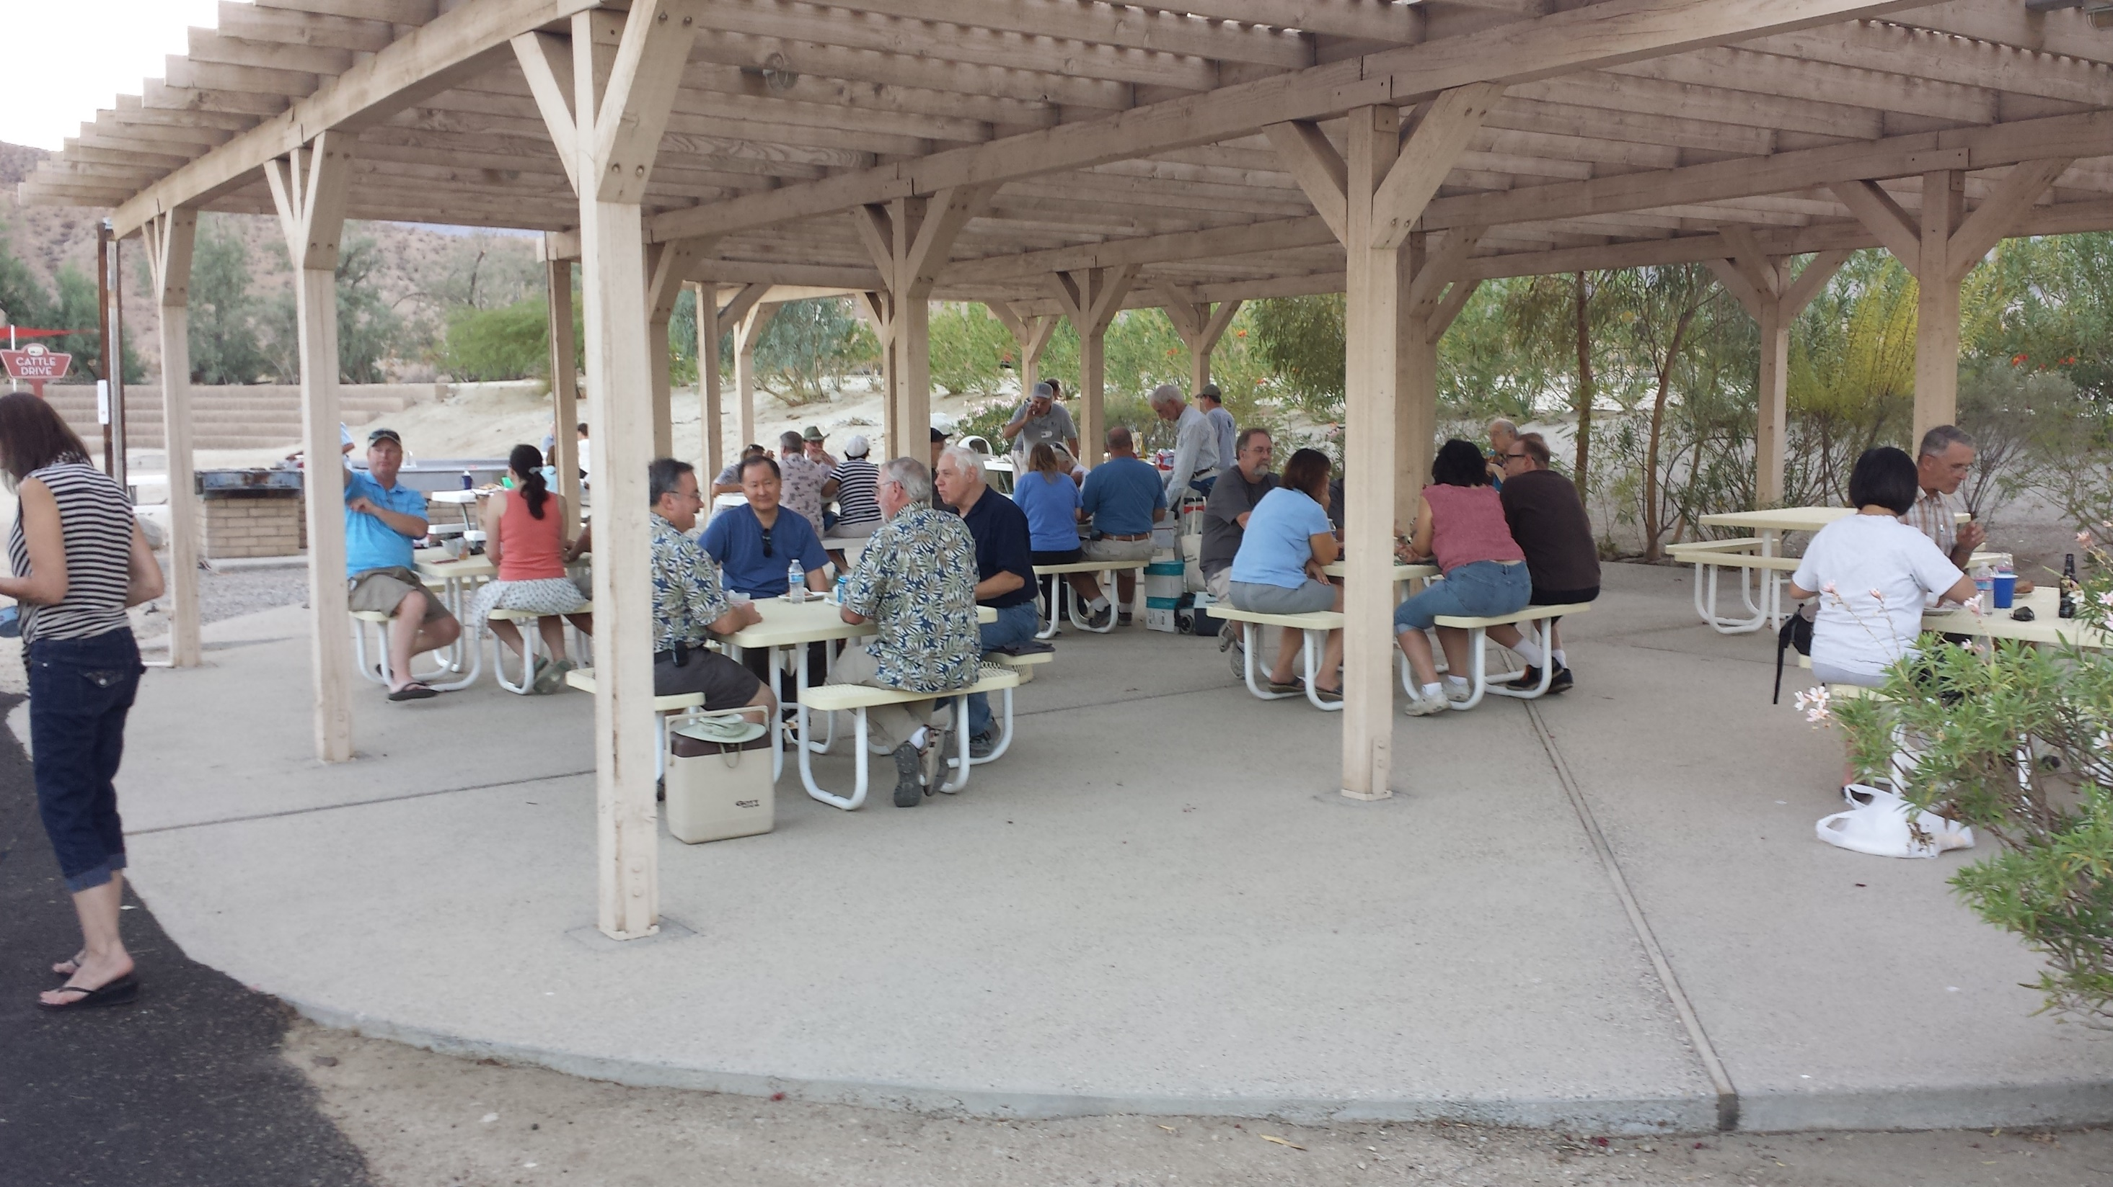

Slide 47
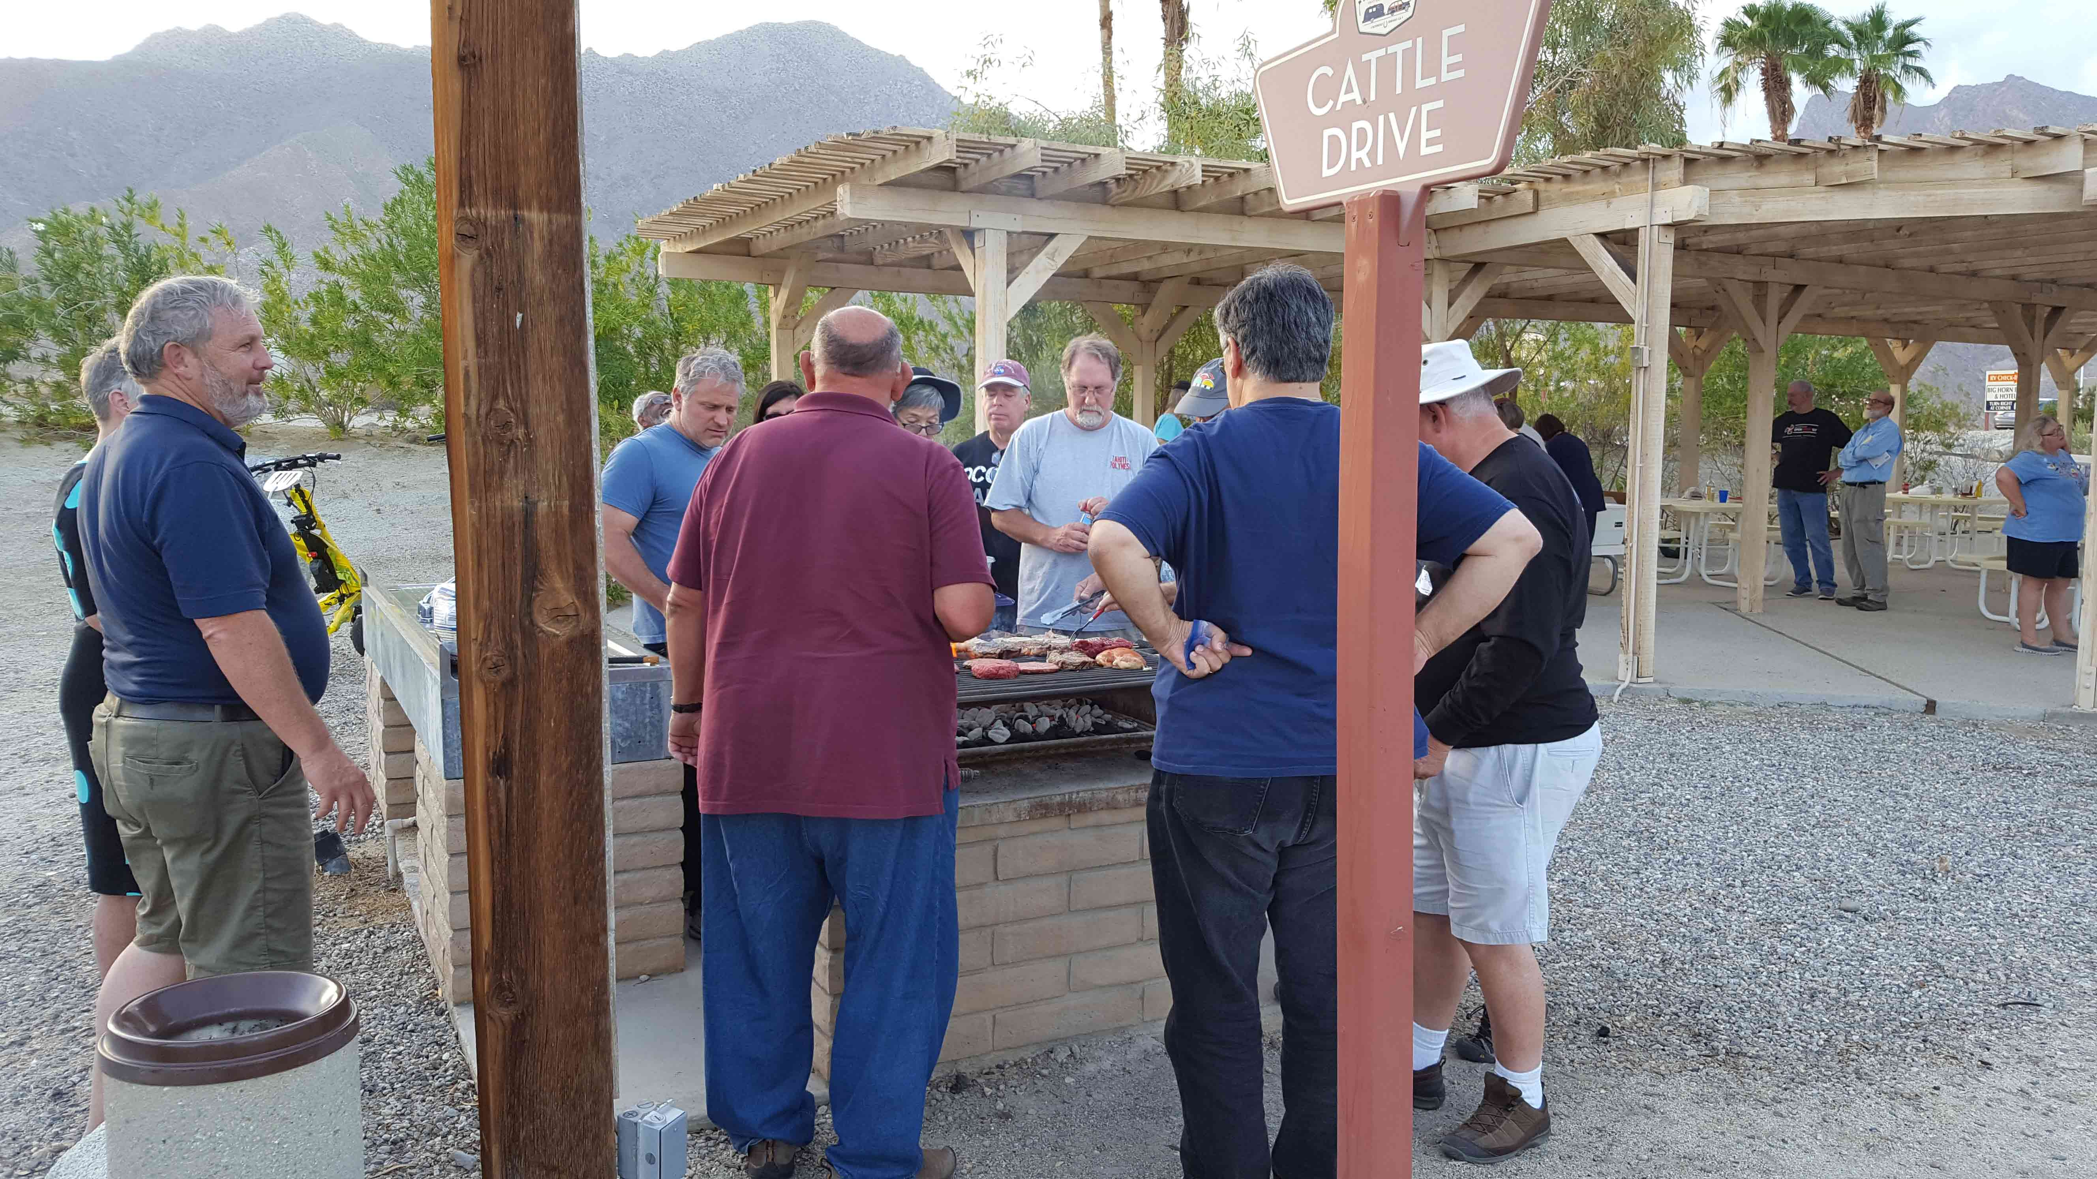

Slide 48
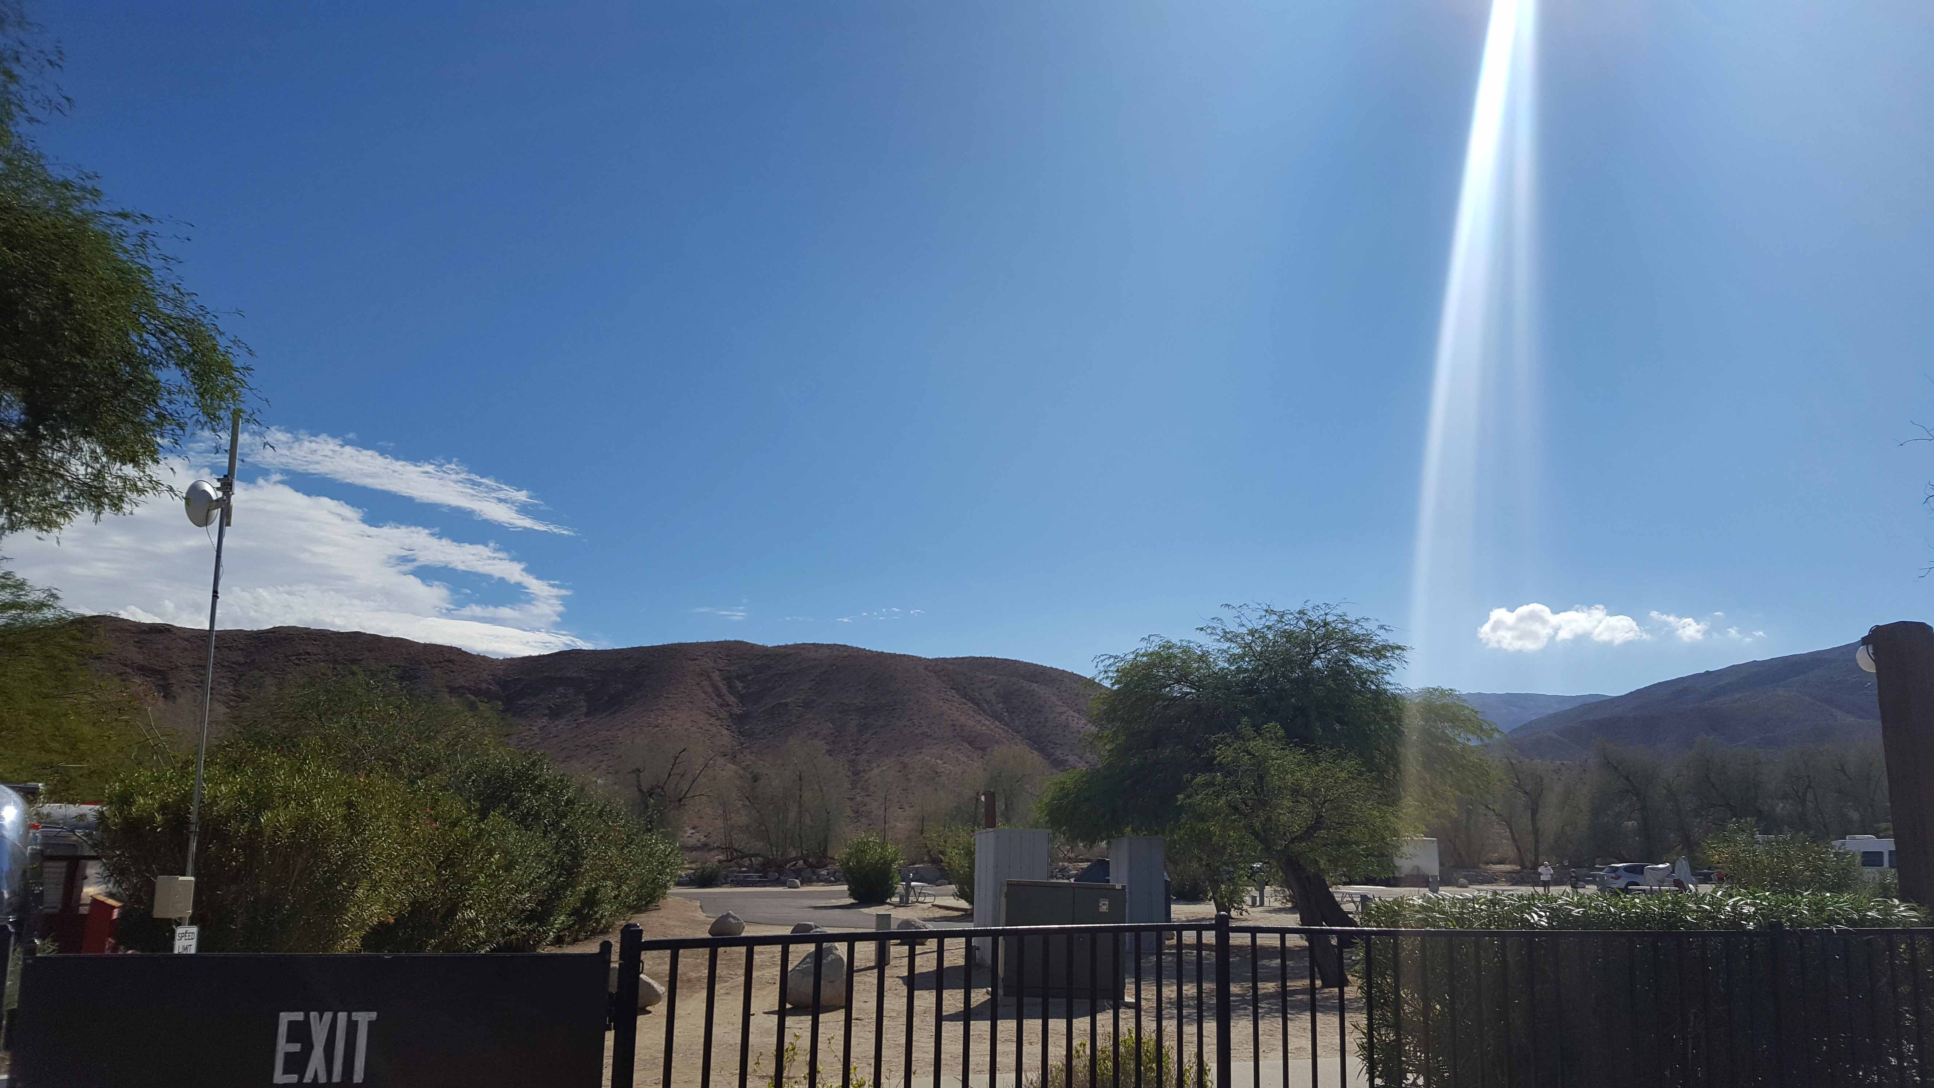

Slide 49
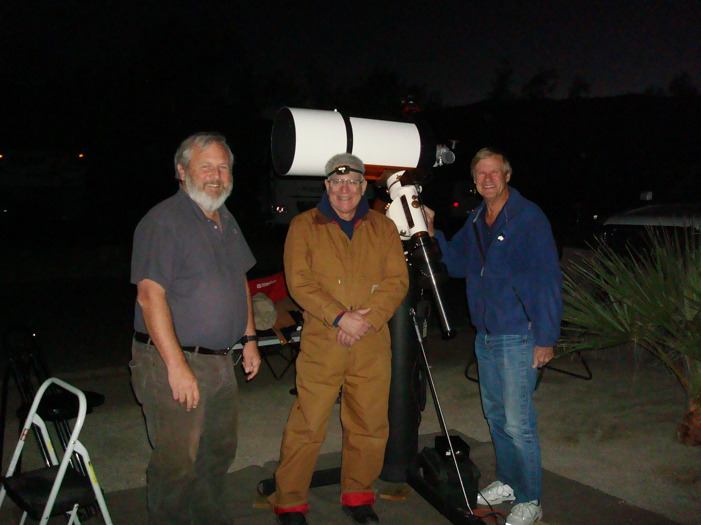

Slide 50
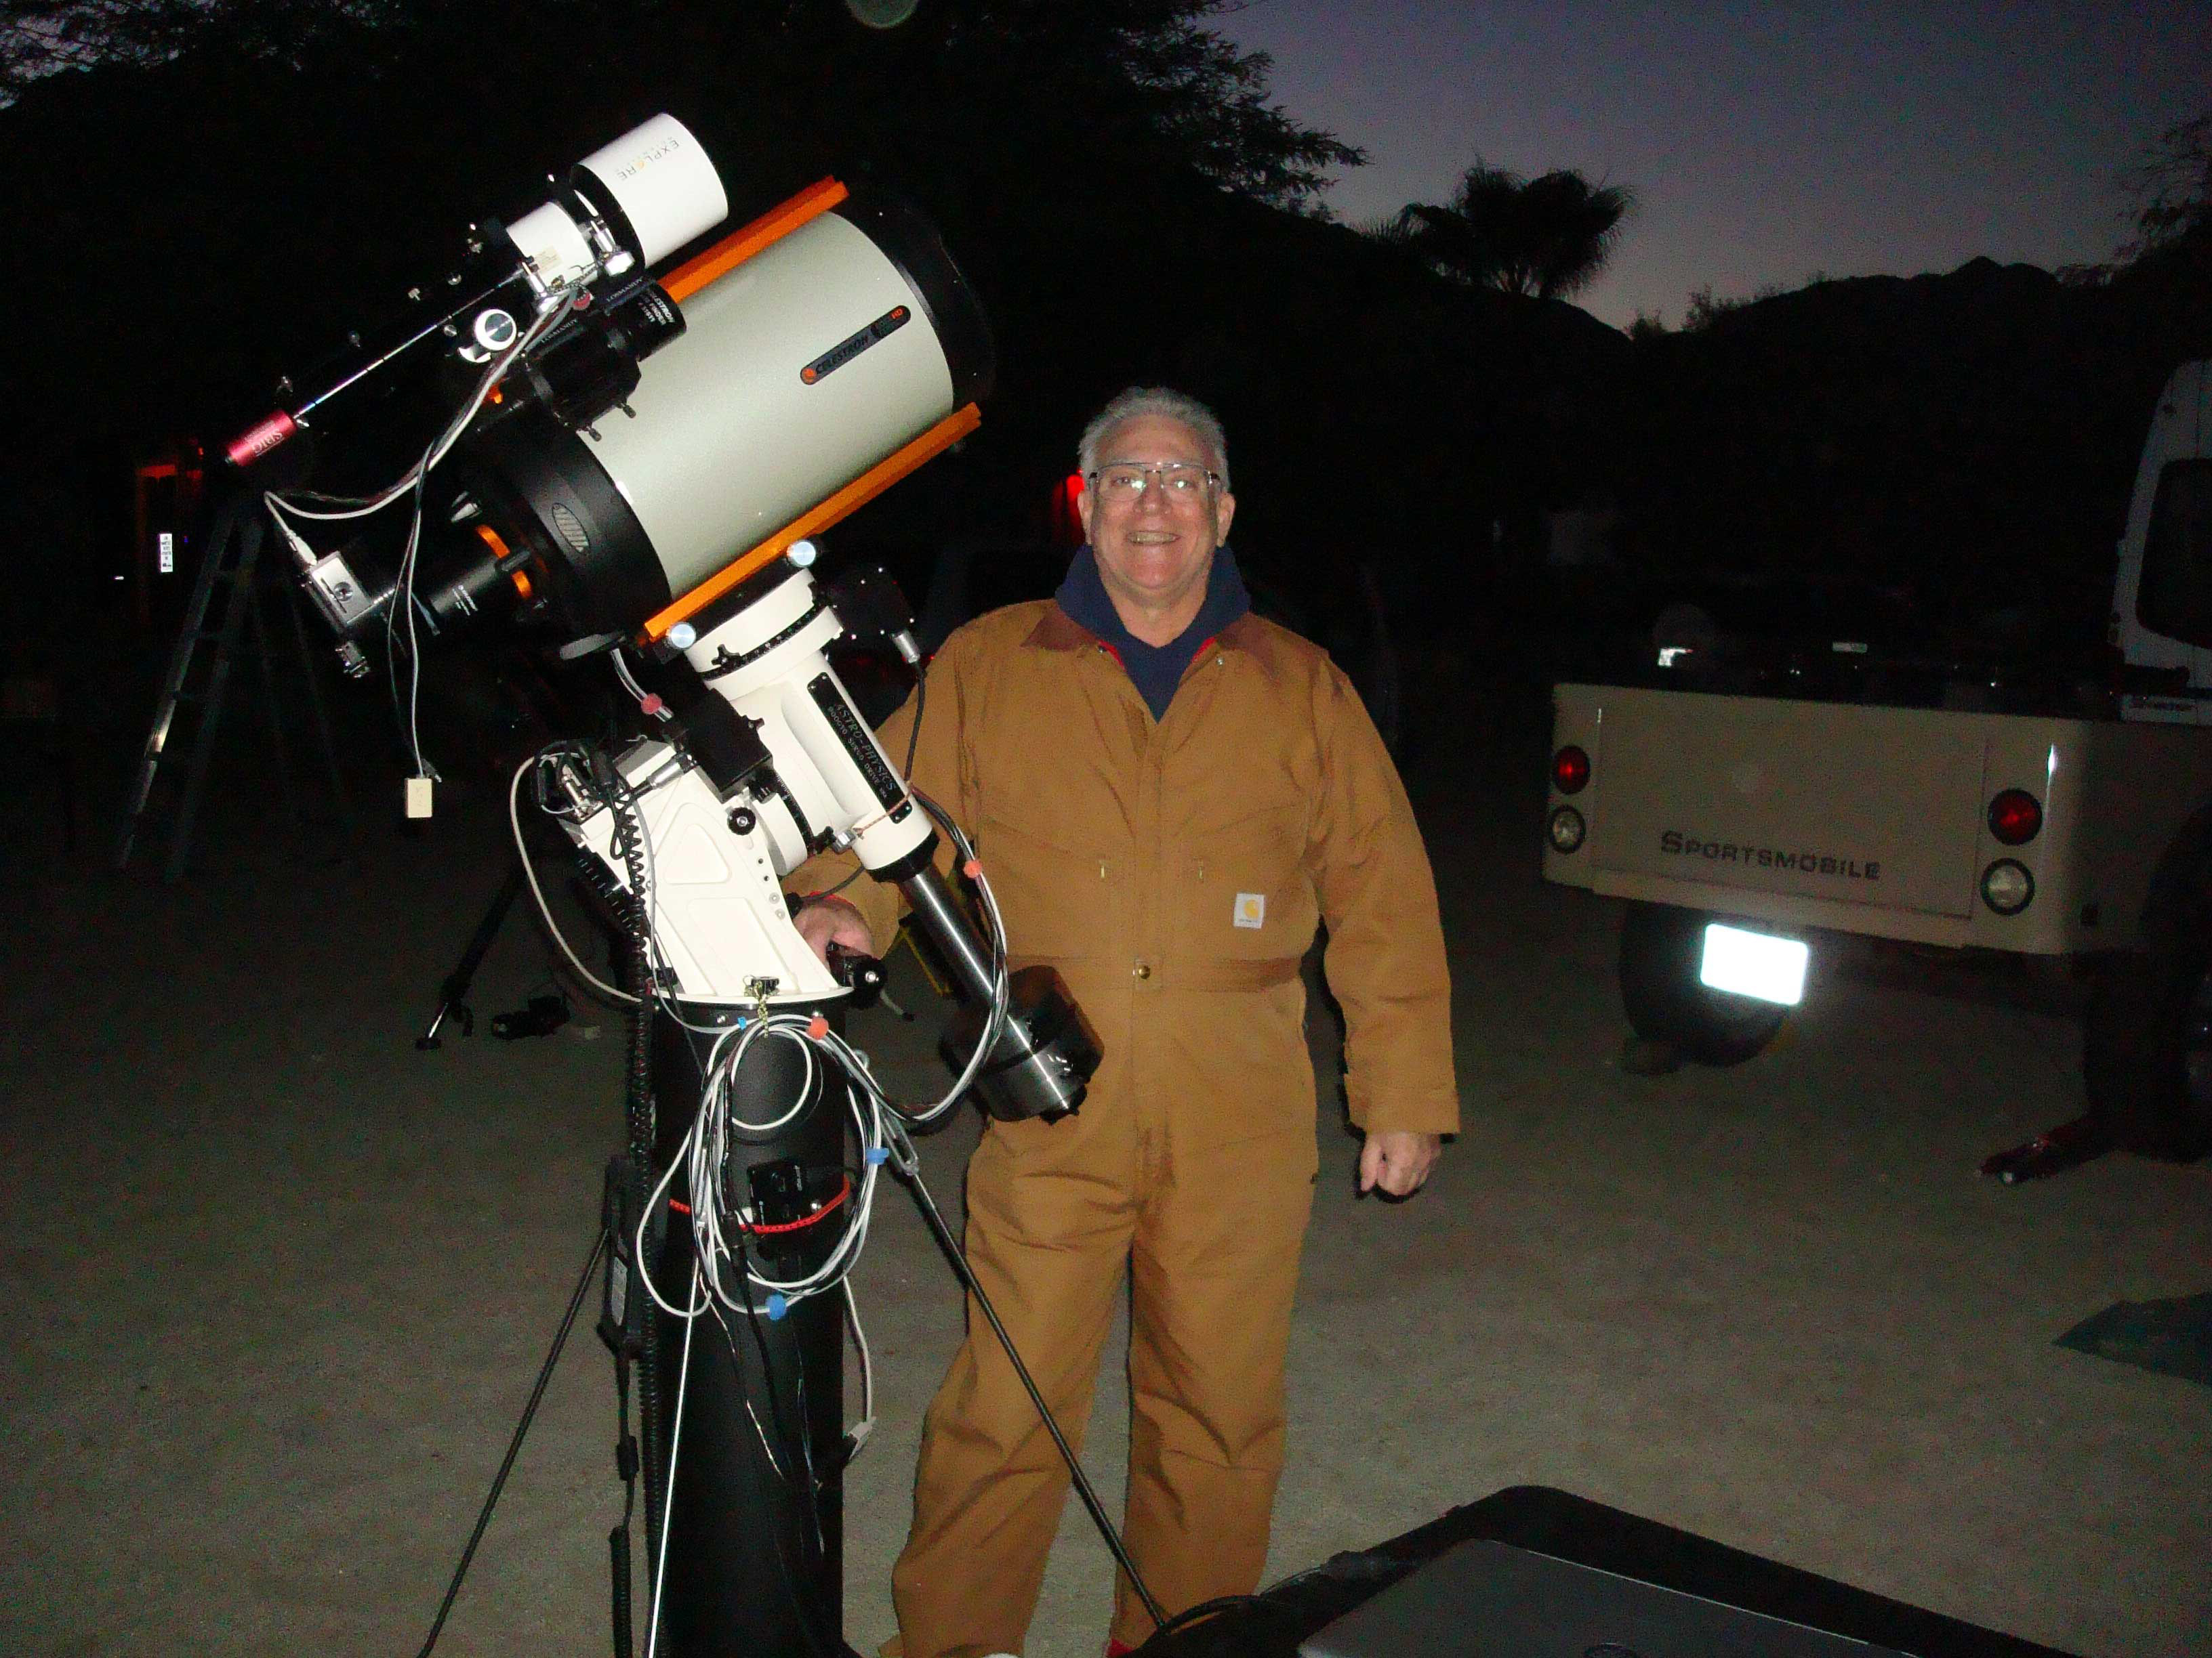

Slide 51
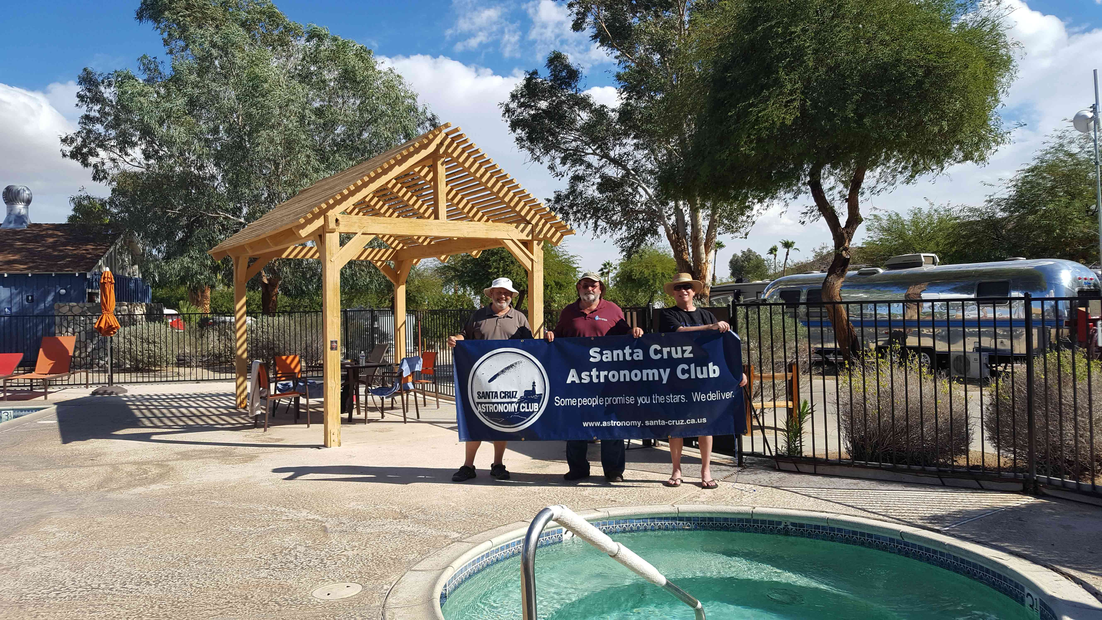

Slide 52
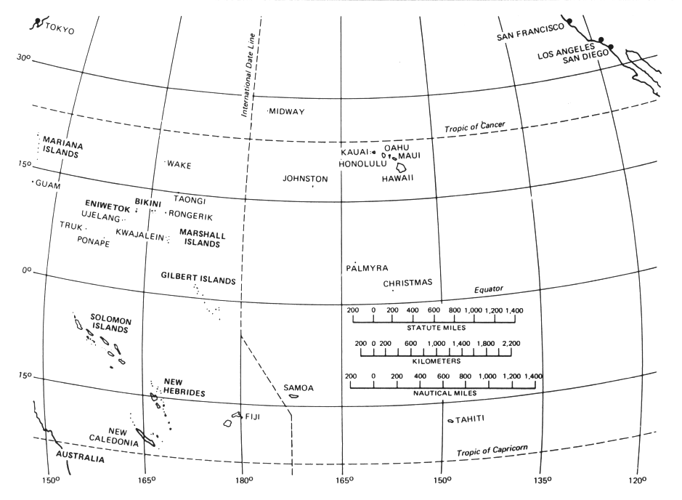
Trident II Missile Test Launch
November 7, 2015
Fired from the USS Kentuckey,
A nuclear powered submarine.
Los Angeles to Marshall Islands
(Eniwetok/Bikini) 4900 miles

Slide 53
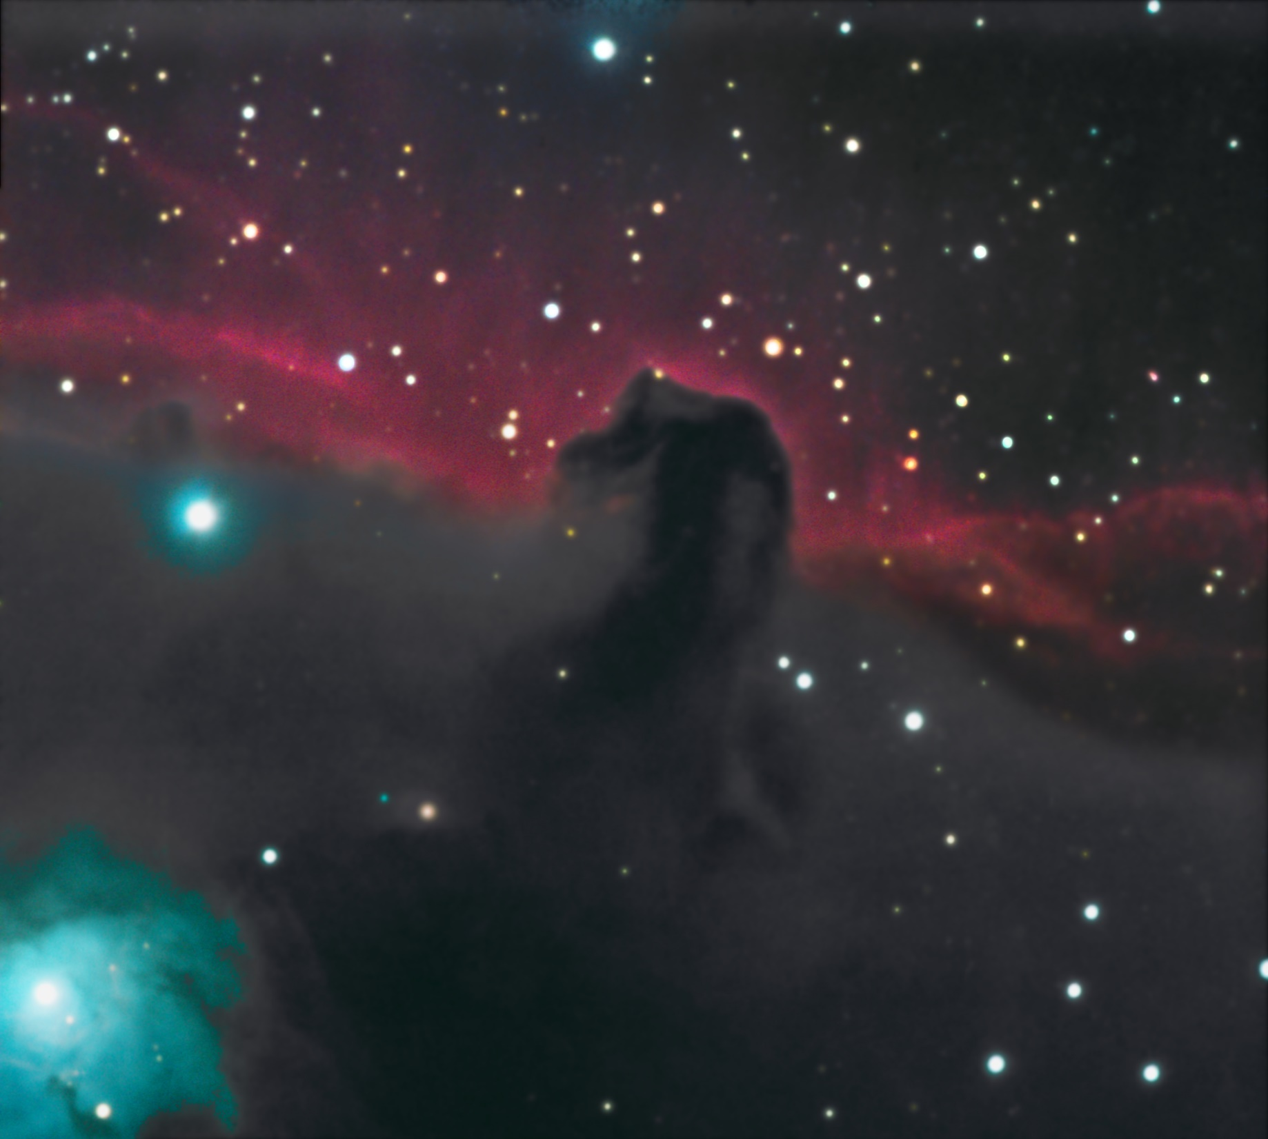
Horsehead Nebula
Orion
March 2015

Slide 55
Messier 34
Open Cluster
Perseus
October 2011

Slide 56
Messier 74
Pisces
November 2015

Slide 57
Messier 77
&
NGC 1055
Cetus
November 2015

Slide 58
Messier 81
&
Holmberg IX
Ursa Major
March 2015

Slide 59
NGC 253
Sculptor Galaxy
Sculptor
November 2013

Slide 60
NGC 457
Open Cluster
Cassiopeia
October 2016

Slide 61
NGC 6888
Crescent Nebula
Cygnus
October 2011

Slide 62
NGC 6888
Crescent Nebula
Cygnus
October 2013

Slide 63
NGC 7635
Bubble Neb.
Cassiopeia
October 2017

Slide 65
That’s All Folks

